Slide 1
Describing a celebration

Slide 2
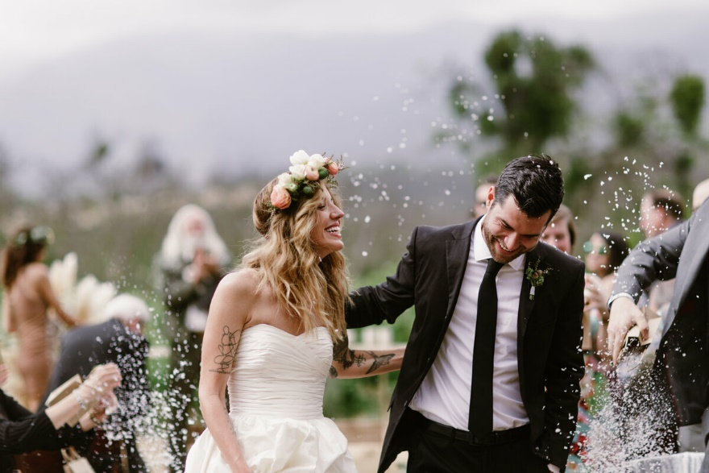
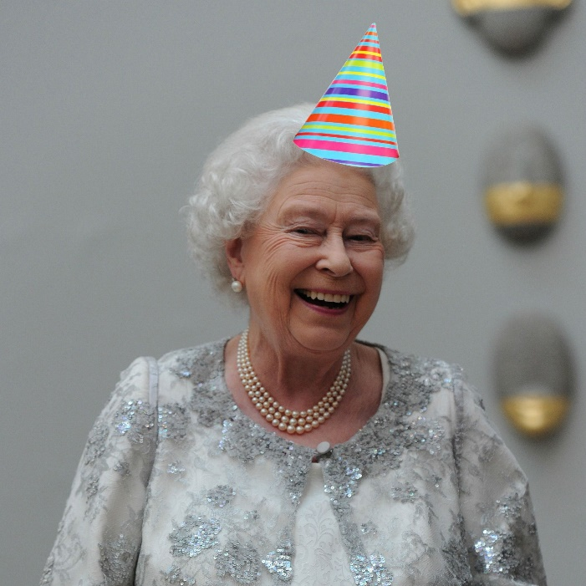
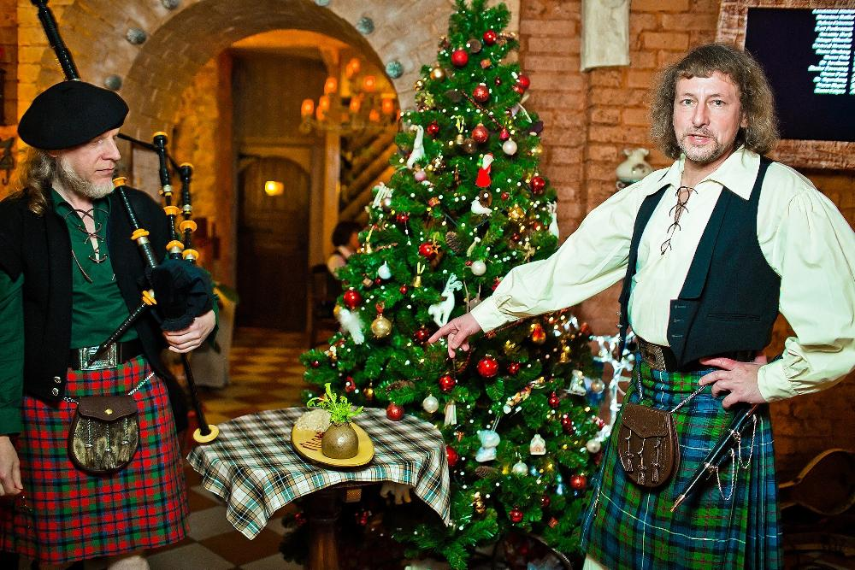
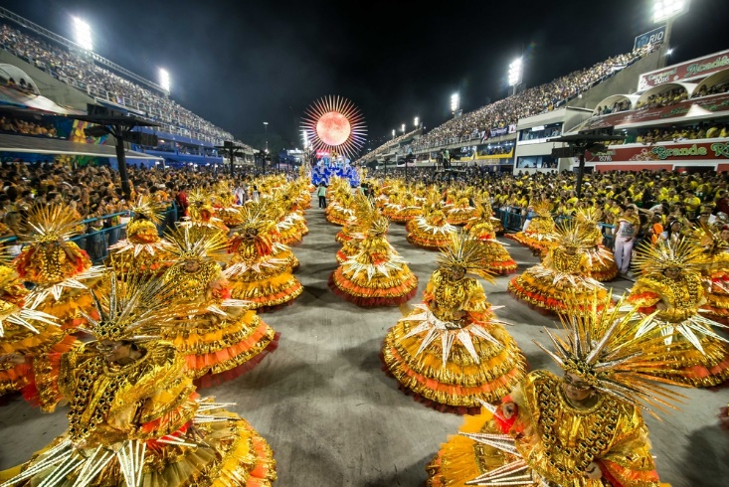
Listen to the music and look at the pictures

Slide 3
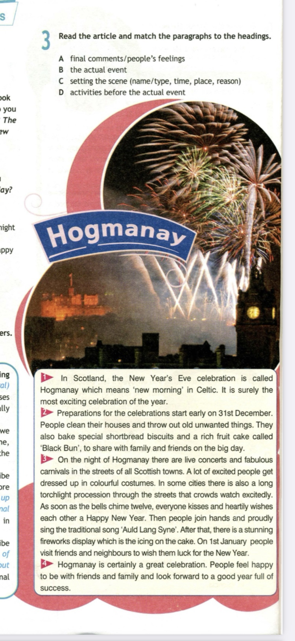
A descriptive article describing an event which takes place every year uses present tenses and normally includes
An introduction – mention the name\type, time, place of the celebration and the reason we celebrate it.
A main body – describe the activities that happen before the actual event and the actual event, in separate paragraphs.
A conclusion – describe people’s feelings and any other final comments on the event.

Slide 4
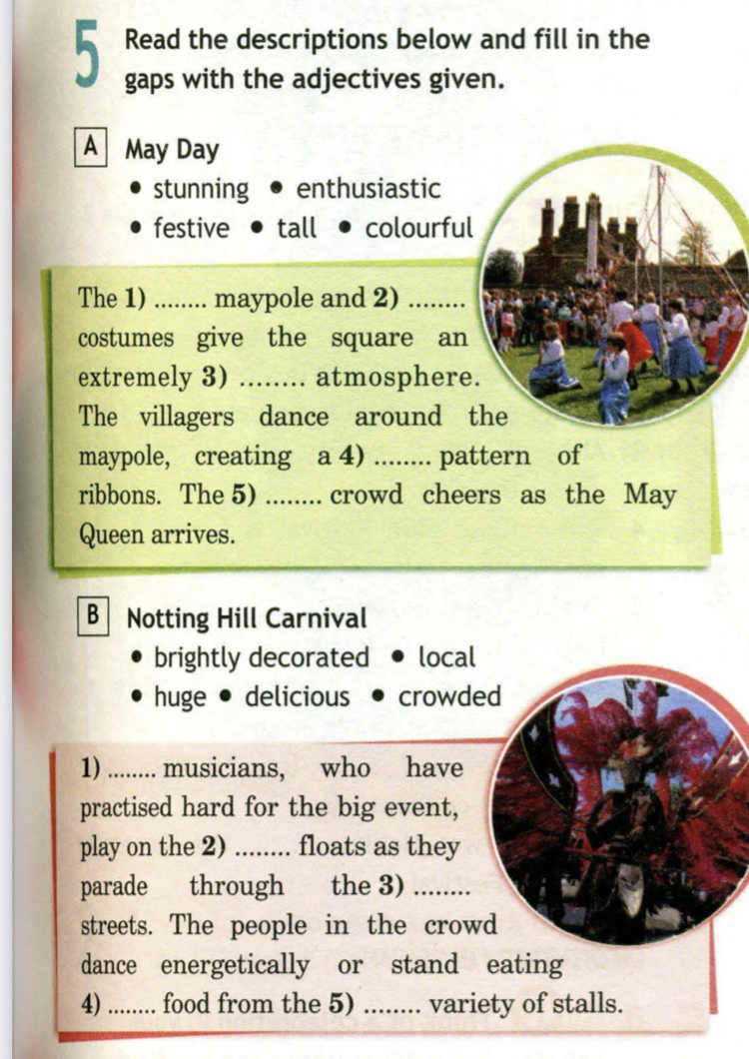
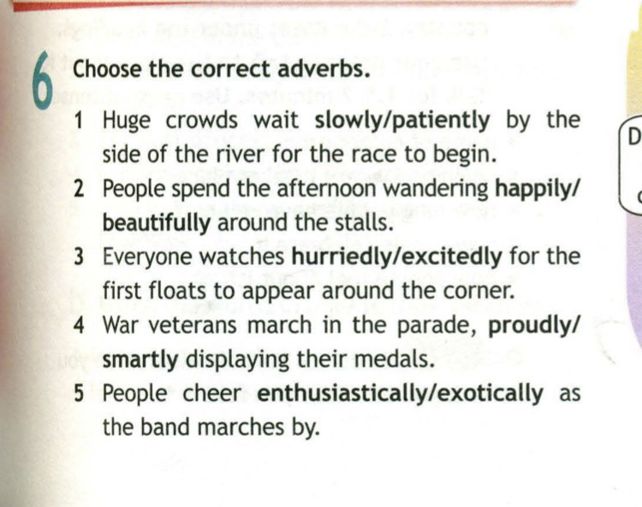

Slide 5
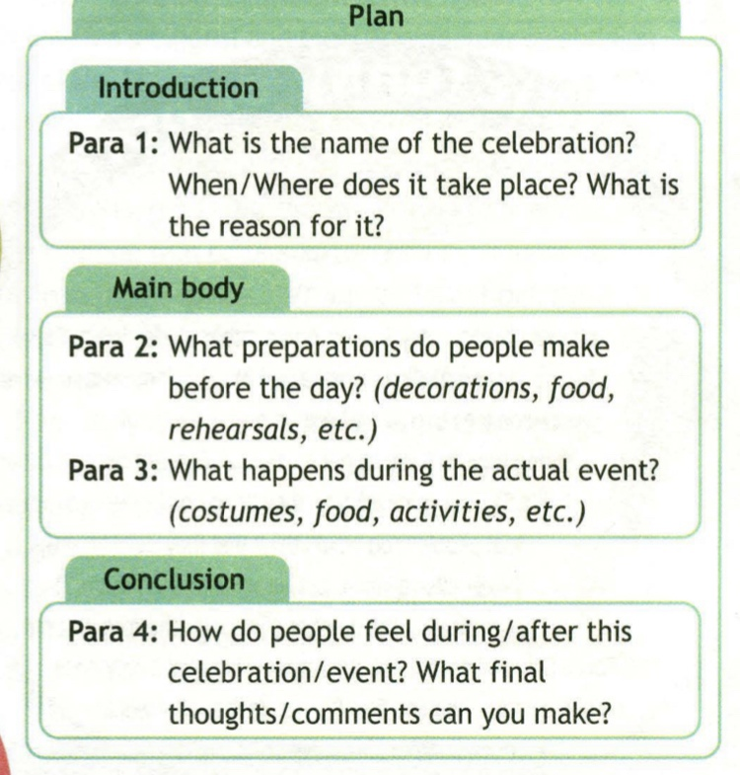
Look at the plan and write the essay describing a celebration.

