Slide 1
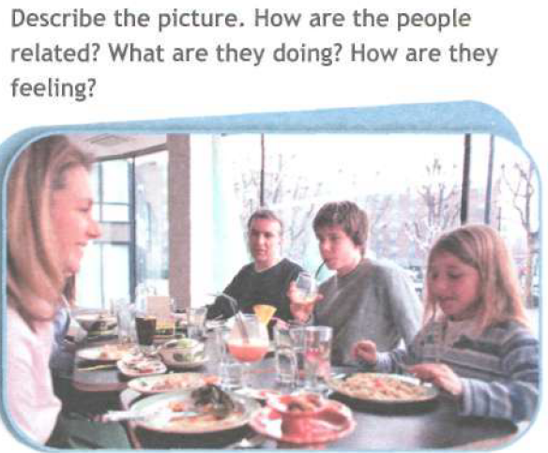
- The people in the picture are sitting at a table enjoying a meal. They may be in a restaurant. They seem to be a family. The mother and the daughter are talking and smiling, so they must be happy and the father and the son are listening, so they must be interested in what is being said.

Slide 2


Family Matters

Slide 3
“A successful society consists of happy people, a happy personality is grown up in a happy family”.

Slide 4
Blood Is Thicker Than Water

Slide 5
Marriages are made in heaven but occur on earth

Slide 6
I don't care how poor a man is; if he has family, he's rich.
Dan Wilcox and Thad Mumford
When you look at your life, the greatest happinesses are family happinesses.
Joyce Brothers
Families are the compass that guide us. They are the inspiration to reach great heights, and our comfort when we occasionally falter.
Brad Henry

Slide 7
How well do you know your kinsfolk?
Your father's sister is your ___
Your mother's mother is your ___
Your sister's daughter is your ___
Your son's son is your ___
Your sister's brother is your ___
Your mother's brother is your ___
Your uncle's son is your ___
Your brother's son is your ___
Your mother's father is your ___

Slide 8
How well do you know your kinsfolk?
Your father's sister is your ___ (aunt)
Your mother's mother is your ___ (grandmother)
Your sister's daughter is your ___ ( niece)
Your son's son is your ___ (grandchild)
Your sister's brother is your ___ (brother)
Your mother's brother is your ___ (uncle)
Your uncle's son is your ___ (cousin)
Your brother's son is your ___ (nephew)
Your mother's father is your ___ (grandfather)

Slide 9
Which member of your family…
never gets off the phone?
is always taking things without asking?
never helps around the house?
never switches the lights off?
is always leaving things everywhere?
never tidies up?
plays loud music?
doesn’t let you stay out late?
is always there for you?
helps you with your homework?

Slide 10
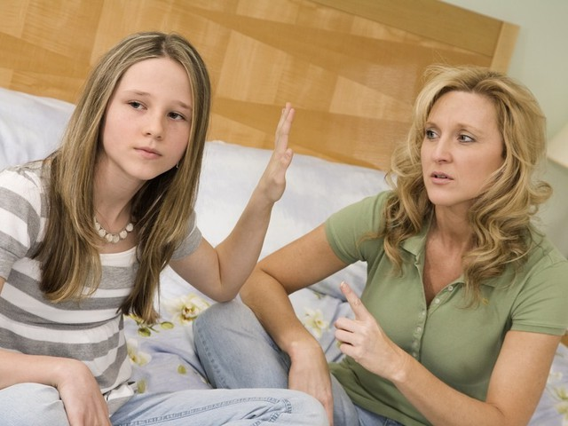
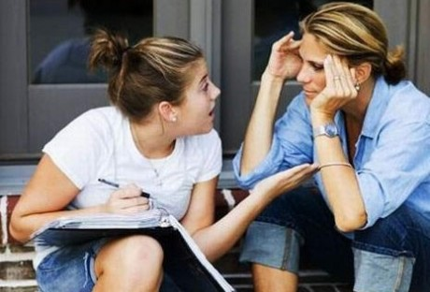
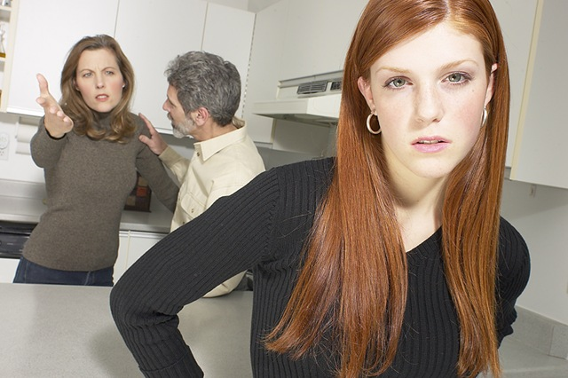
?????

Slide 11

Parents interfere in the relationships with my friends

Slide 12
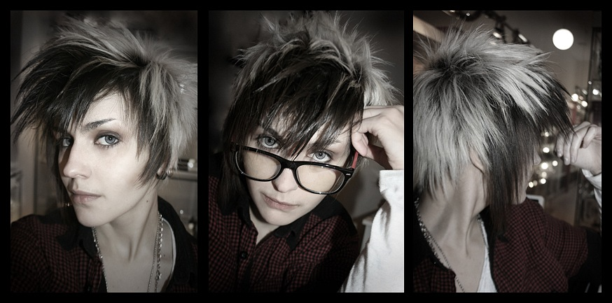
Parents don’t like my hair cut

Slide 13
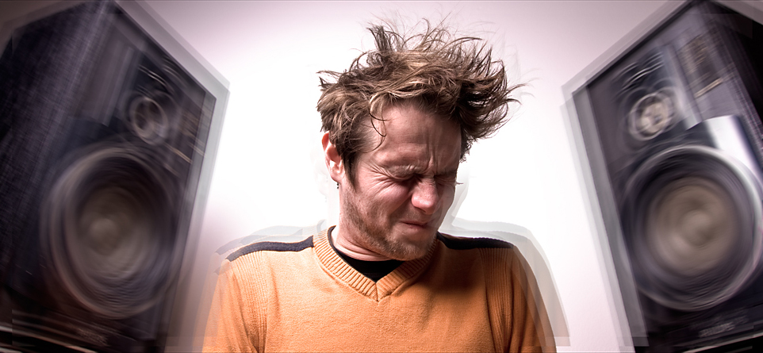

Parents don’t like the music I listen to

Slide 14

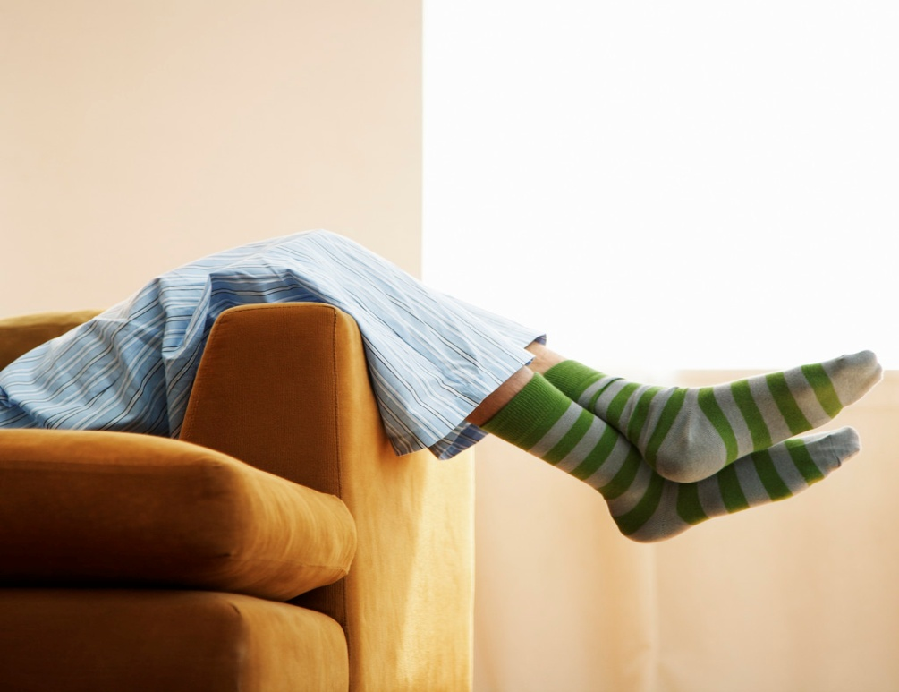
Parents think I’m lazy

Slide 15


Parents think I waste much time with my gadgets

Slide 16
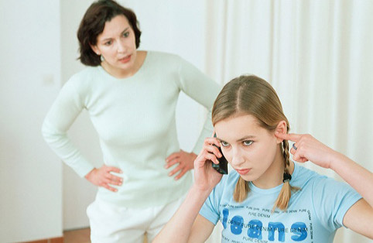
Parents try to solve my personal problems without me

Slide 17
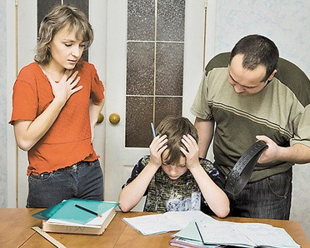
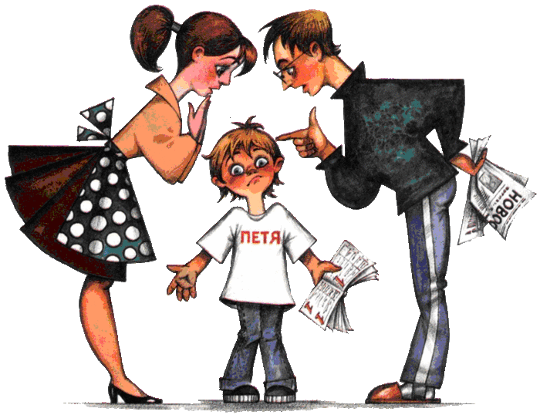
Parents think I can have better marks at school

Slide 18
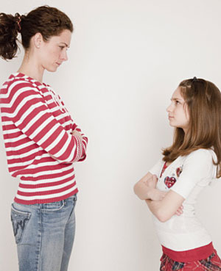
Parents break their promises

Slide 19
Parents think I’m lazy
Parents think I waste much time with my gadgets
Parents think I can have better marks at school
Parents interfere in the relationships with my friends
Parents don’t like the music I listen to
Parents try to solve my personal problems without me
Parents don’t like my hair cut
Parents break their promises

Slide 20
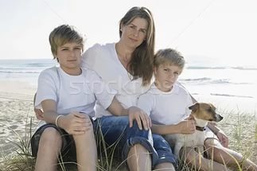
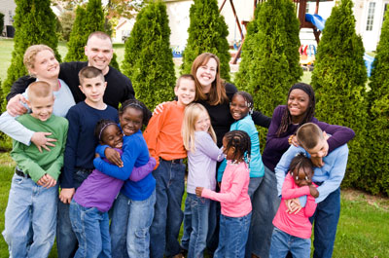
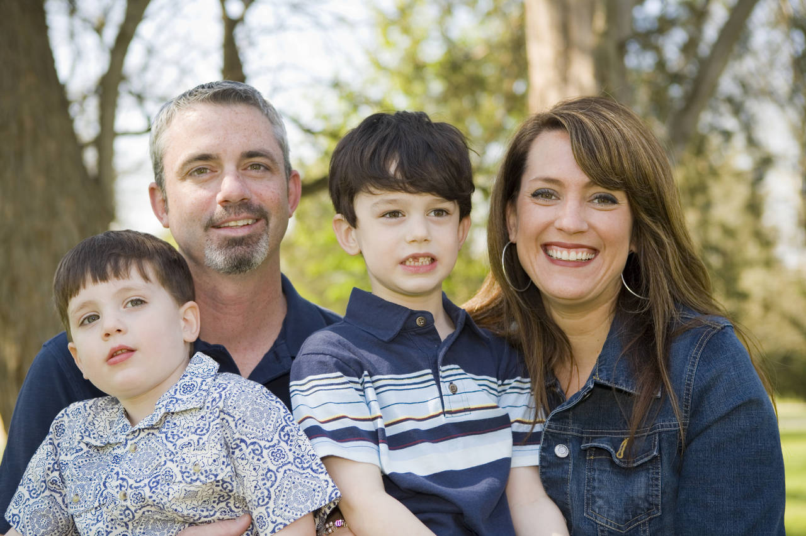

Single – parent family
Adoptive (foster) family
Nuclear family
Extended family

Slide 21
Criticising | Apologising
That’s / It’s not very good / nice. | Sorry! / I’m so sorry. I won’t do it again.
You shouldn’t do / have done that. | I’m (very) sorry. I didn’t realise…
You drive me crazy / get on my nerves when you… | Please forgive me. I didn’t mean to…
I can’t stand it when you… | I apologise. / I do apologise.

Slide 22
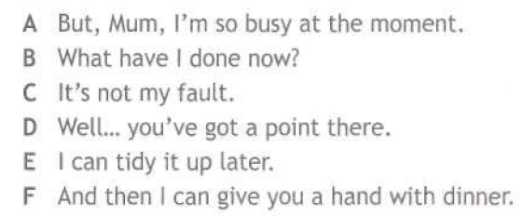
1. Now we are going to read a dialog between a mum and her daughter. Look at ex.4 (a). Read and translate the sentences A-F.

Slide 23
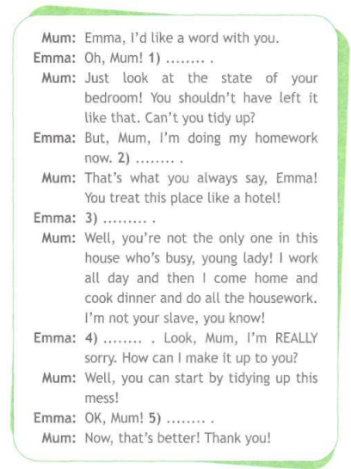

2. Listening. B2.
Now we will listen to the speaker. You must fill in the gaps with appropriate phrases.
Ex.4b, p. 28

Slide 24
Ex.4a, p. 28. Let’s check.
A | B | C | D | E
4 | 1 | 5 | 2 | 6

Slide 25
WORD FORMATION.
My great-grandmother,Frances Thompson,was a very 1)………… woman. She was a 2)………. But she also loved to paint and draw things. For years she tried to become a 3)……… artist,but she never became 4)………. However, she enjoyed teaching a lot, so she wasn`t 5)……. She taught in a primary school for forty years and when she retired she enjoyed a club in order to meet more people and managed to make friends 6)…………. I still have some of the paintings which she gave to me years ago.
1)TALENT
2)TEACH
3)SUCCESS
4)FAME
5)HAPPY
6)EASY

Slide 26
My great-grandmother,Frances Thompson,was a very 1)TALENTED woman. She was a 2)TEACHER. But she also loved to paint and draw things. For years she tried to become a 3)SUCCESSFUL artist,but she never became 4)FAMOUS. However, she enjoyed teaching a lot, so she wasn`t 5)UNHAPPY. She taught in a primary school for forty years and when she retired she enjoyed a club in order to meet more people and managed to make friends 6)EASILY. I still have some of the paintings which she gave to me years ago.

Slide 27
CINQUAIN.
Line 1: title -1 noun
Line 2: description – 2 adjectives, that describe line 1.
Line 3: 3 verbs, that relate to line 1.
Line 4: 4 or more words (a complete sentence), that relate to line 1.
Line 5: one word (synonym of line 1that sums it up)

Slide 28
HOMEWORK:
Give a 1,5 – 2 minute talk about your family
Remember to say:
who your family consists of
what relations have you got in your family
how you spend weekends
what duties you have got in your family

