Slide 1
Seat of Power

Slide 2
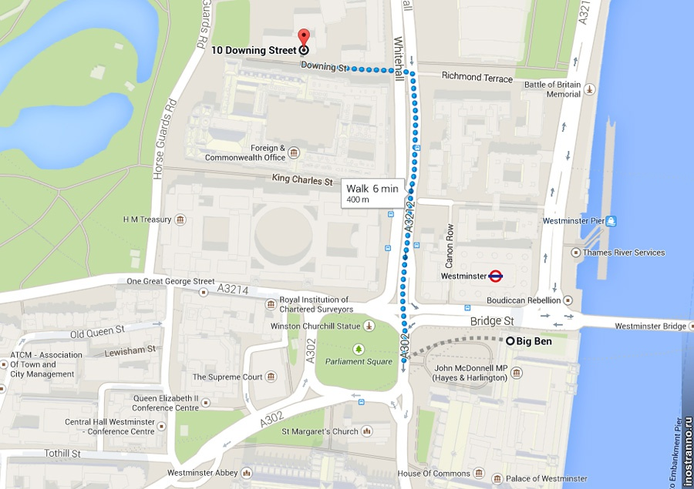

Slide 3
Welcome to 10 Downing Street, the home and office of the British prime minister, located in Whitehall in central London.

Slide 4
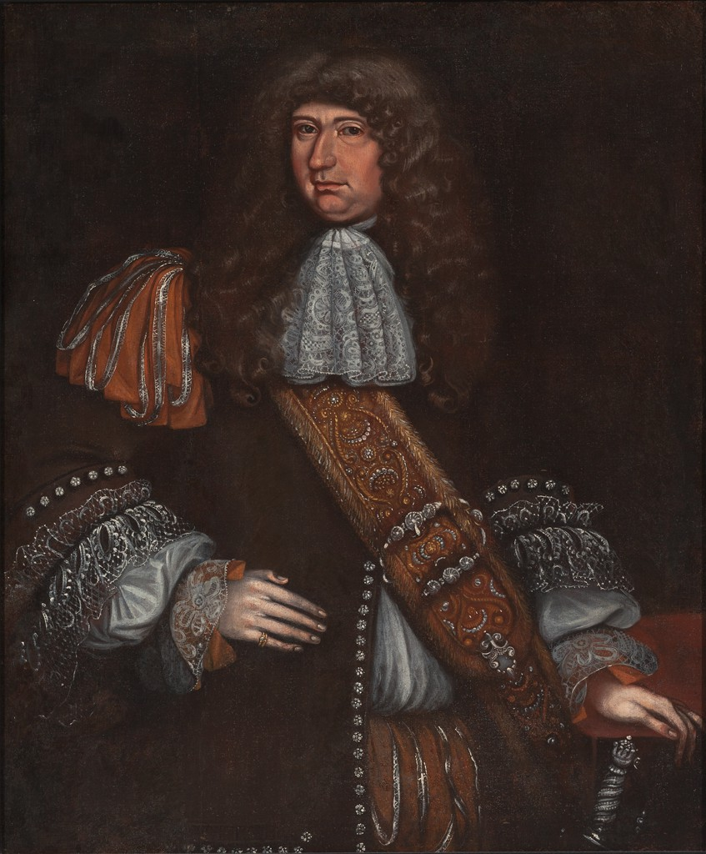
Sir George Downing, the Treasury
Secretary in the British Government in 1667.

Slide 5
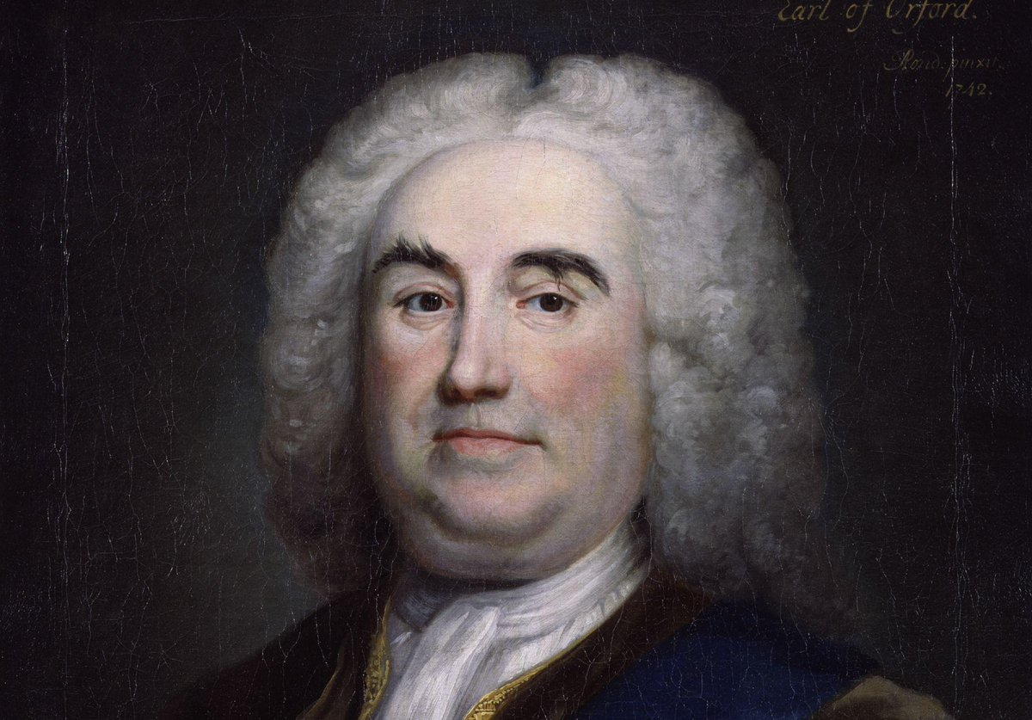
Sir Robert Walpole was the first prime minister from 1721 till 1742

Slide 6
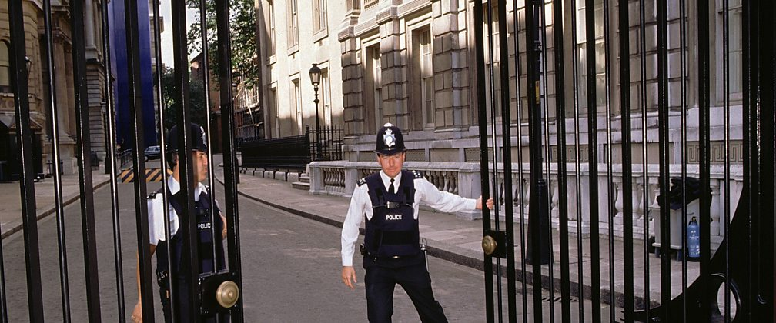
Special gates were constructed in 1991 for security reasons and now the largest part of Downing Street is closed to the public.

Slide 7
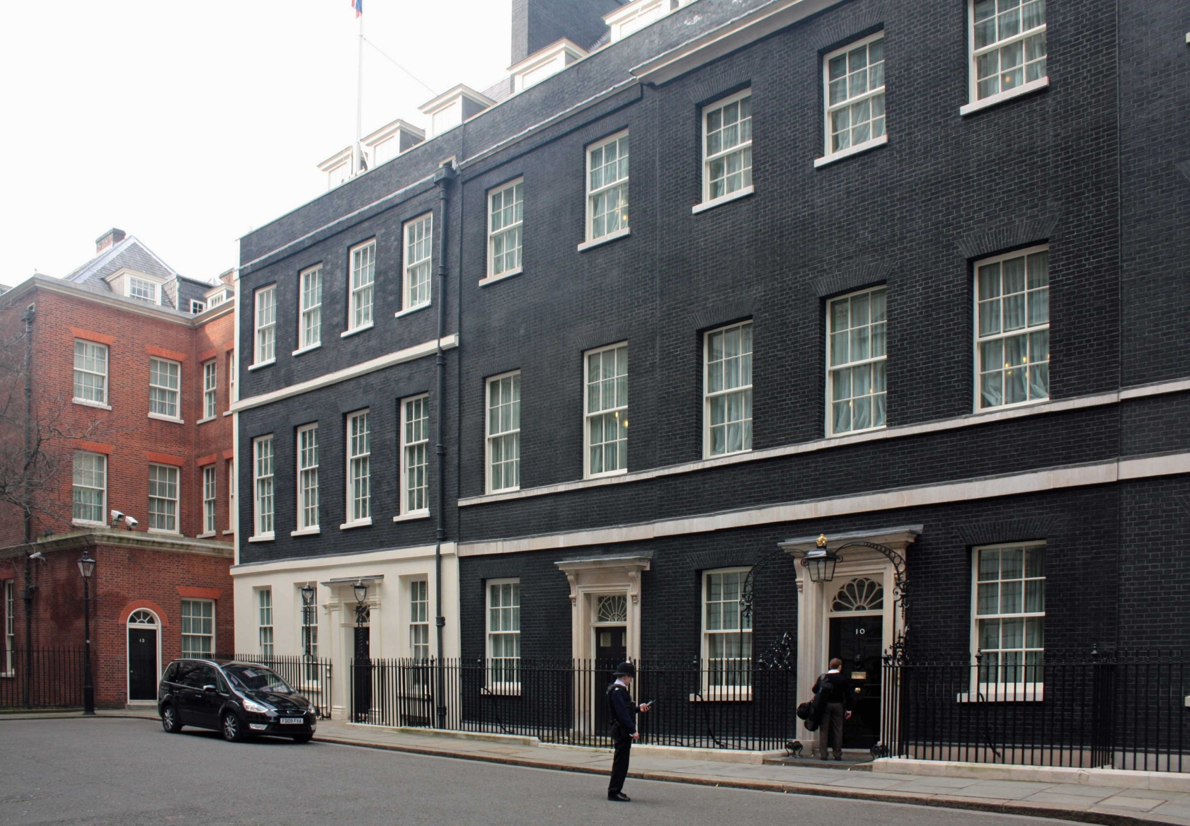
10 Downing Street was originally comprised of three buildings: a mansion, a townhouse, and a cottage.

Slide 8
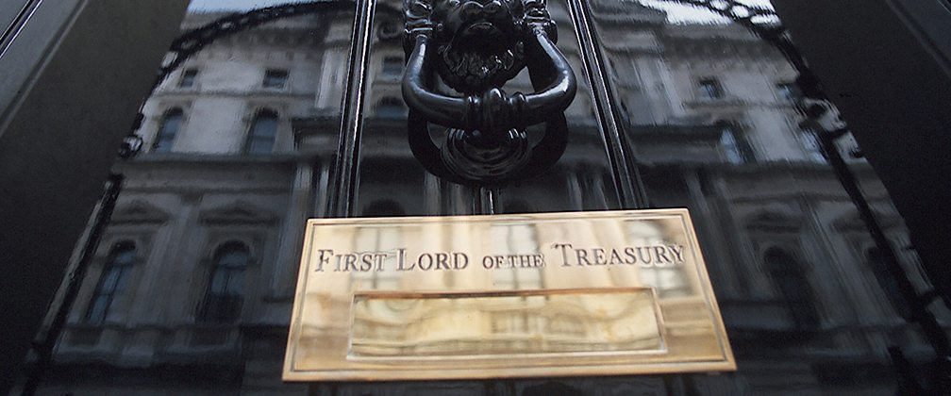
Look closely at the door — there's no keyhole. The door can only be opened from the inside.

Slide 9
Take a rare glimpse inside 10 Downing Street

Slide 10
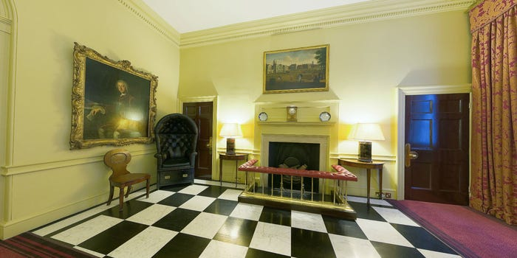
The Entrance Hall

Slide 11
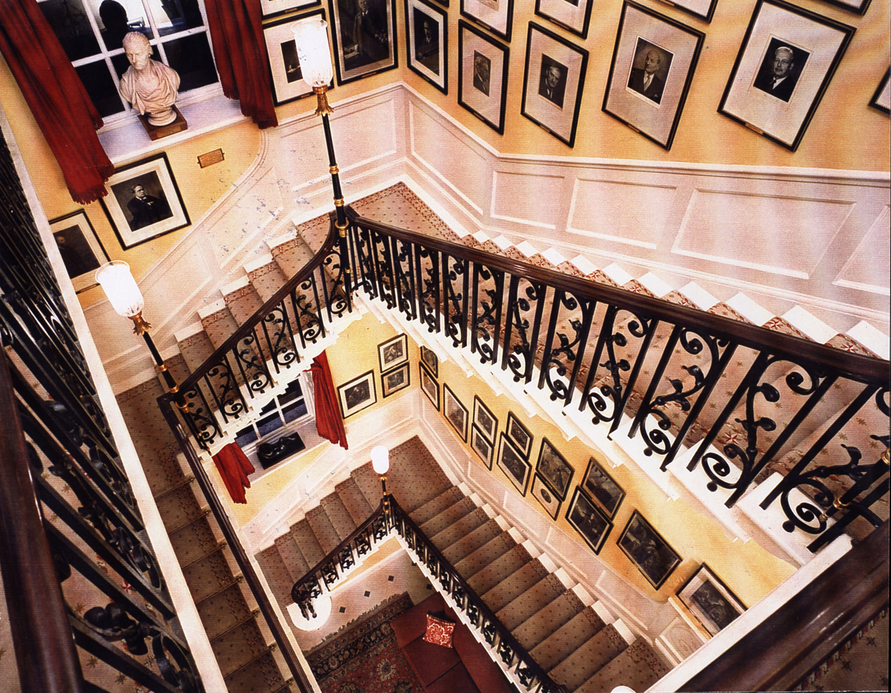
The entrance hall leads to the main staircase.

Slide 12
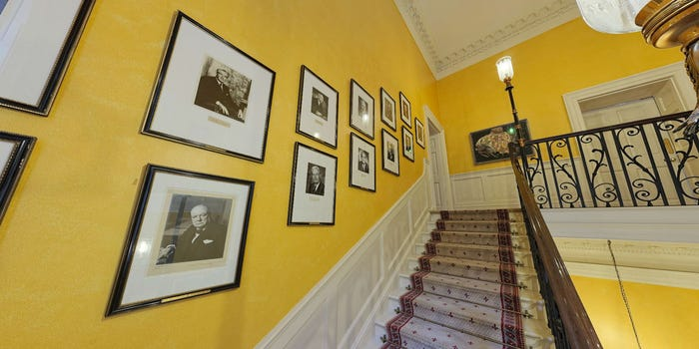
The walls are lined with portraits of past prime ministers.

Slide 13
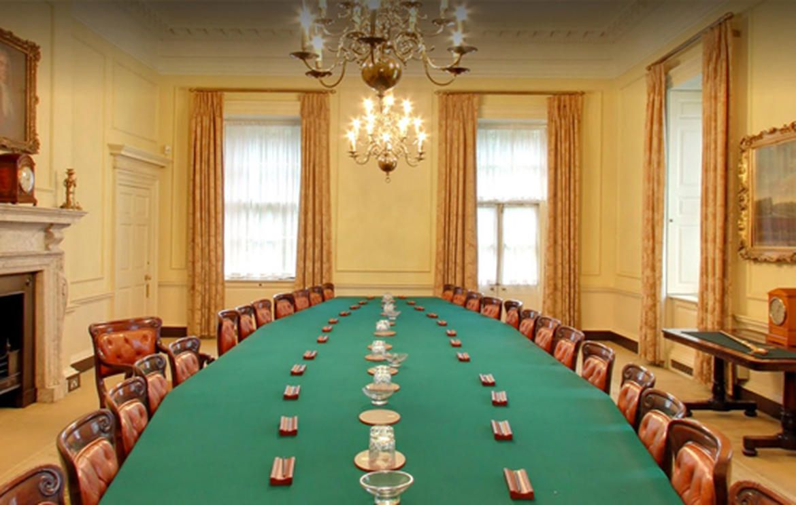
The Cabinet room, located upstairs, is separated from the rest of the house by soundproof doors.

Slide 14
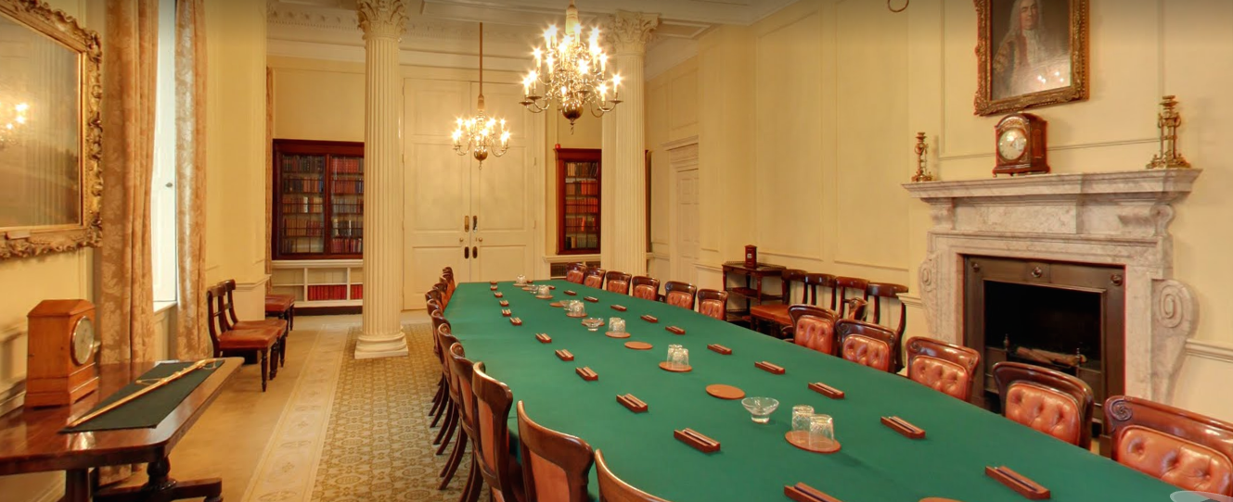
The Cabinet meets weekly, traditionally every Thursday morning.

Slide 15
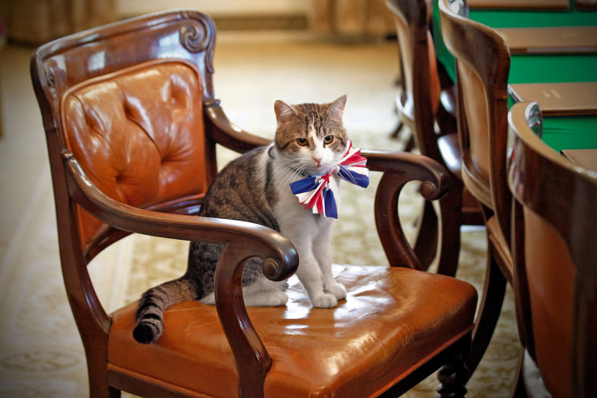
Only the Prime Minister`s chair has arms.

Slide 16
Larry, a brown and white tabby, with the title "Chief Mouser" was adopted in 2011 to control the mice population at 10 Downing Street.

Slide 17
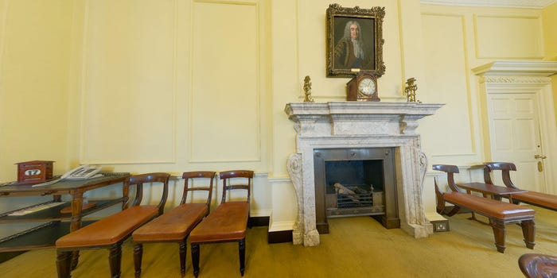
A copy of a portrait of Sir Robert
Walpolе hangs over the fireplace in the Cabinet Room.

Slide 18
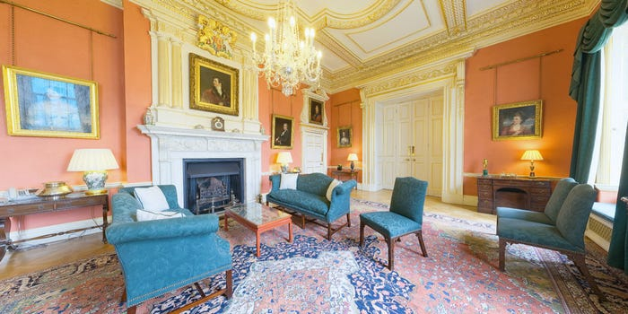
The Terracotta room is named after the colour it is painted.

Slide 19
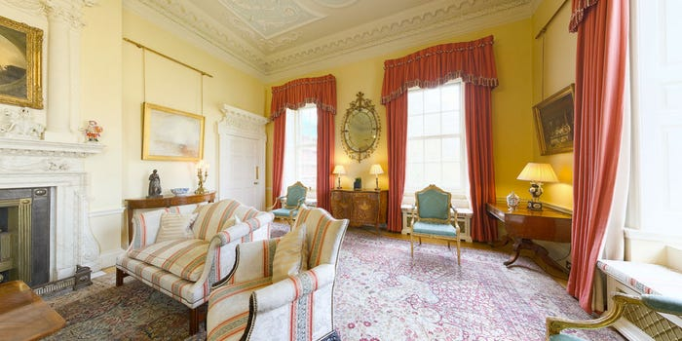
The White Drawing room was used by prime ministers for private use until the 1940s.

Slide 20
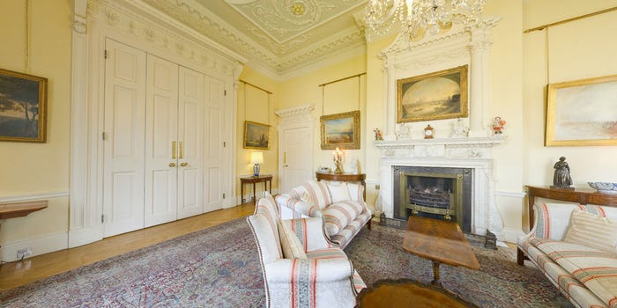
Now, it's often used as a meeting room for Downing Street staff.

Slide 21
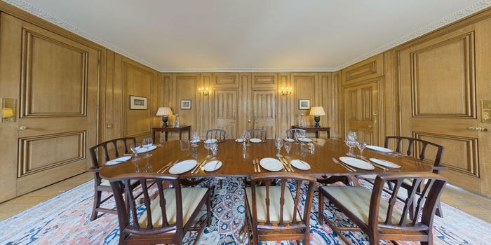
Let's move onto the Small Dining room, or breakfast room, where a mahogany table seats 8.

Slide 22
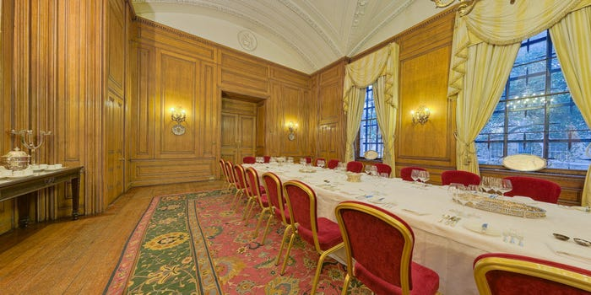
The State Dining room can seat up to 65 people around a large table.

Slide 23
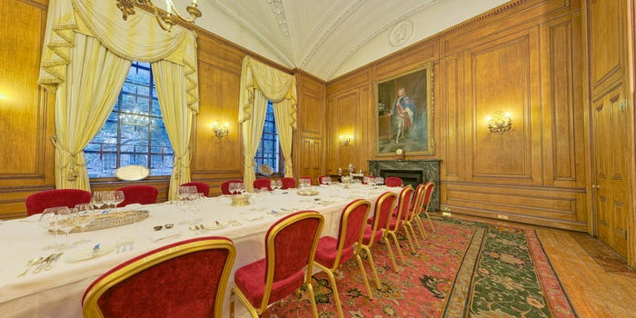
This room is used to host the prime minister's press conferences.

Slide 24
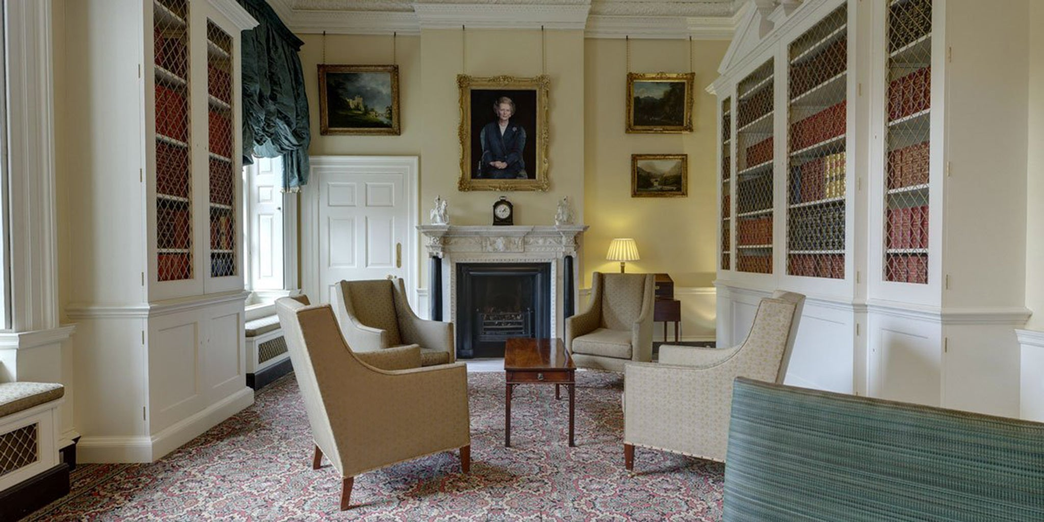
Here's the Study, where a portrait of Margaret Thatcher hangs over the fireplace.

Slide 25
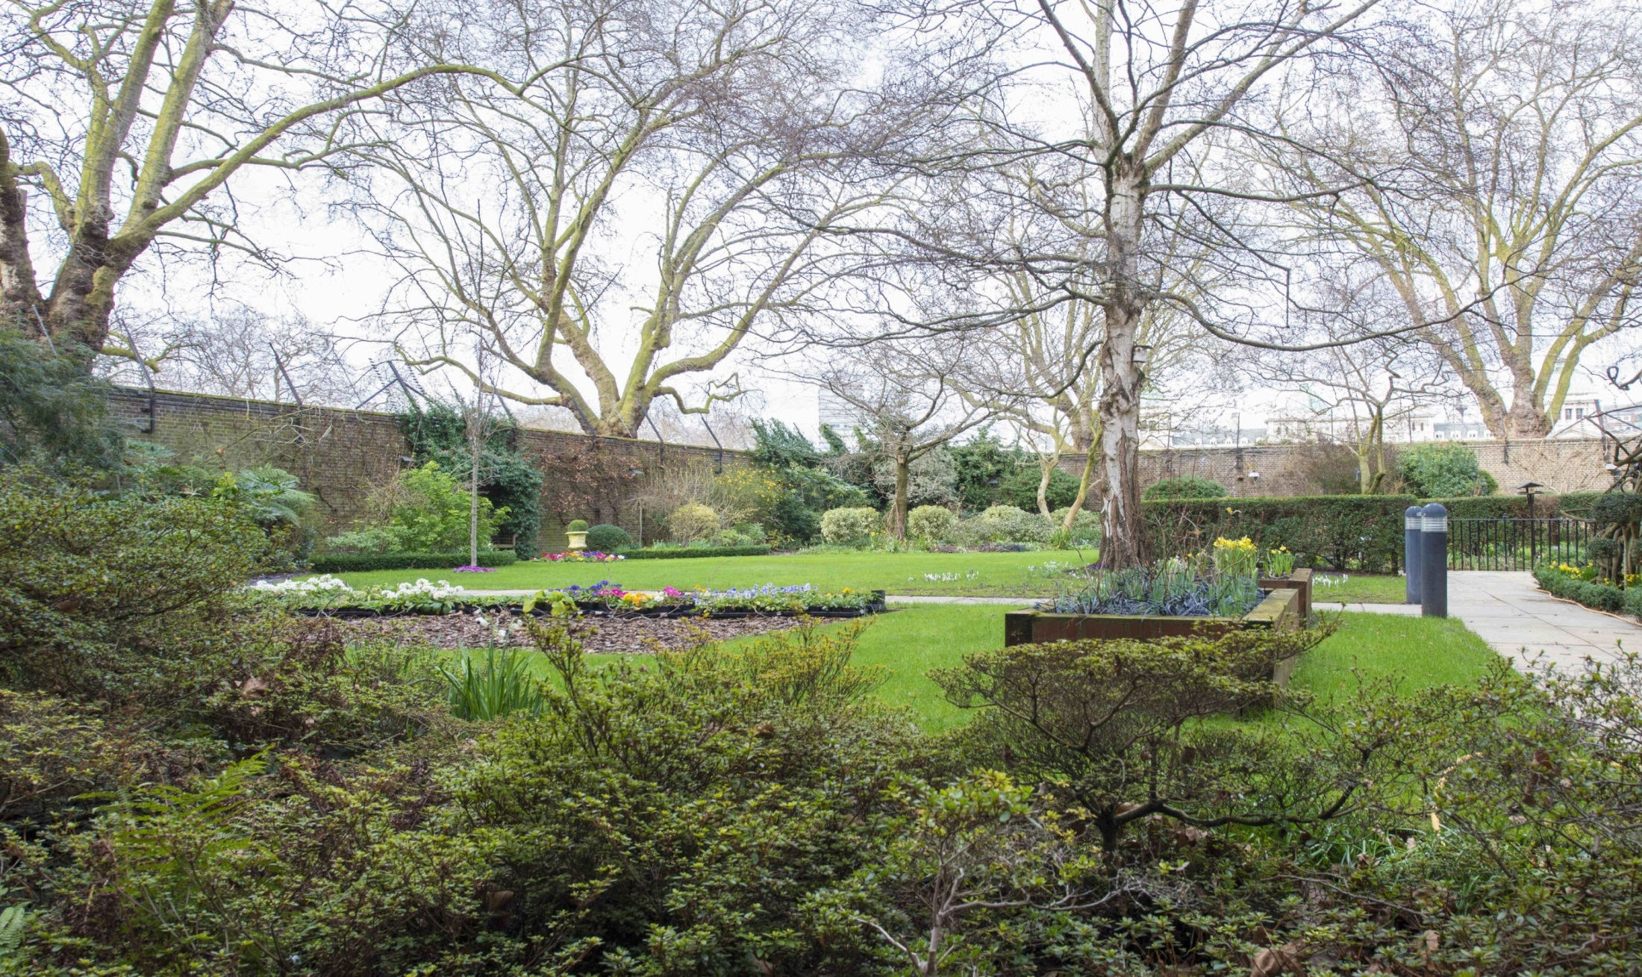
Number 10 also has a well-kept garden, which is often used to host events.

Slide 26
The house is also a workplace for the people who help the prime minister. There are some secretaries, a press centre, some switchboard clerks and a special department that sorts mail. They work on the ground floor.

Slide 27
Who’s the current PM?

Slide 28
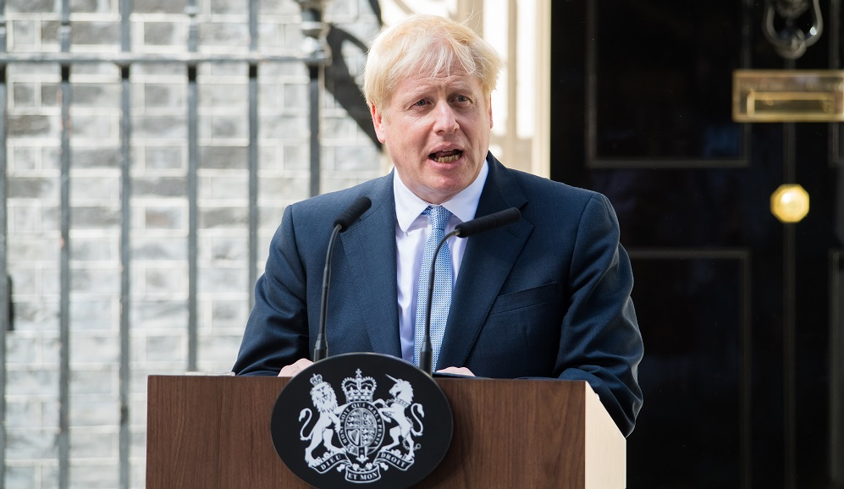
Alexander Boris de Pfeffel Johnson has served as Prime Minister of the UK and leader of the Conservative Party since July 2019.

Slide 29

Answer the questions:
Does it take long to get to Downing Street from the Houses of Parliament?
How did this street get its name?
When did Number 10, Downing Street become the residence of the Prime Minister?

Slide 30
Answer the questions:
What can you see on the walls of the Grand Staircase?
Where and how often does the Cabinet meet?
Who’s Larry?
Where do prime ministers usually live?
Can you visit the Prime Minister residence?

