Slide 1
Spotlight 9
Module 3. See it to believe it.
Unit 3f. English in Use.
Phrasal Verbs: COME

Slide 2
Compound Nouns
Hyphenated(через дефис) words:
  Self-esteem (чувсво собственного достоинства)
  Great-grandmother
  Fund-raiser(сборщик средств)
  Sister-in-law(золовка)
  Thirteen-year-old

Slide 3
Compound Nouns
Separate words:
  Compact disc
  Police officer
  Barak Obama
  Hill Middle School
  Harry Potter and the Sorcerer’s Stone

Slide 4
Compound Nouns
One word:
  Seafood
  Filmmaker(режиссер)
  Footsteps
  Videocassette
  Grasshopper

Slide 5
Compound Nouns
What is a compound noun?
2 or more words used together as a single noun
Parts can be written as:
  One word
  Separate words
  Hyphenated words с. 52 у. 1б

Slide 6
Phrasal verbs: COME
Come across | meet or find by chance | случайно встретиться или найти
Come down with | get an illness, often not a very serious one | заболеть чем-либо не очень серьезным
Come over | affect somebody strongly | овладеть (о чувстве)
Come out | become available to the public | опубликовать; выходить на экран
Come up with | think of an idea | предлагать идею

Slide 7
ACROSS
DOWN WITH
COME
OUT
OVER
UP WITH

Slide 8

across
1.She came ________ a pile(куча) of old books while she was clearing the attic.

Slide 9


2.I’m sorry – I don’t know what came _______ me. I don’t know what made me behave in that way.
over

Slide 10
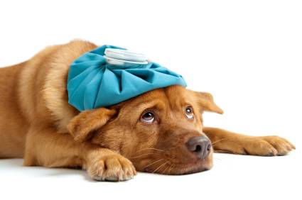
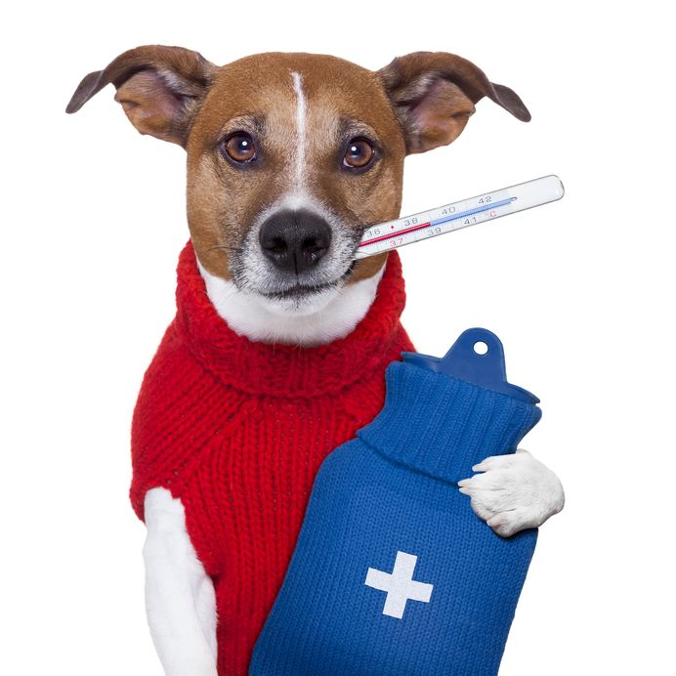
3.I think I’m coming _______ something. I have a temperature.
down with

Slide 11


4.He came ________ a great idea for the story.
up with

Slide 12
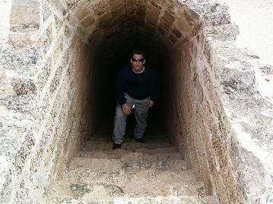
5.Dave came ______ a secret passage in the castle.
across

Slide 13
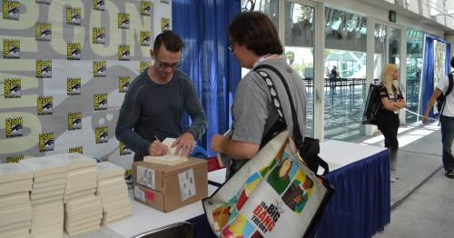
6.His new novel has just come ________.
out

Slide 14
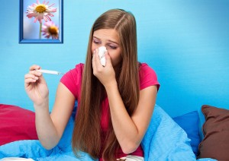
down with
7.I came _________ a bad cold yesterday.

Slide 15

8.She came _______ a great idea for solving the problem.
up with

Slide 16

9.Stephen King’s new book has just come ________.
out

Slide 17
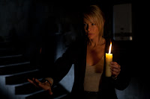
10.As soon as I stepped into the creepy house, a strange feeling came _______ me.
over

Slide 18
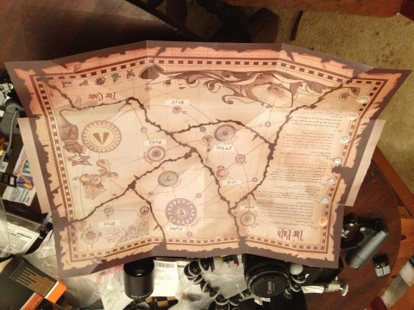
Alan came ________ a mysterious map in his grandmother’s house.
across

Slide 19
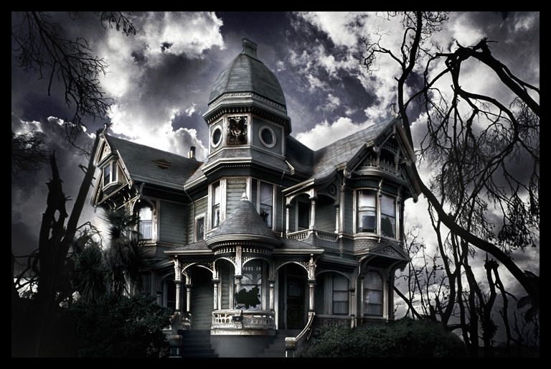
It was Will who came _______ the idea of going into the haunted house.
up with

Slide 20
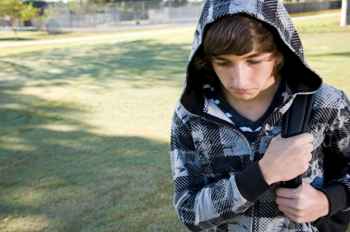
A strange feeling came ________ me as I walked home.
over

Slide 21

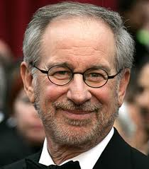
I can’t wait for Spielberg’s new film to come _______.
out

Slide 22
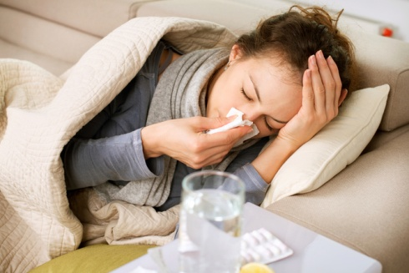
She feels ill. She must be coming _________ the flu.
down with

Slide 23

When do the exam results come ________ ?
out

Slide 24
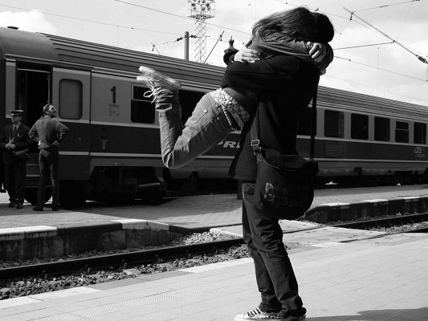
I came _________ him at the station.
across

Slide 25
Hear of- hear from-
Be part of-
Succed in-
Think of-
Think about-
Be nervous about-
Know from experience-
In search of-

Slide 26
Hear ....-знать hear ..... -услышать
Be part ...-быть частью
Succed ...- быть успешным в
Think .....-думать о
Think .....-серьезно задумываться
Be nervous .....-нервничать
Know .... experience-знать по опыту
.... search ....-в поиске

Slide 27
Scenes-сцены упр. 4 с. 52
Sightings-наблюдения
Sights- места, достопримечательности
Fantasy –фантастика, фантазия
Imagination- воображение
Illusion- иллюзия, мираж
Witness-свидетель, очевидец
Spectator-зритель, наблюдатель
Investigator-следователь, исследователь
Same-тот же, тот же самый
Similar- подобный, похожий
Alike- одинаково, подобно,

Slide 28
С. 52 упр. 3 и выписать 10 сложных сущ. Через дефис

Slide 29
Resources
Images:
Slide 4 http://www.huffingtonpost.com/2013/11/07/story_n_4232112.html
Slide 5 http://authenticclaritycoaching.com/blame-game/
http://authenticclaritycoaching.com/blame-game/
Slide 6 http://www.dayjob.com/content/veterinary-science-degree-855.htm
http://www.hudsonveterinaryhospital.com/services/emergency-services/
Slide 7 http://www.smarta.com/smartastart2013/idea/
http://chrisankele.com/
Slide 8 http://www.tiuli.com/track_info.asp?lng=eng&track_id=44
Slide 9 http://www.8cn.tv/content/sdcc-chuck-palahnuik-announces-fight-club-sequel-graphic-novel-format
Slide 10 http://comerecommended.com/affordable-care-for-college-students-is-it-possible/
Slide 11 http://www.eckington.net/launchpad/problem.html
Slide 12 http://madmikesamerica.com/2013/08/inside-the-stephen-king-family/
Slide 13 http://obscurendure.blogspot.ru/2012/01/review-julias-eyes-2010-dir-guillem.html
Slide 14 http://westkarana.com/index.php/2012/10/23/pirate101-a-mysterious-map/
Slide 15 http://royaltutorial.com/haunted-house-photomanipulation/
Slide 16 http://kids.idshungary.com/street_wise/content/
Slide 17 http://irez.me/2012/03/31/the-minority-report-on-saveme-oh/
http://www.topnews.in/light/people/steven-spielberg?page=1
Slide 18 http://theconversation.com/mondays-medical-myth-feed-a-cold-starve-a-fever-13661
Slide 19 http://www.timeprep.me/cfa-exam-results/
Slide 20 http://74211.com/romantic-pics-couple-meeting-at-train-station-hugging-each-other/
Free Notebook Themed PowerPoint Backgrounds
http://www.brainybetty.com/NotebookBacks2006/Notebook_Backgrounds.htm

