Slide 1
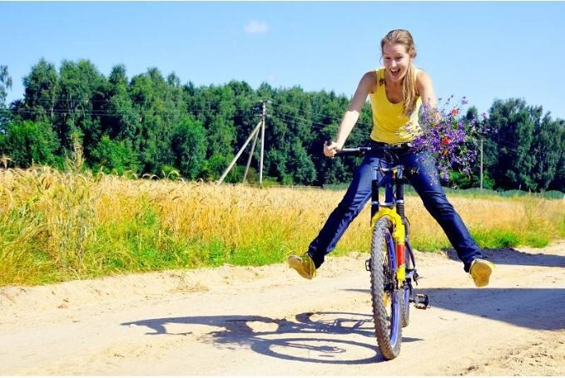
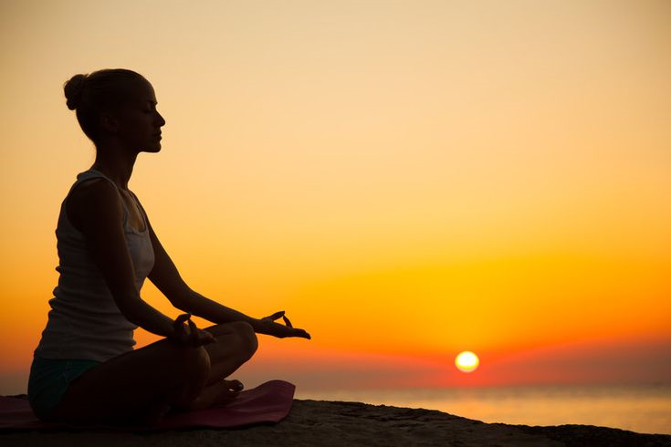
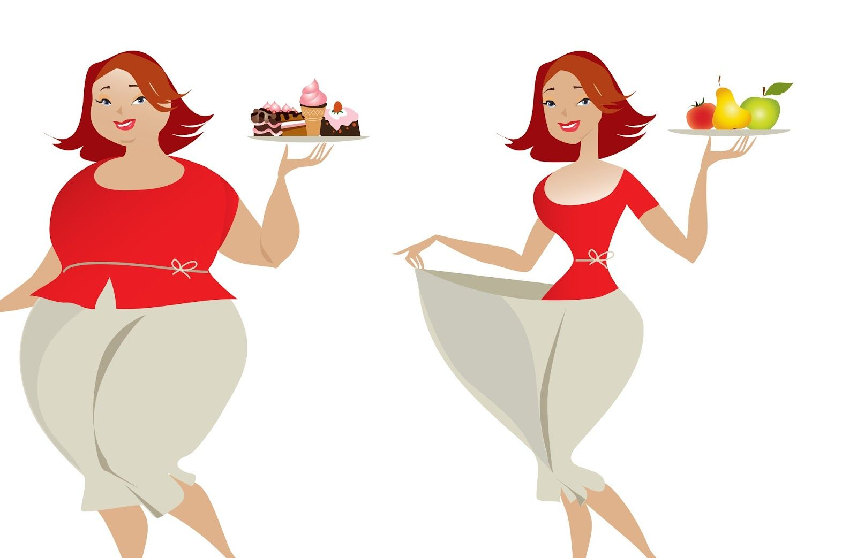
I practiced meditation when I was a student
I went on a diet and lost 12 kg
TRUE
FALSE
TRUE
Notes:
© Copyright PresentationGO.com – The free PowerPoint and Google Slides template library

Slide 2

I think that the most important aspect to be healthy is because
1......
2......
DOING SPORT
AVOIDING BAD HABITS
HEALTHY EATING
PSYCHOLOGICAL HARMONY
Notes:
© Copyright PresentationGO.com – The free PowerPoint and Google Slides template library

Slide 3
I think that the most important aspect to be healthy is because
1......
2......
DOING SPORT
AVOIDING BAD HABITS
HEALTHY EATING
PSYCHOLOGICAL HARMONY
Notes:
© Copyright PresentationGO.com – The free PowerPoint and Google Slides template library

Slide 4
“Healthy eating”
Notes:
© Copyright PresentationGO.com – The free PowerPoint and Google Slides template library

Slide 5

The aim of our lesson is
give the meaning of “a healthy lifestyle”
to discuss the importance of our healthy lifestyle
to practice vocabulary and grammar in real communication
What about you?
On this lesson I would like to....
Notes:
© Copyright PresentationGO.com – The free PowerPoint and Google Slides template library

Slide 6
Healthy eating is…….
Notes:
© Copyright PresentationGO.com – The free PowerPoint and Google Slides template library

Slide 7
Healthy eating is a way of life without junk food when my good shape depends on products which are full of useful nutrients
Be full of
 | Depend on
 |  | Junk food
Notes:
© Copyright PresentationGO.com – The free PowerPoint and Google Slides template library

Slide 8
Let’s remember the words
affect smth depend on be appetizing be nutritious be full of carbohydrates be rich in vitamins, protein, nutrients, fiber to lose weight to put on weight irreversible process | to lead to anorexia become a victim of eating disorder a nutritionist put one’s health at risk An apple a day keeps a doctor away nutrients take smth seriously lead to anorexia
Notes:
© Copyright PresentationGO.com – The free PowerPoint and Google Slides template library

Slide 9
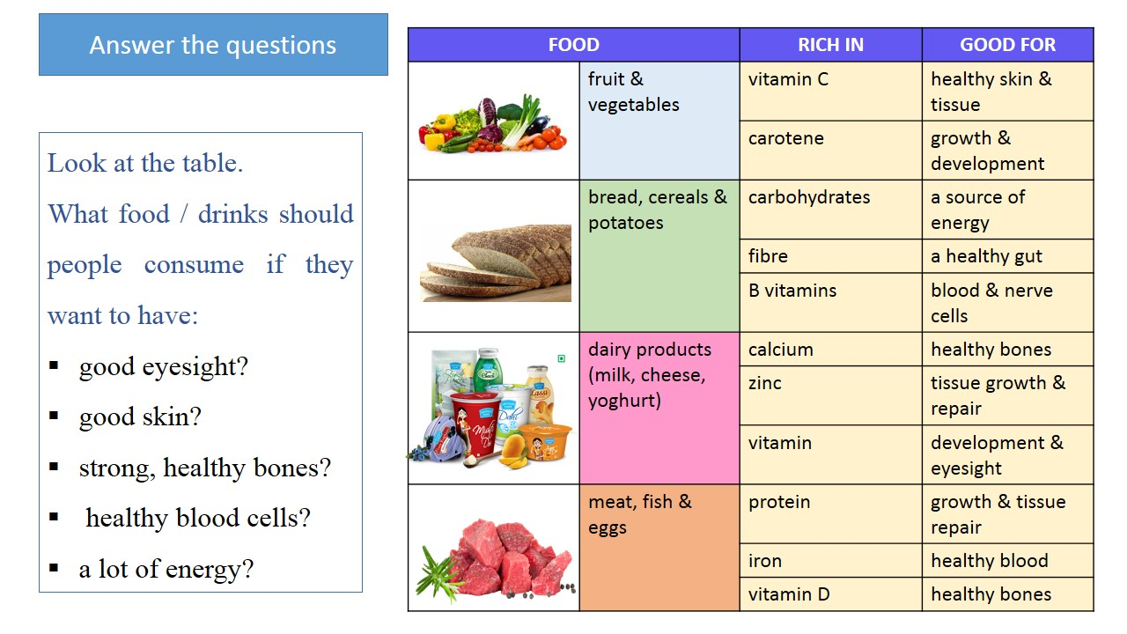
Notes:
© Copyright PresentationGO.com – The free PowerPoint and Google Slides template library

Slide 10
Match the nutrients that you can find in different products
You need this to help you grow. You can find it in meat, eggs and milk. _______
It helps to store energy in your body. You can find it in butter and oil. _________
It is used to make food and drinks sweet. You can find it in biscuits and cakes.____
Substances you need to be healthy. You can find them in fruit and vegetables._____
Parts of plants or seeds that your body cannot digest. Helps food pass through the body quickly.____
They provide you with energy. You can find them in bread, pasta and rice. ______
A substance that is formed naturally in rocks or the earth and is found in small quantities in food and drinks. _______
protein
fat
sugar
vitamins
fiber
carbohydrates
minerals
Notes:
© Copyright PresentationGO.com – The free PowerPoint and Google Slides template library

Slide 11
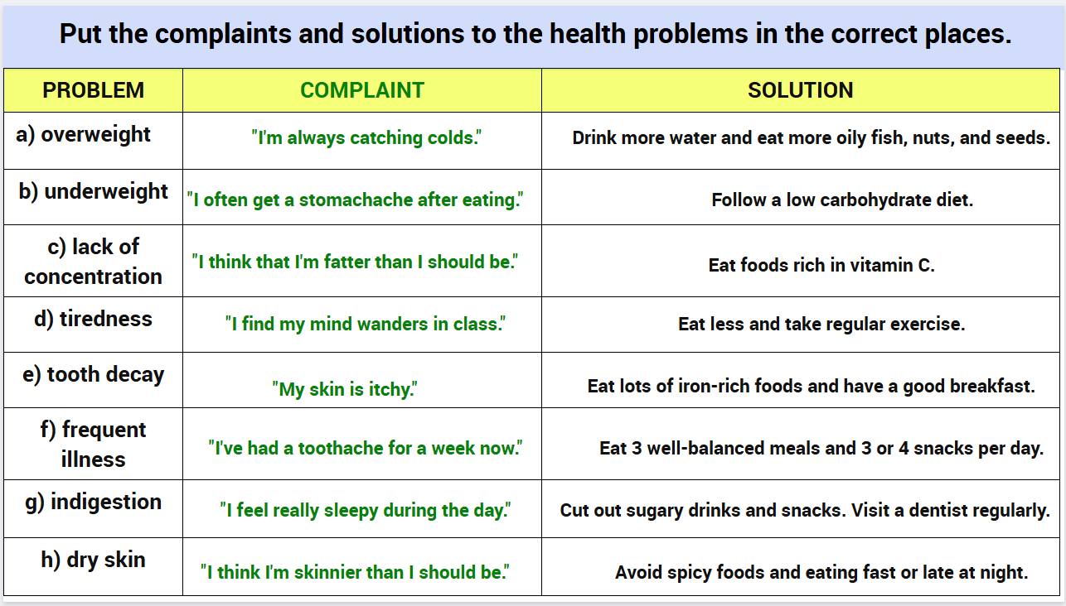
The aim of our lesson is
to define the meaning of “healthy lifestyle”
to discuss the importance of our healthy lifestyle
to practice vocabulary and grammar in real communication
What about you?
On this lesson I would like to....
Notes:
© Copyright PresentationGO.com – The free PowerPoint and Google Slides template library

Slide 12
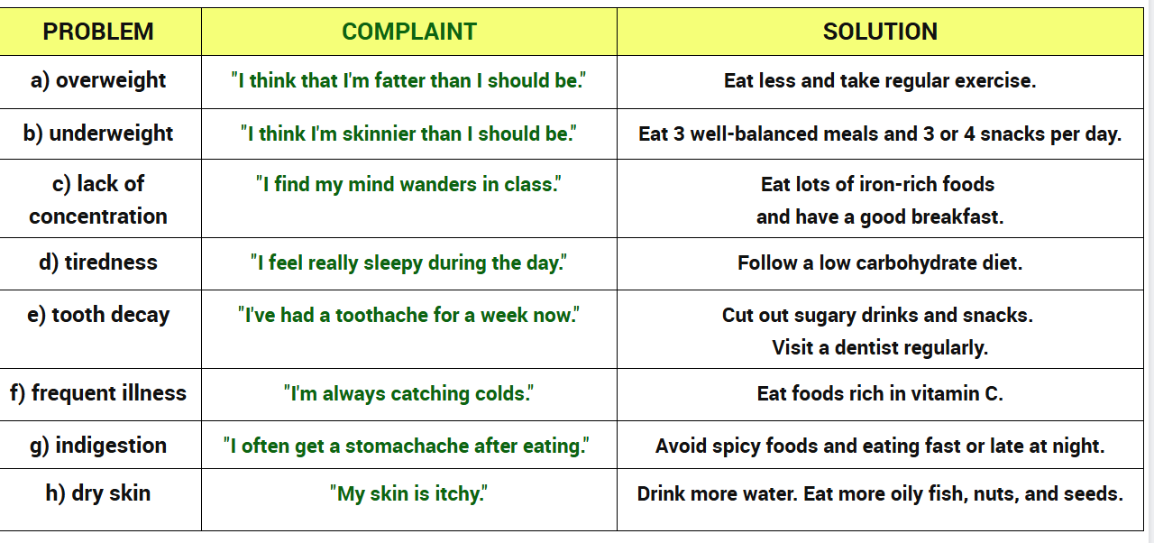
Notes:
© Copyright PresentationGO.com – The free PowerPoint and Google Slides template library

Slide 13

“If you were a sailboat”
Notes:
© Copyright PresentationGO.com – The free PowerPoint and Google Slides template library

Slide 14
If…..
If I had toothache, I would go to the dentist
You won’t lose weight if you eat to much chocolate and ice cream every day!
If I were you, I would stop eating too much junk food.
If you knew more about healthy habits, you would not put on weight so quickly.
This soup would have tasted better if you had added more salt
Notes:
© Copyright PresentationGO.com – The free PowerPoint and Google Slides template library

Slide 15
If I were you, I would eat less and take regular exercise

Slide 16
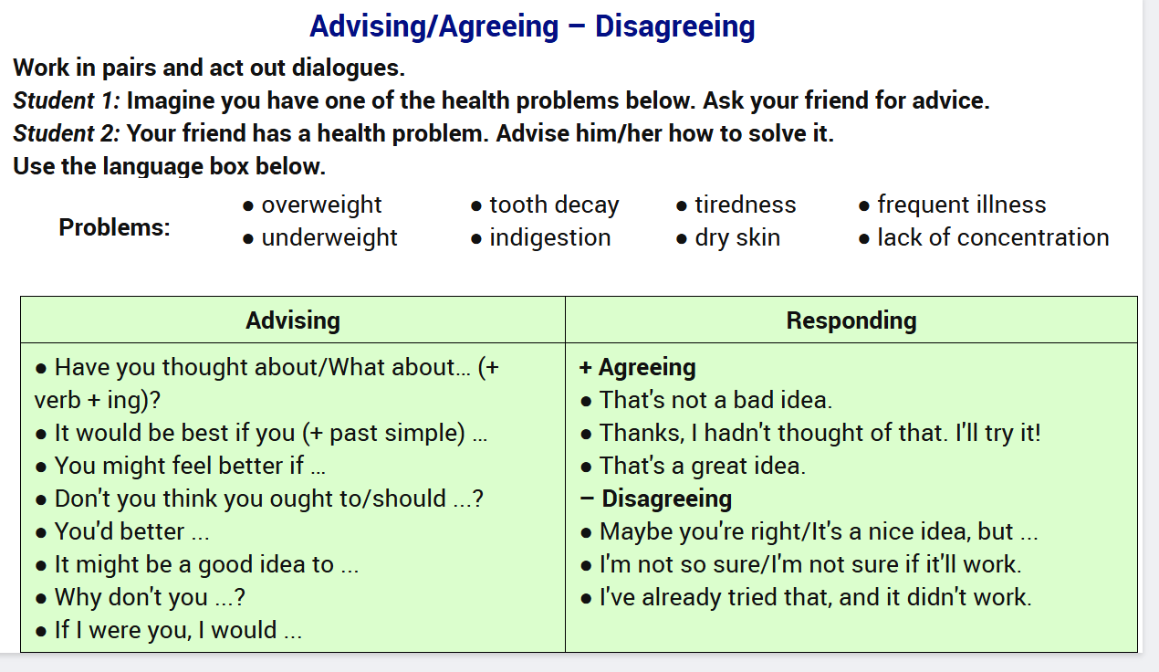
Notes:
© Copyright PresentationGO.com – The free PowerPoint and Google Slides template library

Slide 17
“Activity is the only road to knowledge” said George Bernard Show.
Today, on our lesson WE HAVE…
Learnt…….
Remembered…..
Done….
3 necessary nutrients for our body
2 problems with health
1 advice to your friend to be in good shape
Notes:
© Copyright PresentationGO.com – The free PowerPoint and Google Slides template library

Slide 18
H/w
Write a letter to your English friend
Notes:
© Copyright PresentationGO.com – The free PowerPoint and Google Slides template library

Slide 19
Thank You!
Notes:
© Copyright PresentationGO.com – The free PowerPoint and Google Slides template library

