Slide 1

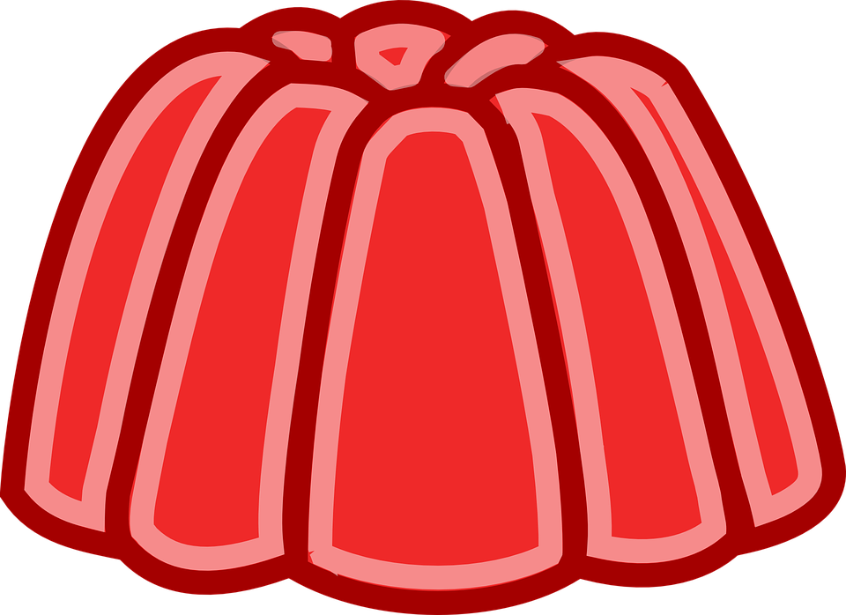
Module 5a
“ He loves jelly”
« Он любит желе»

Slide 2
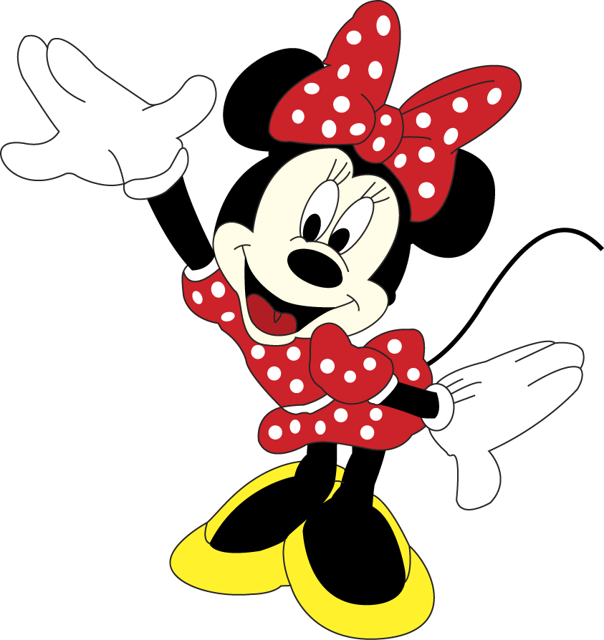
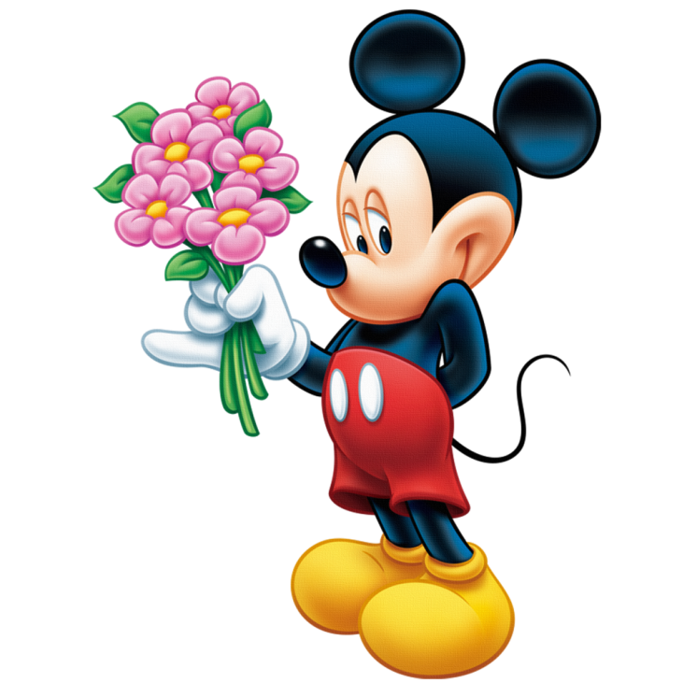
Phonetic drill
[ ʧ ] chocolate, sandwich, chicken, chips, cheese
[ ʤ ] jug, jar, juice, jelly, jam, vegetables
[ ʃ ] shape, fish, dish, sugar, sure, bush

Slide 3
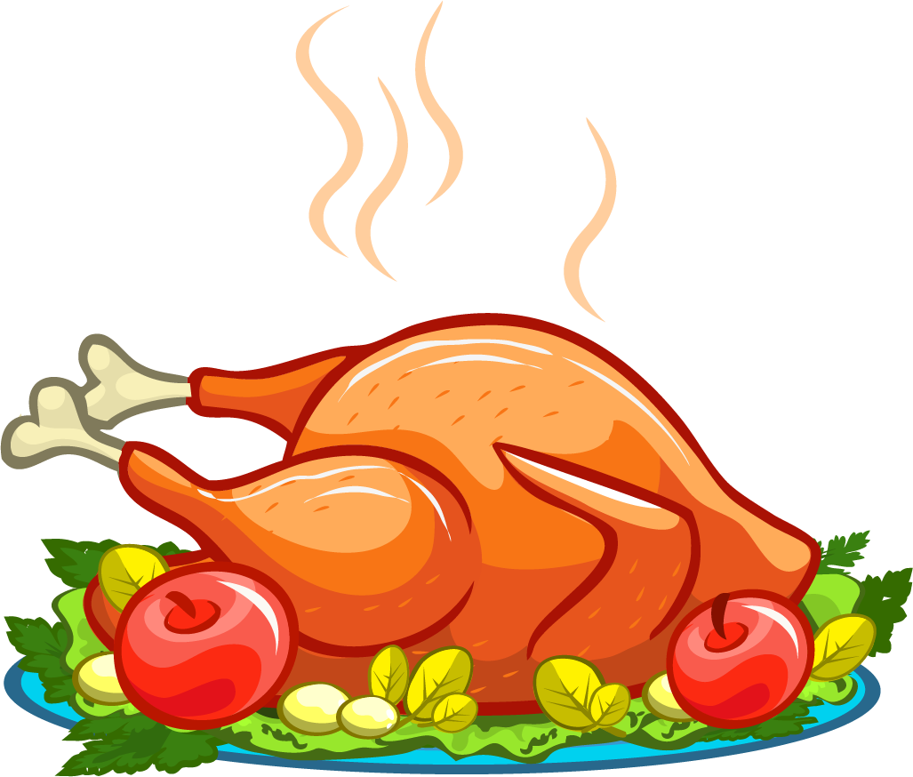
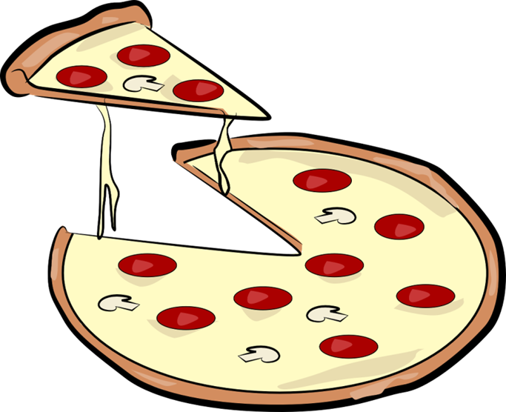
New words
What is it?
What is it?
Chicken
Pizza

Slide 4
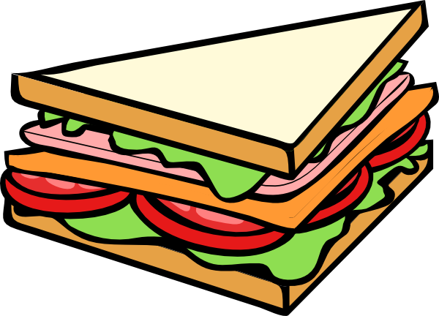
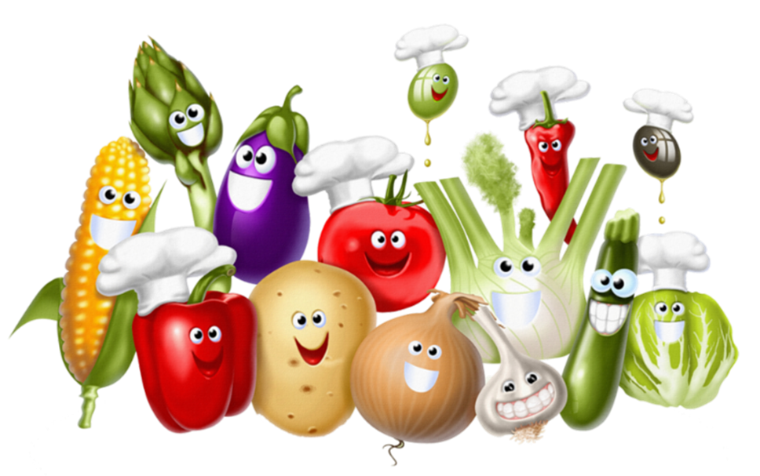
What is it?
What is it?
Sandwich
Vegetables

Slide 5
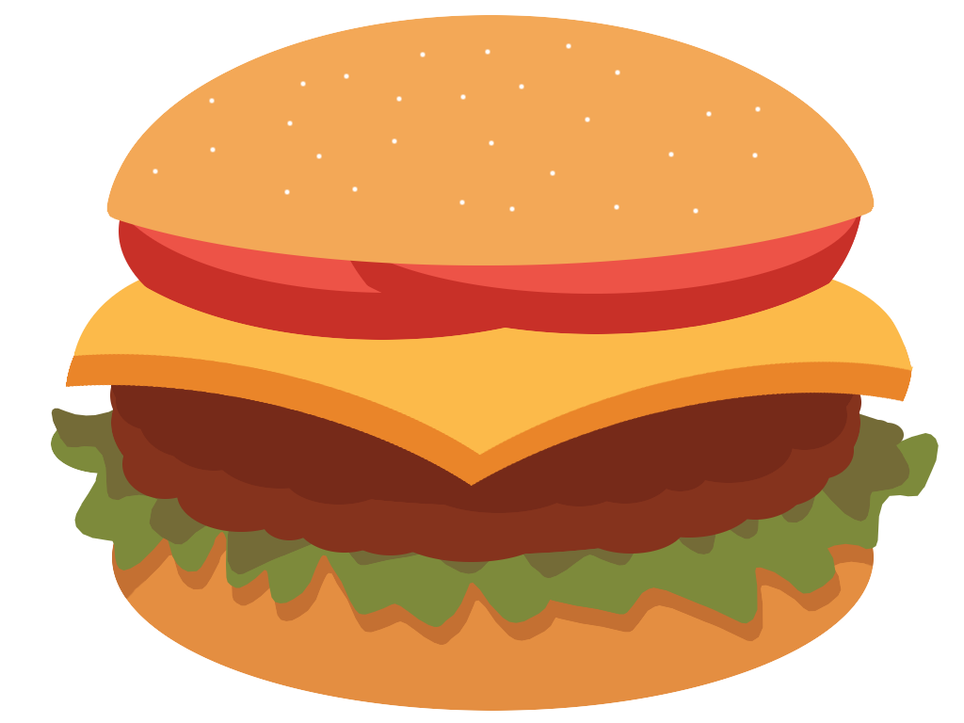

What is it?
What is it?
Burger
Ice cream

Slide 6
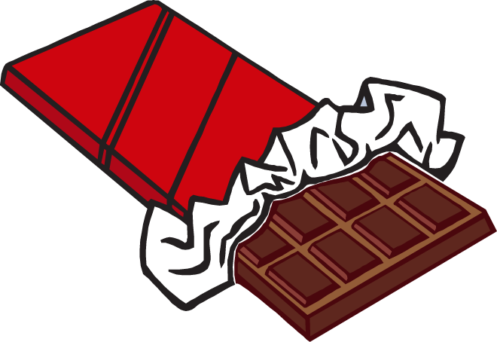
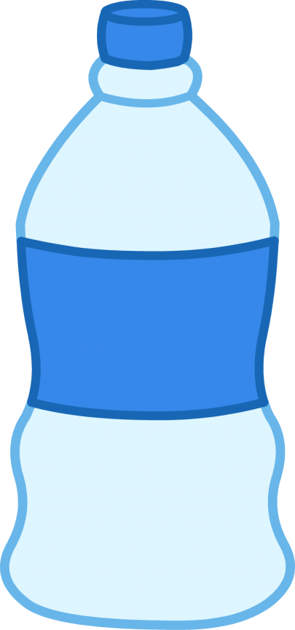
What is it?
What is it?
Chocolate
Water

Slide 7
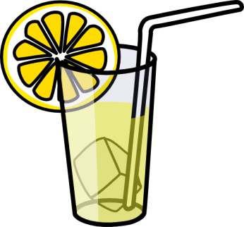
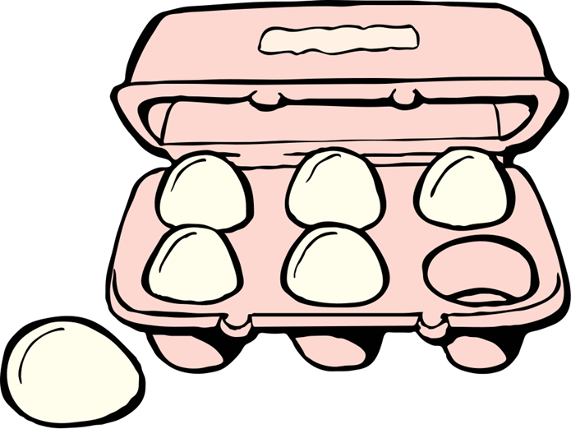
What is it?
What is it?
Lemonade
Eggs

Slide 8


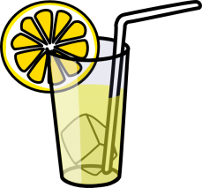
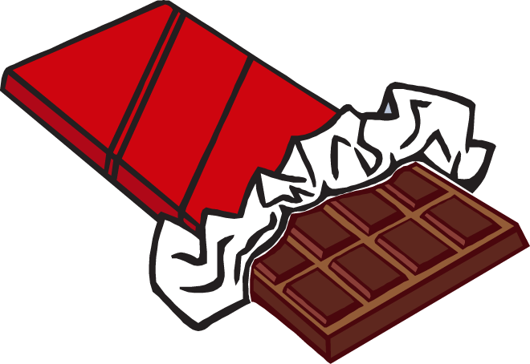
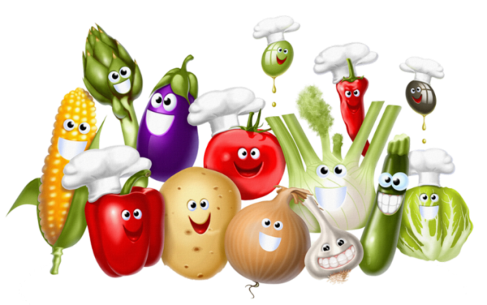
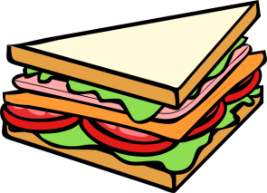
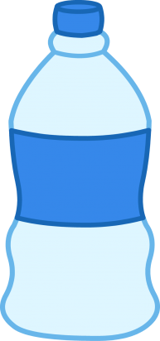
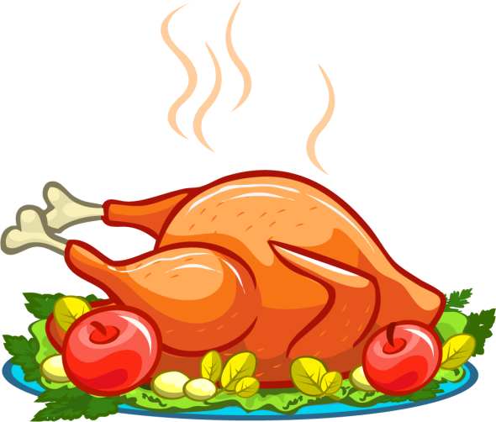

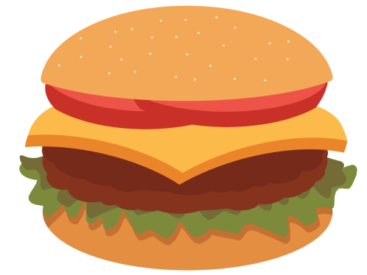
Ex. 1 page 42
- Open your books at page 42
- Listen to the song, please
- What type of food do you listen at our song?

Slide 9
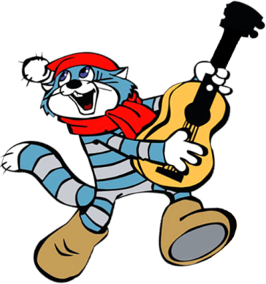
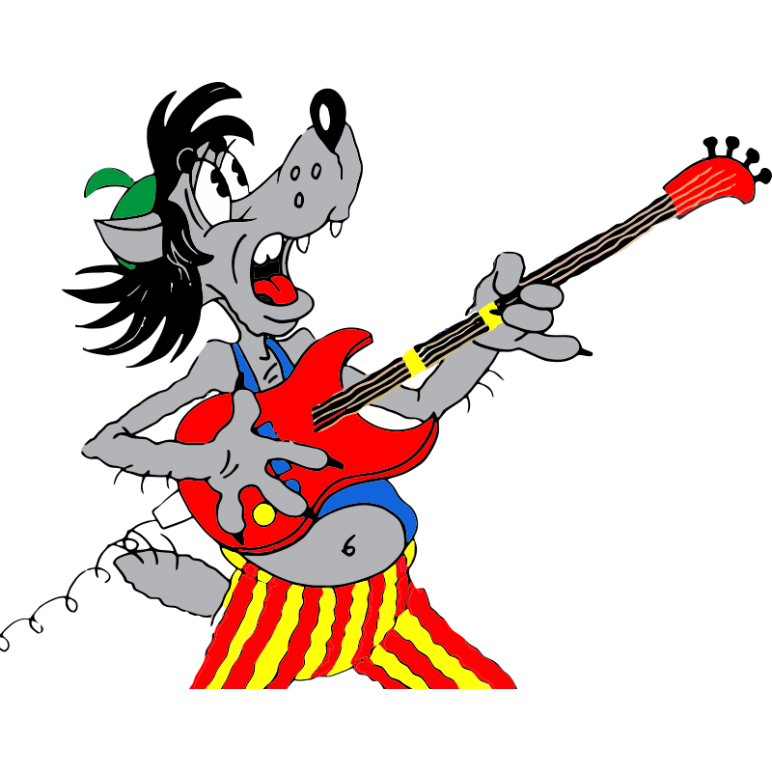
- Now, repeat the song after me
Chicken with vegetables,
Ice cream and chocolate.
Water and lemonade
Pizza with cheese on it!
Eggs in my sandwiches,
Burgers with chips:
These are just some
Of my favourite things

Slide 10
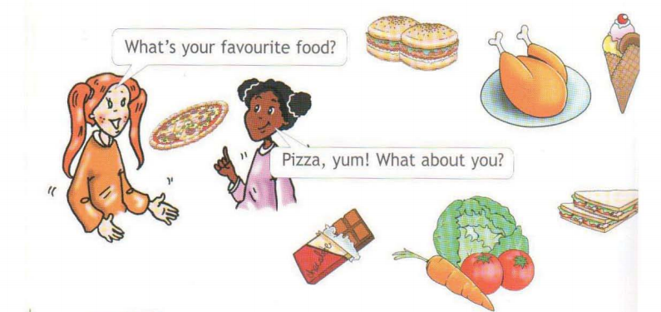
Ex. 2 page 42
- Look! Lulu and Maya are talking about their favourite food.

Slide 11
- Догадайтесь, что они говорят об остальных продуктах.
Do you like …?
Yes, I do.
No, I don’t.

Slide 12
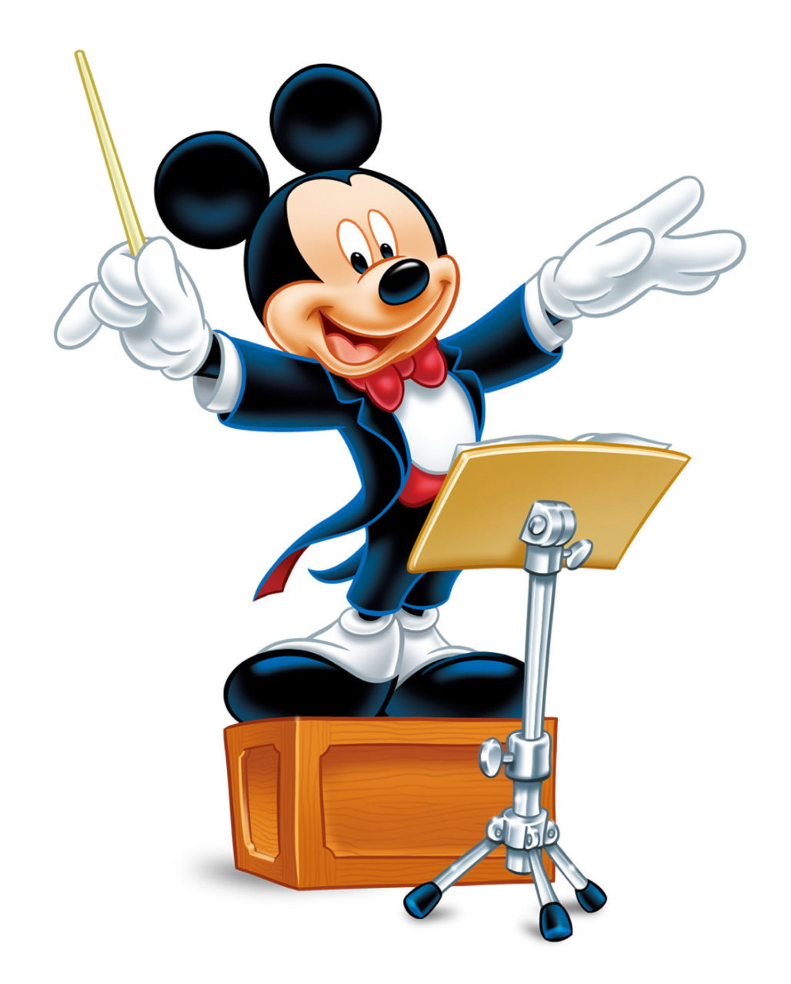
- Now, you listen to the song and try to sing along!
Do you like broccoli?
Yes, I do!
Do you like ice cream?
Yes, I do!
Do you like broccoli ice cream?
No, I don’t. Yucky!
Do you like donuts?
Yes, I do!
Do you like juice?
Yes, I do!
Do you like donut juice?
No, I don’t. Yucky!

Slide 13

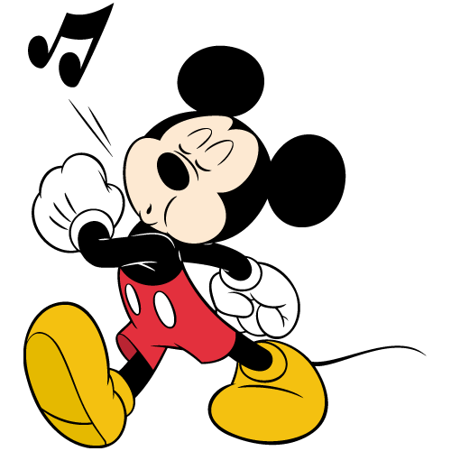
Do you like popcorn?
Yes, I do!
Do you like pizza?
Yes, I do!
Do you like popcorn pizza?
No, I don’t. Yucky!
Do you like bananas?
Yes, I do!
Do you like soup?
Yes, I do!
Do you like banana soup?
No, I don’t. Yucky!

Slide 14
Physical exercises
- Let’s relax and do some exercises
Хлопни в ладоши, когда услышишь название напитка, топни ногой, когда услышишь название фрукта, покрути головой, когда услышишь название овоща.

Slide 15
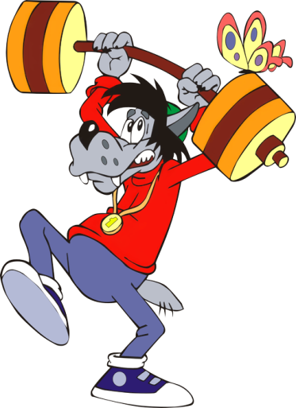
an orange
a banana
tea
juice
coke
fruit
an apple
lemonade
a potato
a carrot
vegetable
milk
water

Slide 16


Ex. 3, 4 page 43
- Listen and say who likes jelly.
Who likes jelly?

Slide 17
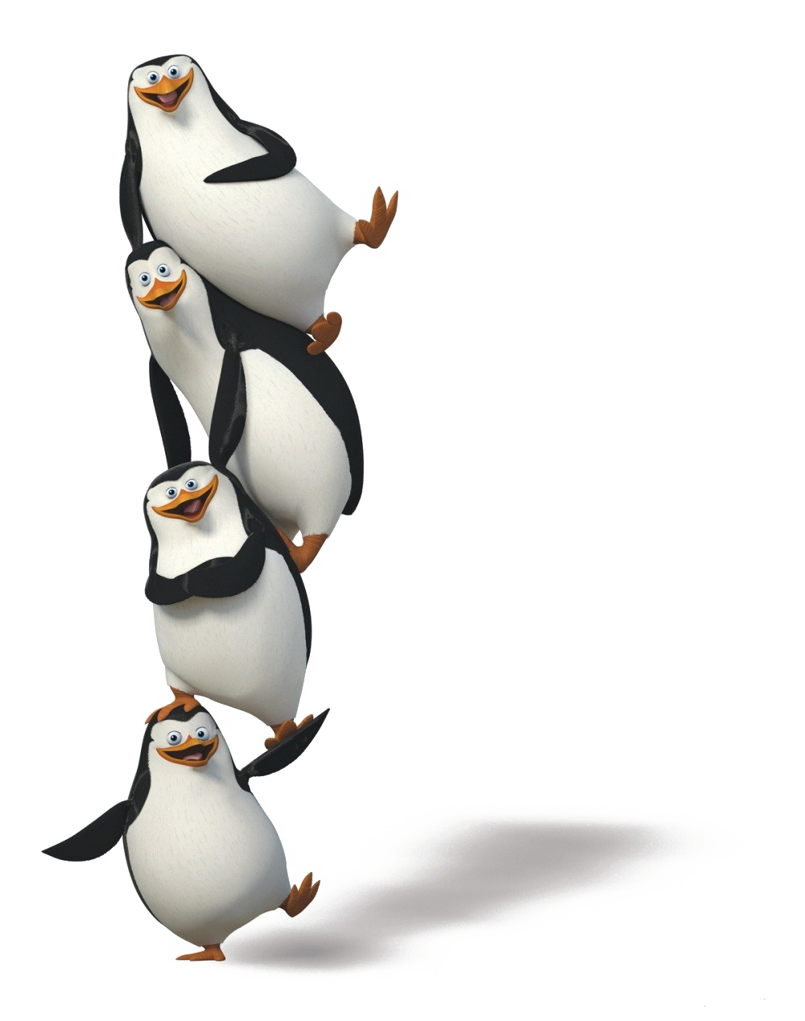
Thanks for your attention!

