Slide 1


Slide 2
Hello, I’m ….
Nice to see you again!
Larry

Slide 3
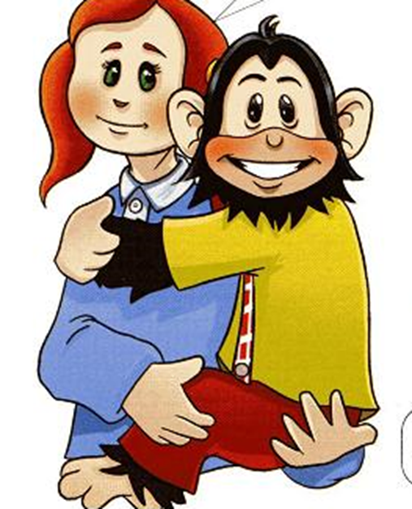
Hello, I’m ….
and this is ….
Welcome back!
Lulu
Chuckles

Slide 4
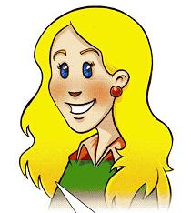
Hello,everyone! I’m ….
Nanny Shine

Slide 5

What is your Name?

Slide 6
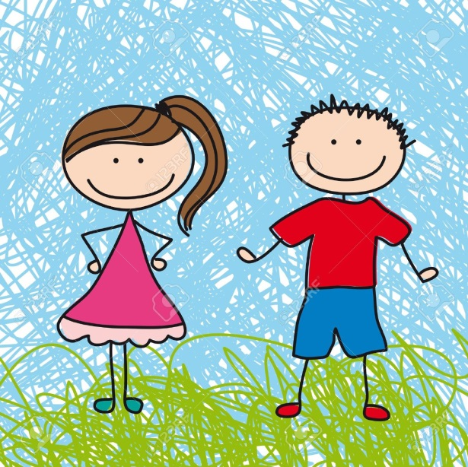
I am…

Slide 7
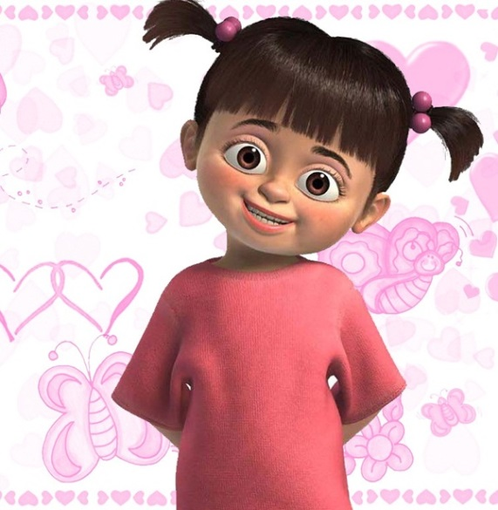

My name is……

Slide 8
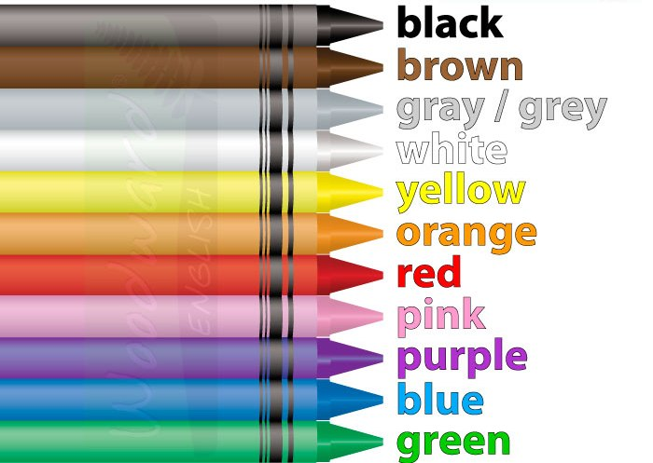
What colour is it?

Slide 9
What colour is it?
-It’s ______
brown

Slide 10
What colour is it?
-It’s ______
purple

Slide 11
What colour is it?
-It’s ______
black

Slide 12
What colour is it?
-It’s ______
white

Slide 13
What colour is it?
-It’s ______
orange

Slide 14
What colour is it?
-It’s ______
green

Slide 15
What colour is it?
-It’s ______
yellow

Slide 16
What colour is it?
-It’s ______
blue

Slide 17
What colour is it?
-It’s ______
pink

Slide 18
What colour is it?
-It’s ______
red

Slide 19
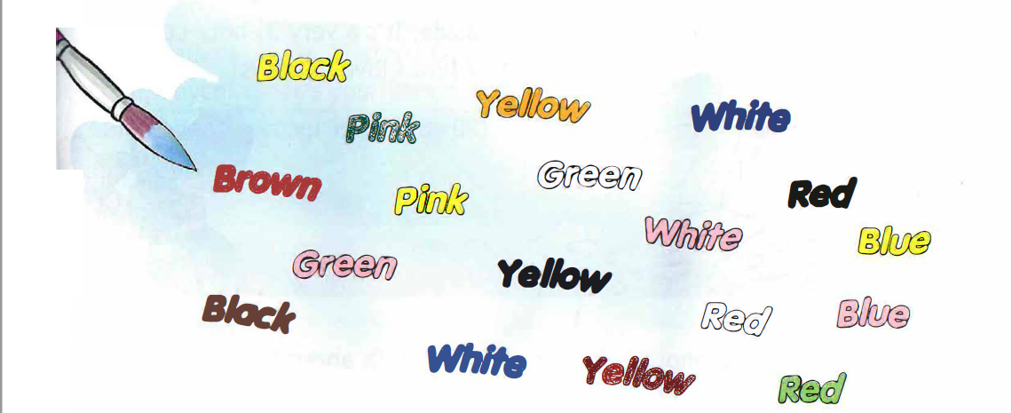
Student 1: black
Student 2: No, it isn’t black. It’s yellow.

Slide 20
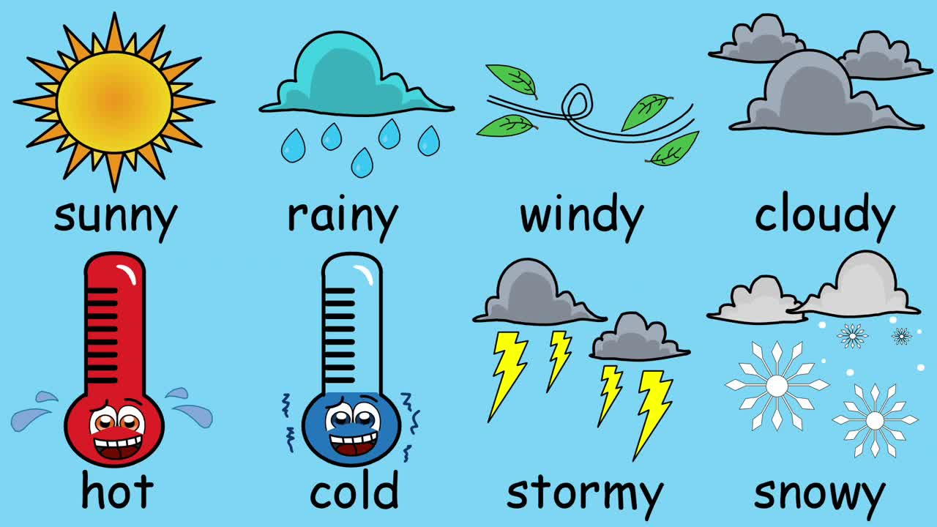
What is the weather like?
It is …

Slide 21
