Slide 1

A happy family

Slide 2

My family
A, B, C, D, E, F,
This is my family.
G, H, I, J,
I love them every day.
K, L, M, N, O,
Mother, father, baby, oh
P, Q, R, S, T,
Brother, sister, you can see
U, V, W, X, Y, Z,
All the people in my family.

Slide 3
Read correctly
Aa
[æ] [ei]
fat
name
has
face
lamp
cake
flag
nanny

Slide 4
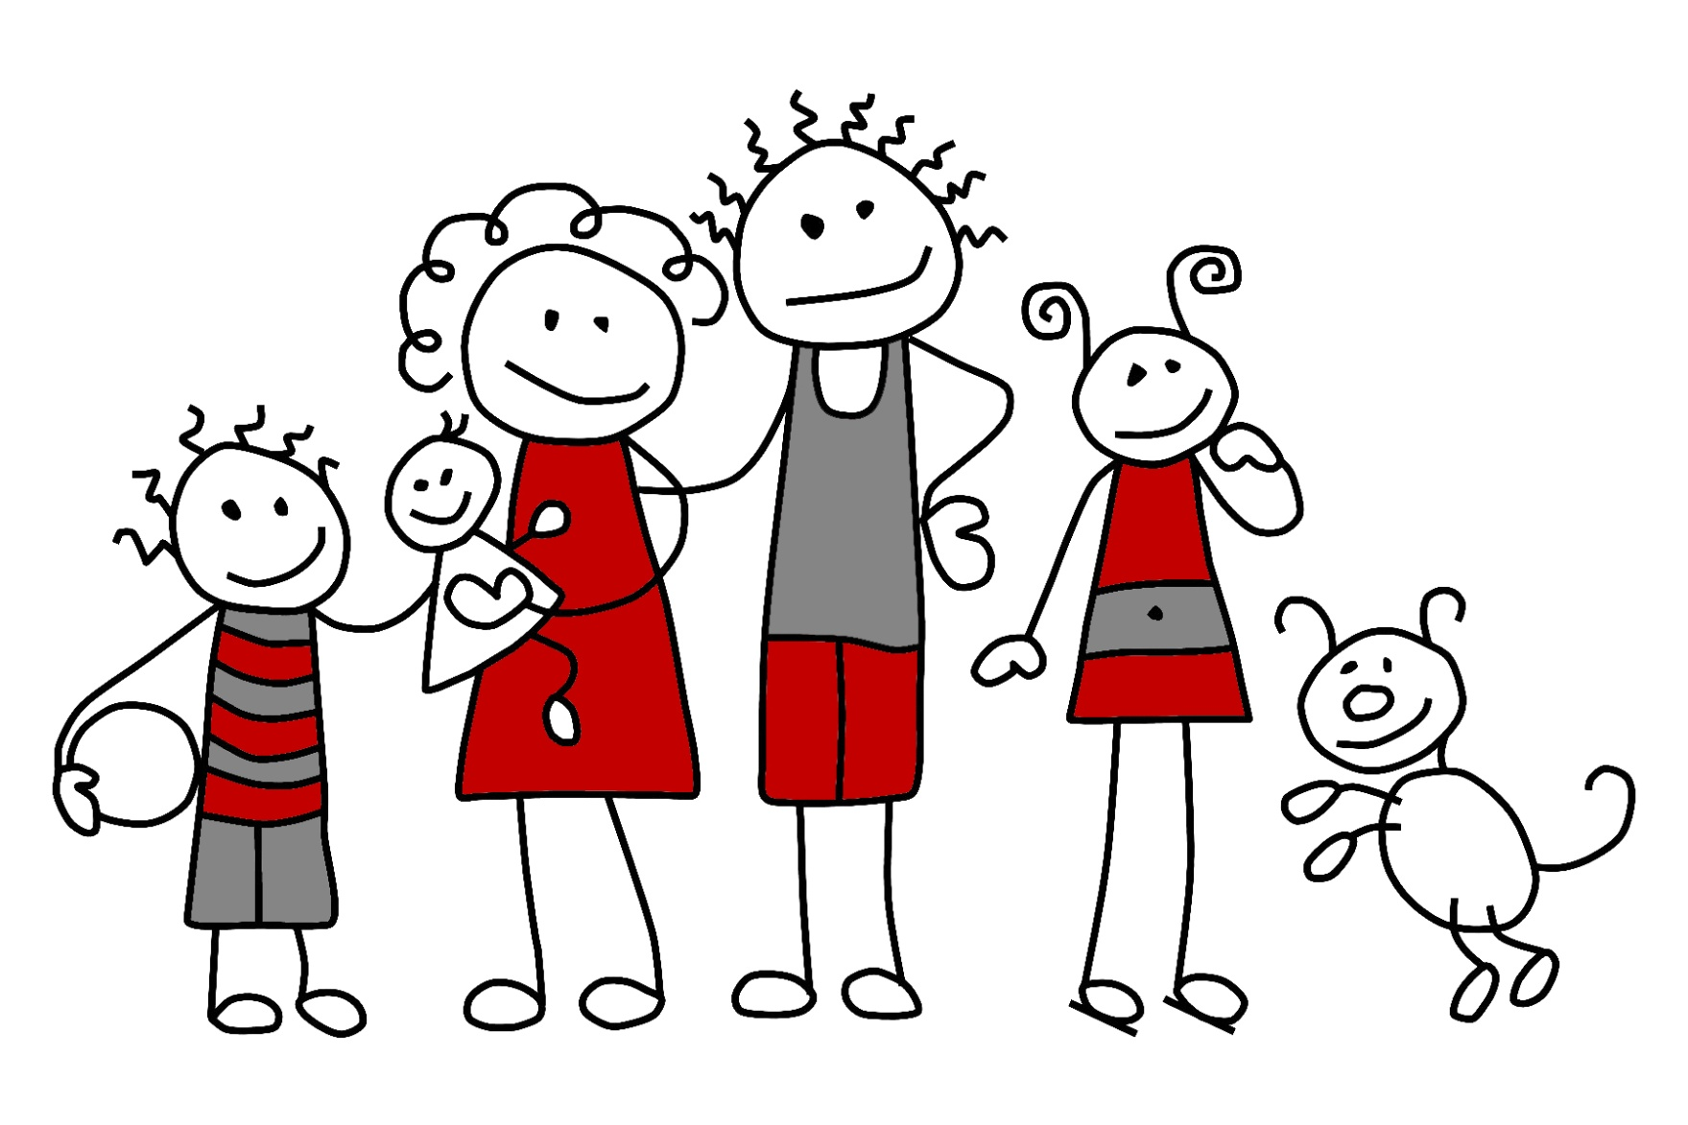
Look at Ron and his … this is his … Her name is …
Jack
Helen
Bess
Ron
Rex

Slide 5
Learn possessive pronouns:
Личное | Перевод | Притяжательное | Перевод
I | я | My | мой
He | Он | His | ?
She | Она | Her | ?
It | Он, она, оно | Its | ?
We | Мы | Our | ?
They | Они | Their | ?
You | Ты, вы | Your | ?

Slide 6
open the brackets:
I have got (my/ her) pet, a cat.
We read (their/ our) books.
She helps (his/ her) mother.
This is Lucy. (She/ Her) hair is dark.

Slide 7


Look and compare:
It is a flower. It’s a flower.
They are flowers. They’re flowers.

Slide 8
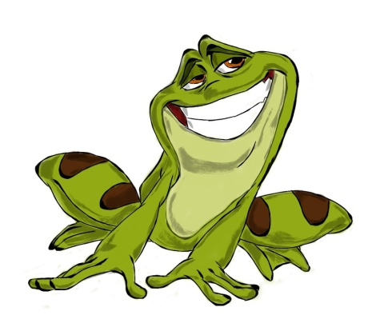

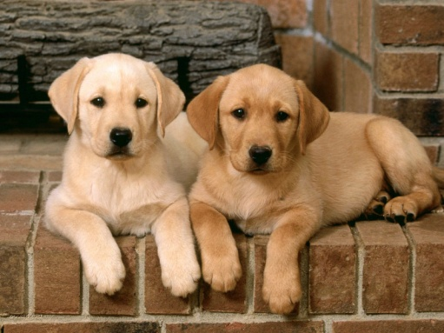
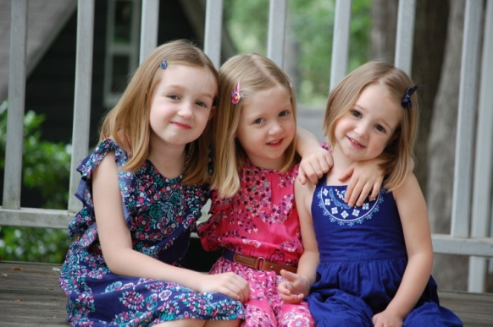
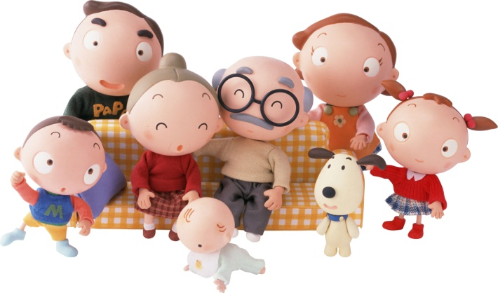
Answer:
Is it a pencil?
Are they books?
Yes, it is. No, it isn’t.
Yes, they are. No, they aren’t.

