Slide 1
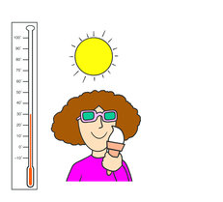
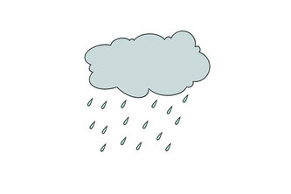

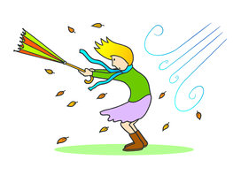
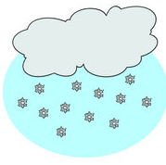
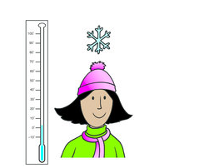
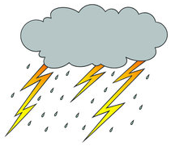

What's the weather like today?
It's…………….today

Slide 2
Y y
[aɪ] [ɪ] fly daddy dry funny sky happy why sunny my windy bye family
My happy family can fly!

Slide 3
A 1 | B 2 | C 3 | D 4 | E 5 | F 67
G 7 | H 8 | I 9 | J 10 | K 11 | L 12
M 13 | N 14 | O 15 | P 16 | Q 17 | R 18
S 19 | T 20 | U 21 | V 22 | W 23 | X 24
Y 25 | Z 26

Slide 4

7 - 4 =
11 - 6 =
11 + 11 =
2 + 3 =
9 + 9 =
- 11 =
7 + 7 =
3 + 6 =
7 + 6 =
20 – 19 =
13 – 1 =
8 + 8 =

Slide 5
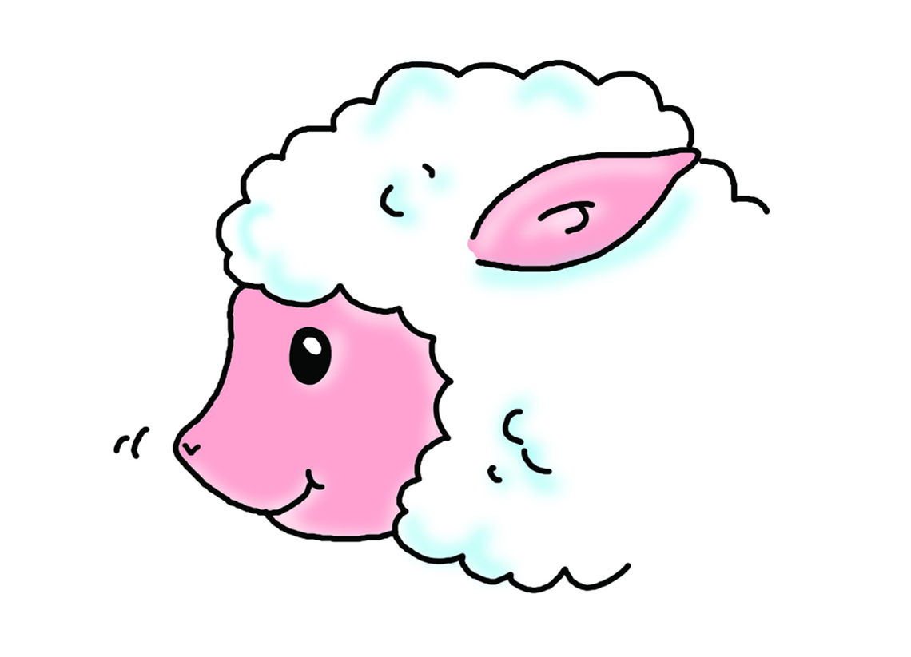
small nose

Slide 6
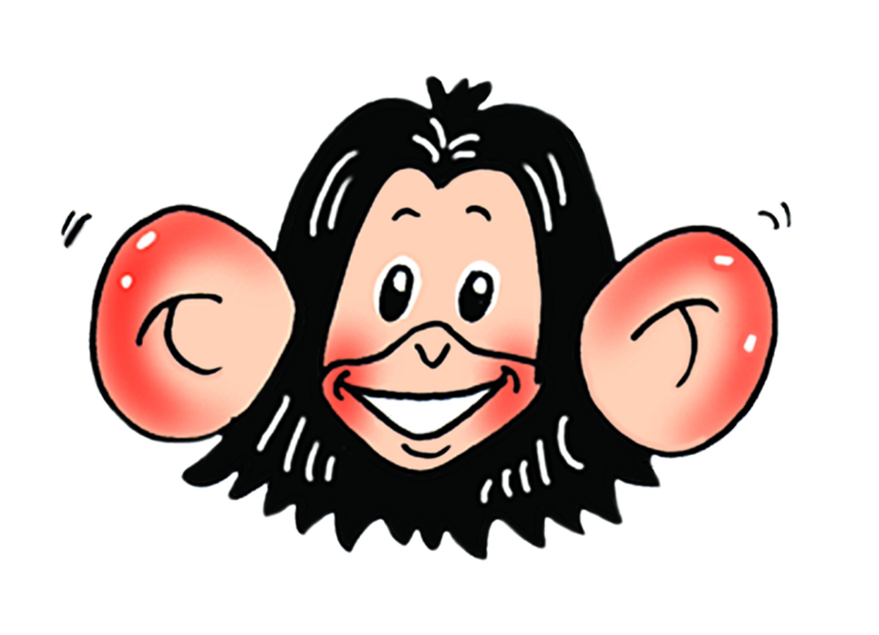
big ears

Slide 7
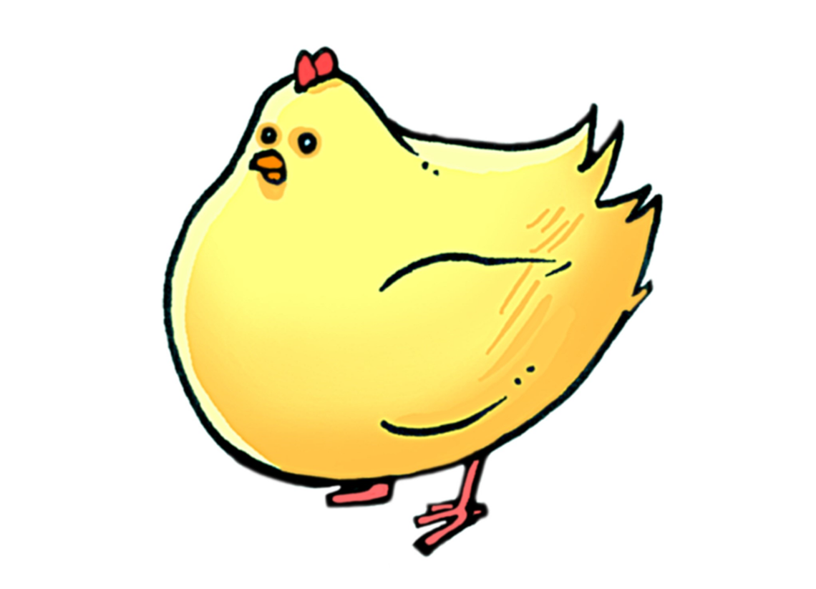
small head

Slide 8

big eyes

Slide 9
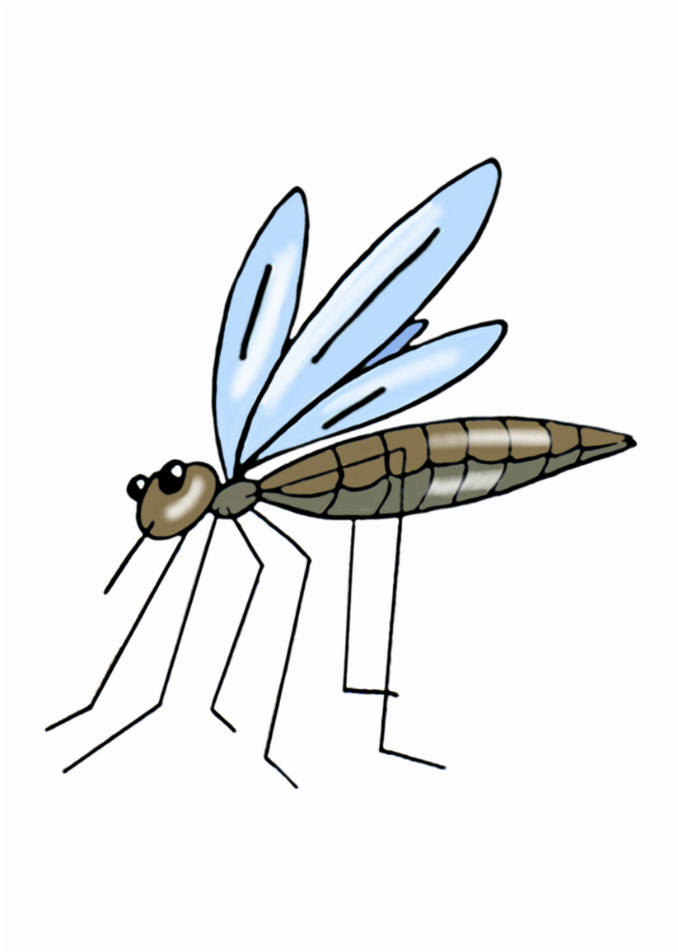
thin legs

Slide 10
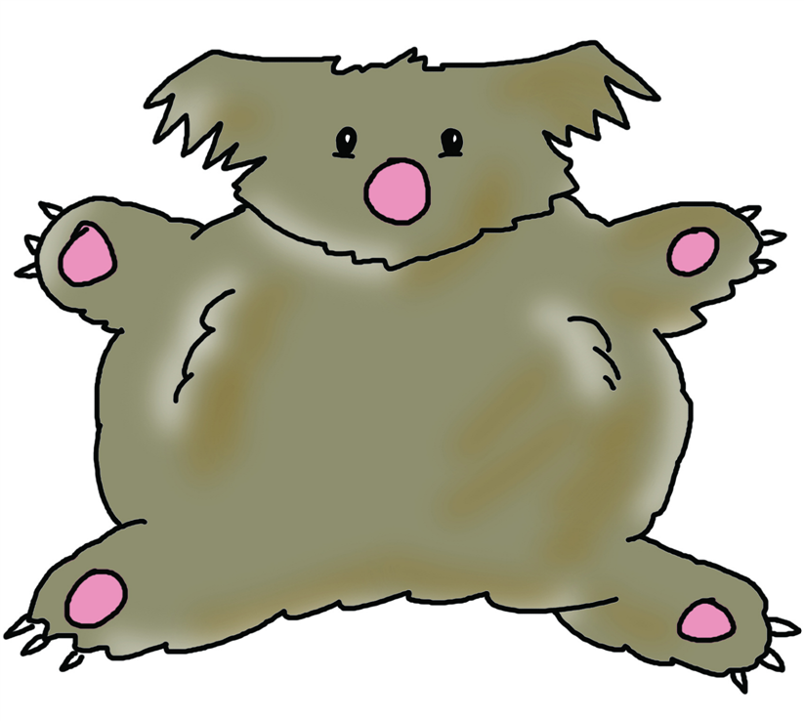
fat body

Slide 11
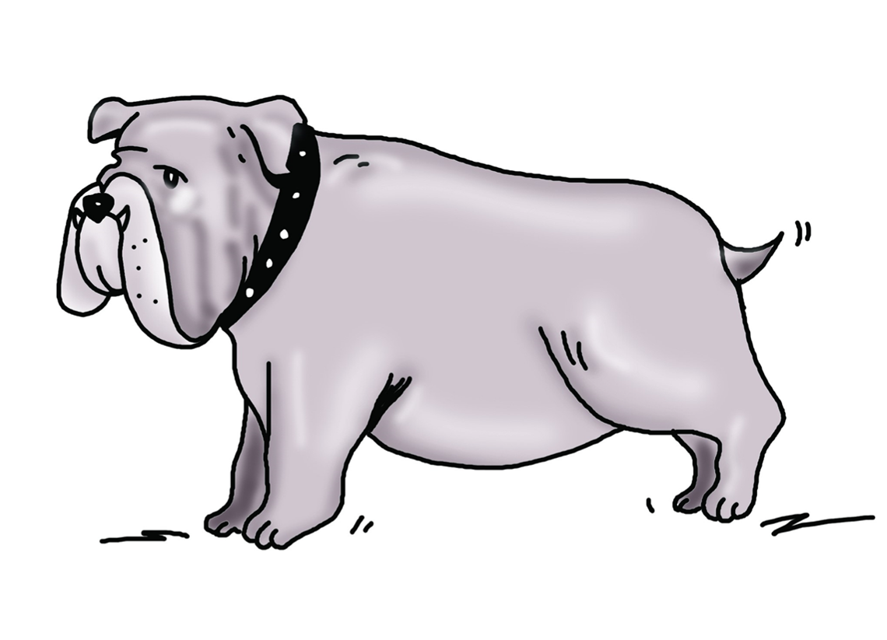
short tail

Slide 12
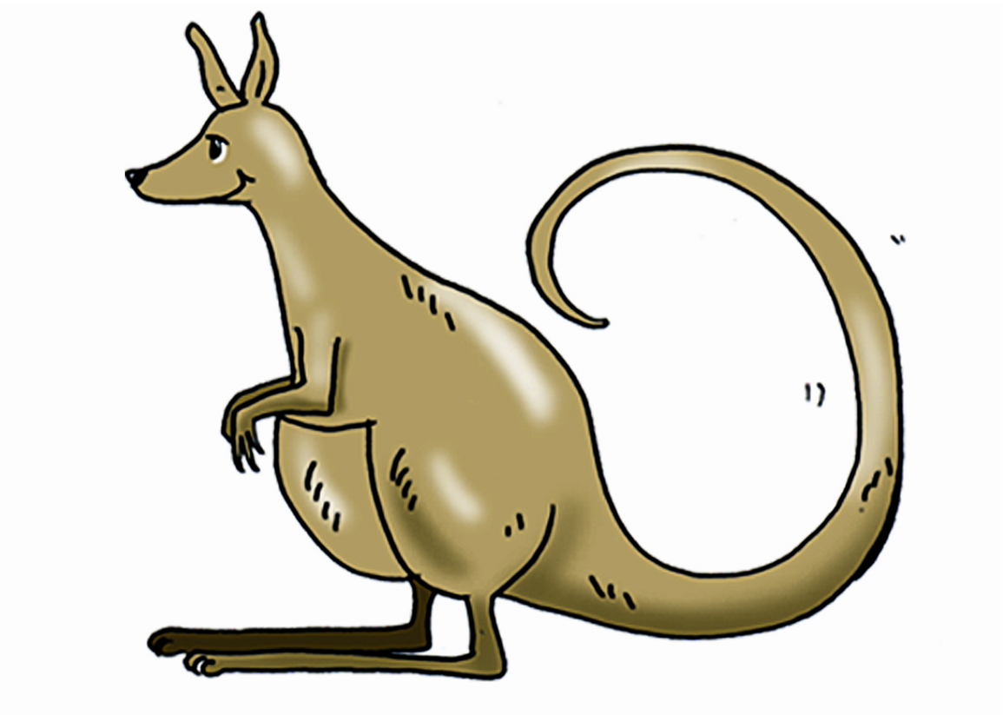
long tail

Slide 13
long tail

Slide 14
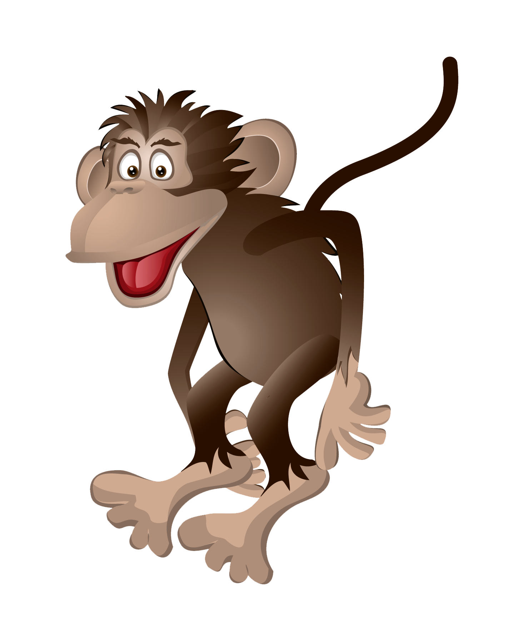
What does it look like?
What has it got?

Slide 15
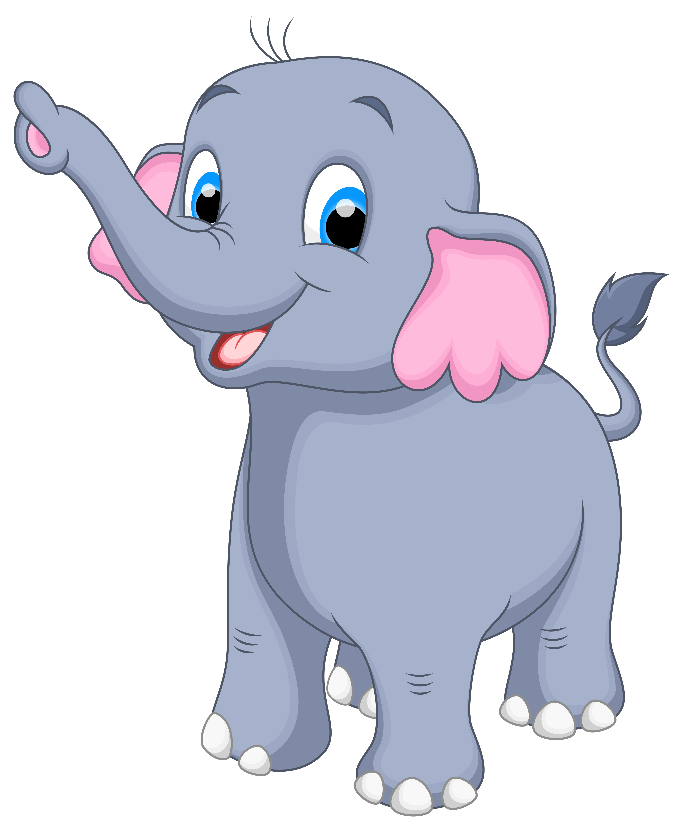
What does it look like?
What has it got?

Slide 16
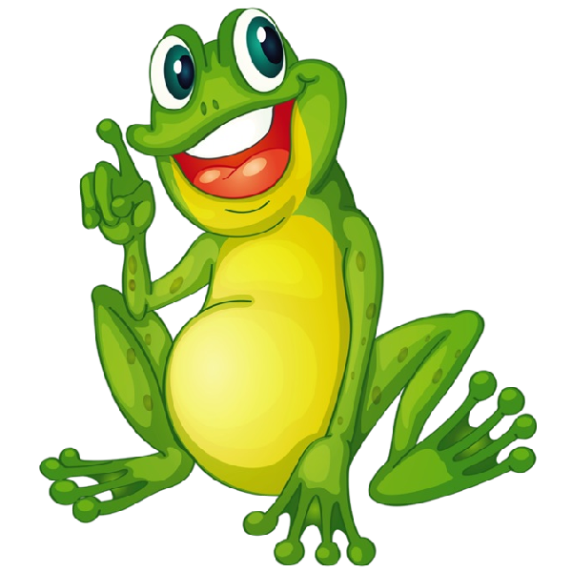
What does it look like?
What has it got?

Slide 17


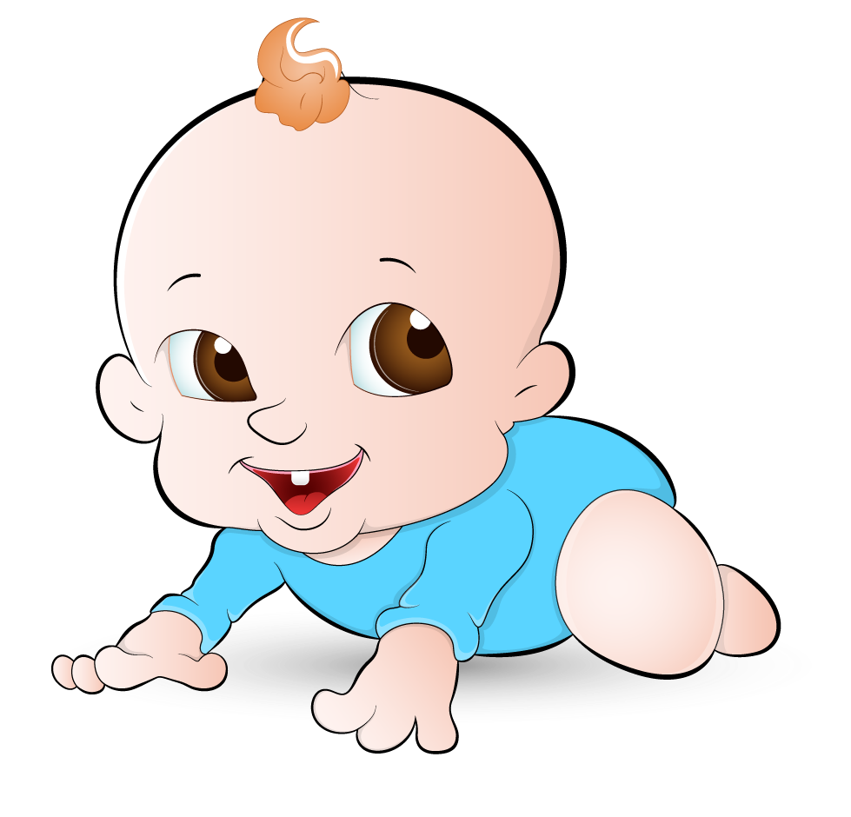
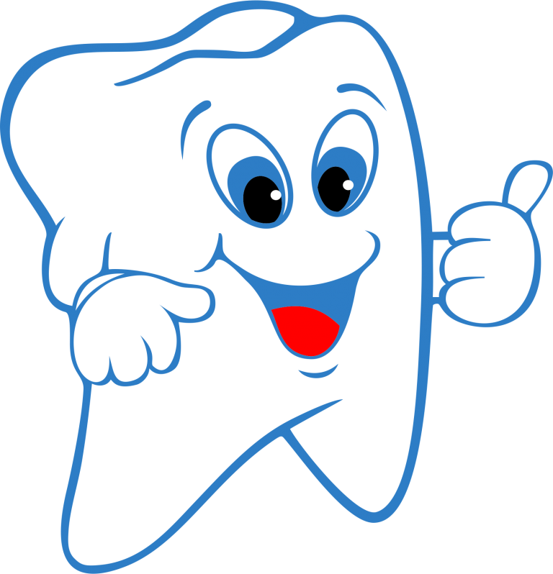
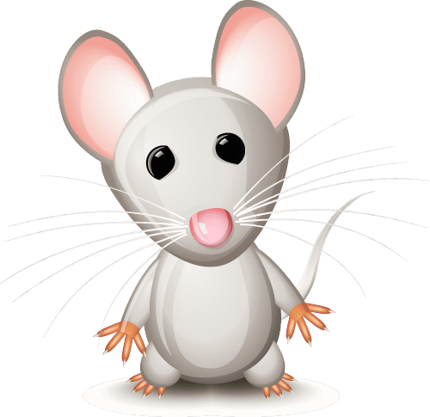
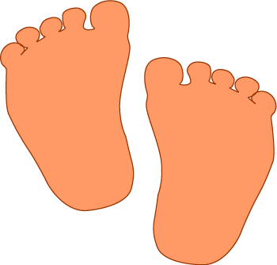
_________________
_________________
_________________
_________________
_________________
_________________
_________________
_________________
_________________
_________________
_________________
_________________

Slide 18
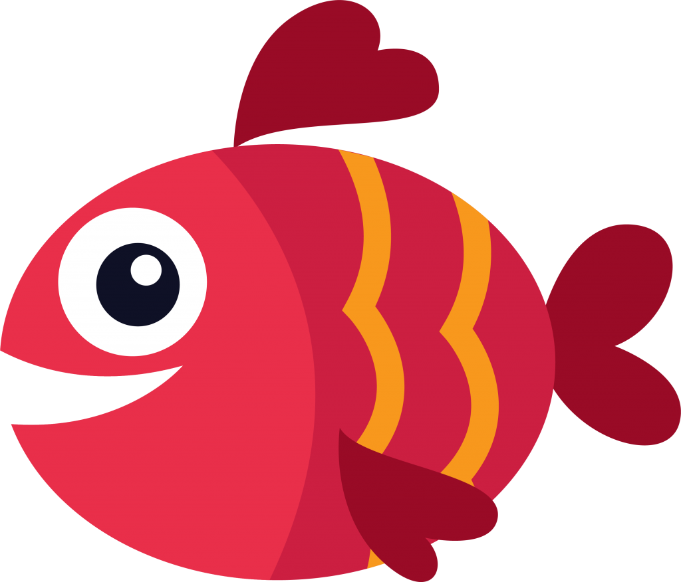
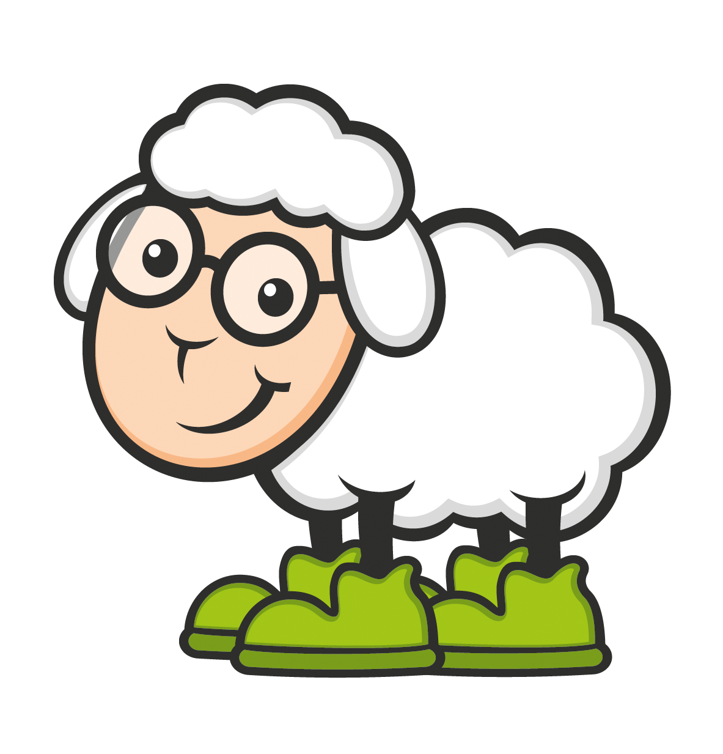
_________________
_________________
_________________
_________________

Slide 19
Образец: one box (4) four boxes
one man (3) ___________________
one tooth (7) ___________________
one child (5) ___________________
one fish (4) ___________________
one mouse (6) ___________________
one sheep (9) ___________________
one foot (2) ___________________
one woman (7) ___________________

Slide 20
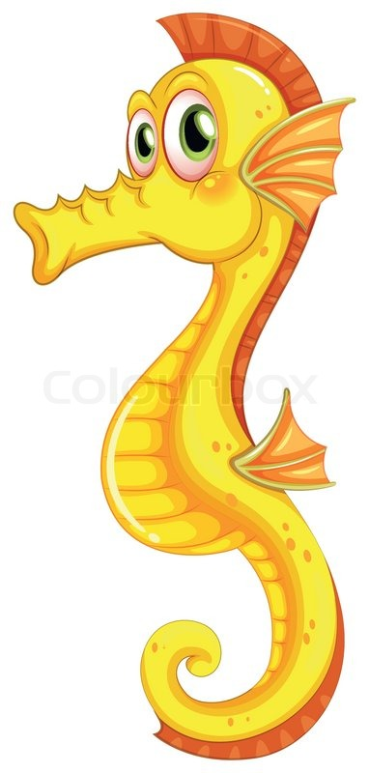
a seahorse

Slide 21
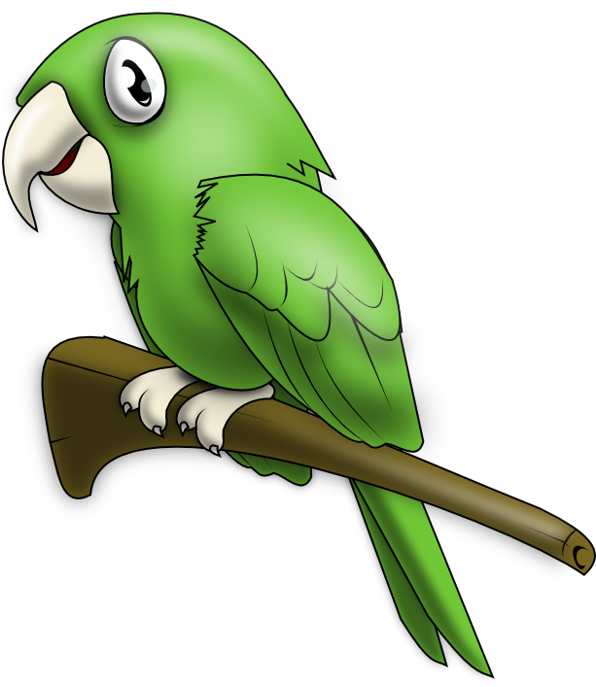
a parrot

Slide 22
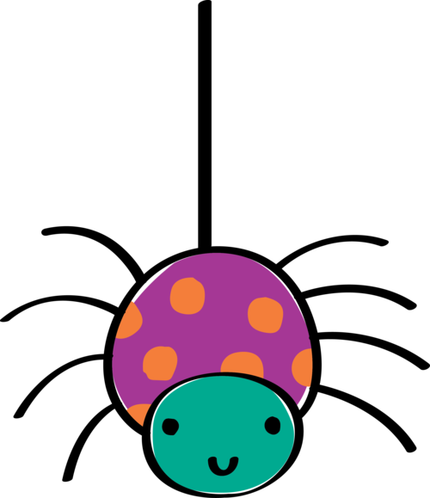
a spider

Slide 23

a tortoise

Slide 24
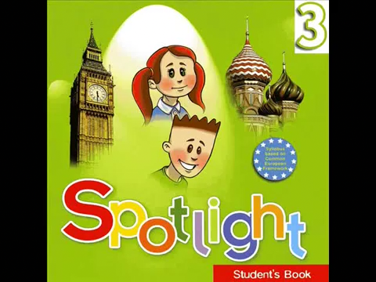
What can crawl?

Slide 25
Can a spider talk?
No, it can’t
Can a parrot talk?
Yes, it can

Slide 26
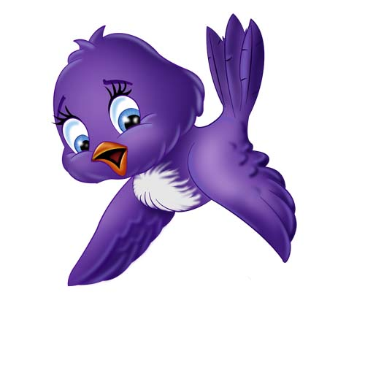
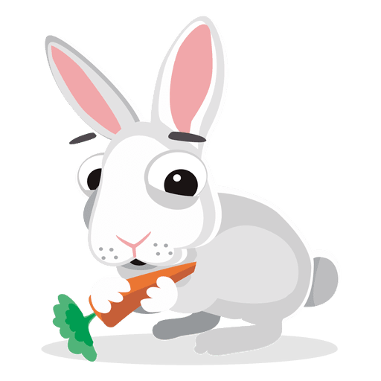
What can they do?
crawl
fly
jump
walk
talk
swim

Slide 27
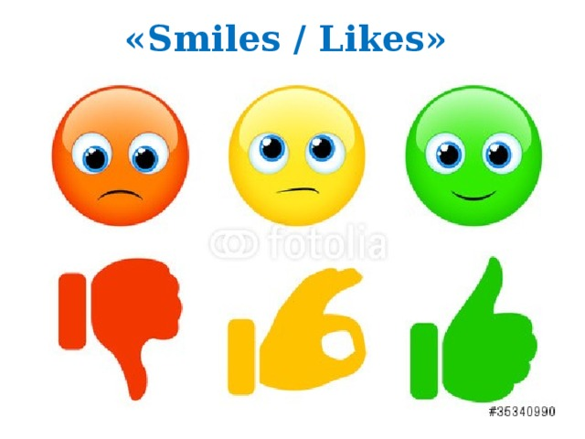

Slide 28
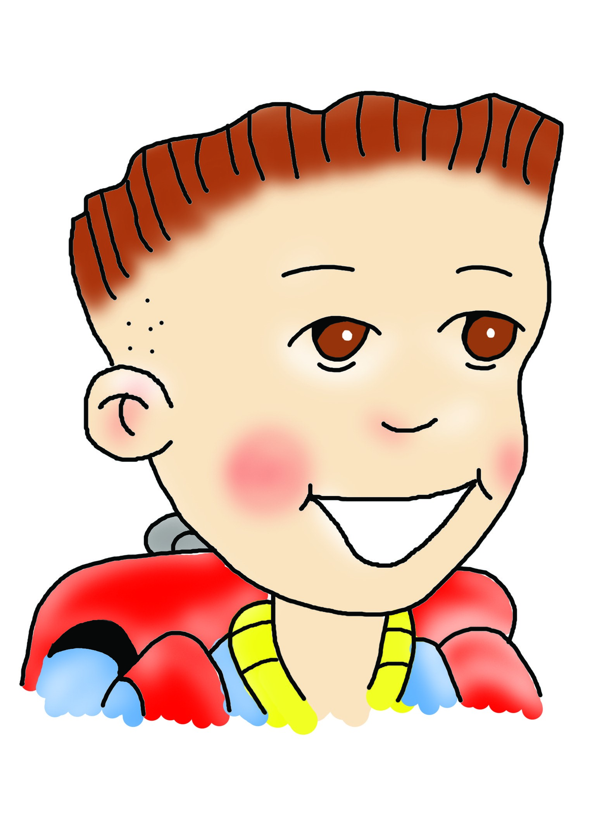
Well done!

