Slide 1
Cows are funny

Slide 2
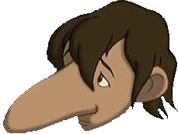
Big or small
Big or small
Is this small?
Not at all!

Slide 3
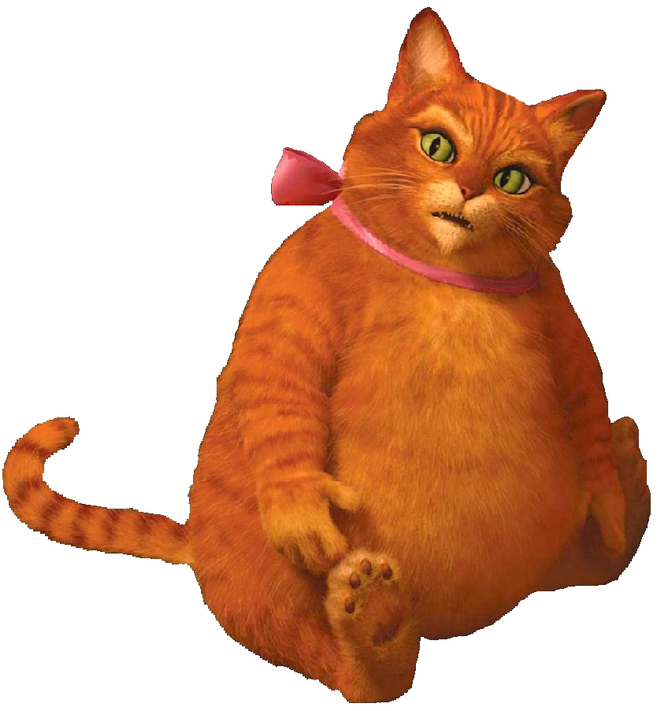
Fat or thin
Fat or thin
Is it thin?
What do you think?

Slide 4

Long or short
Long or short
Is that short?
No, it’s not!

Slide 5
Употребление глагола to have got
Когда мы хотим сказать, что у кого-то что-то
есть
или нет.

Slide 6
Утвердительные предложения
I
You
They
We
have
got
He
She
It
has
You
have
got
a
big
nose.
It
has
got
a
fat
body.

Slide 7
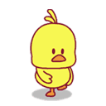
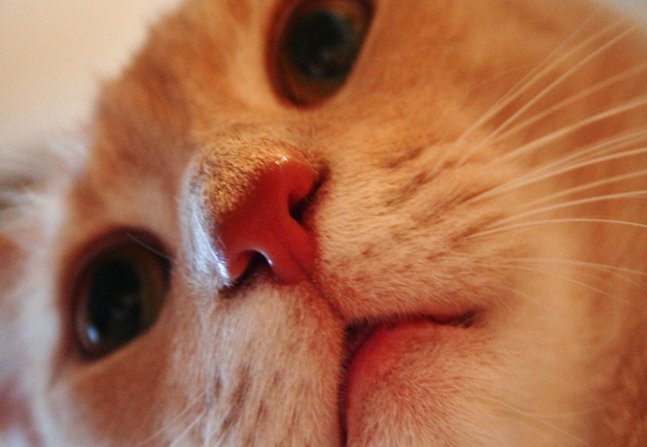
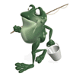
Have got / has got
Вставь-ка
has
1. A chick got a big head.
2. A cat got a small nose.
has
3. Frogs got small ears.
have

Slide 8

Отрицательное предложения
I
You
They
We
have
not
(haven’t)
got
He
She
It
has
not
(hasn’t)
Frogs
haven’t
got
a
big
nose.
A dog
hasn’t
got
a
fat
body.

Slide 9
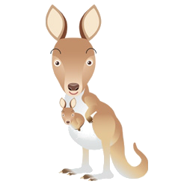
A kangaroo has got a short tail.
A kangaroo hasn’t got a short tail.
short
long
A kangaroo has got a long tail.

Slide 10
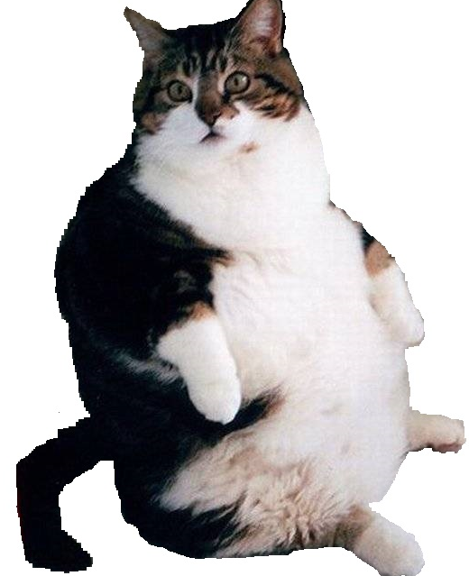
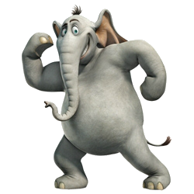
Исправь-ка
1. A cat has got a thin body.
A cat hasn’t got a thin body.
thin
fat
A cat has got a fat body.
2. Elephants have got short legs.
Elephants haven’t got short legs.
short
long
2. Elephants have got long legs.

Slide 11
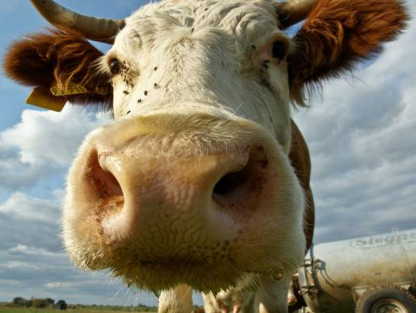
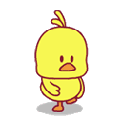
Вопросительное предложения
I
You
They
We
?
Have
got
He
She
It
Has
?
Have
cows
got
a
small
nose
No, they haven’t
?
Has
a hen
got
a
big
head
Yes, it has

Slide 12


Спроси - Ответь
1
A dog
a short tail
-Has a dog got a short tail?
-No, it hasn’t
2
Frogs
thin legs
-Have frogs got thin legs?
-Yes, they have

Slide 13
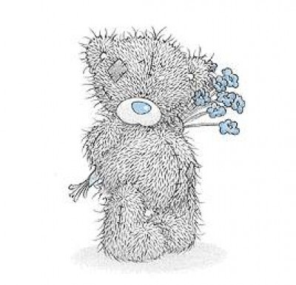
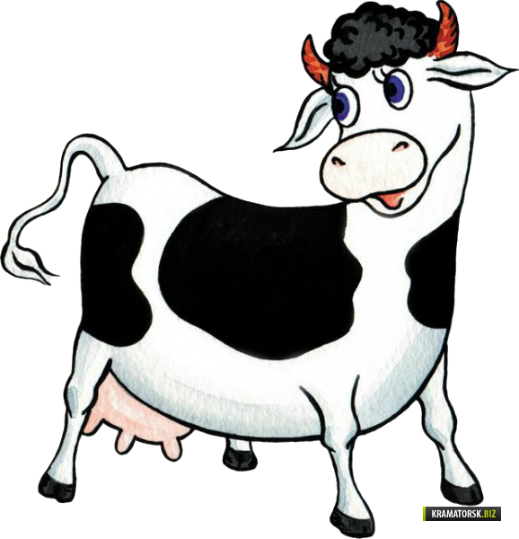
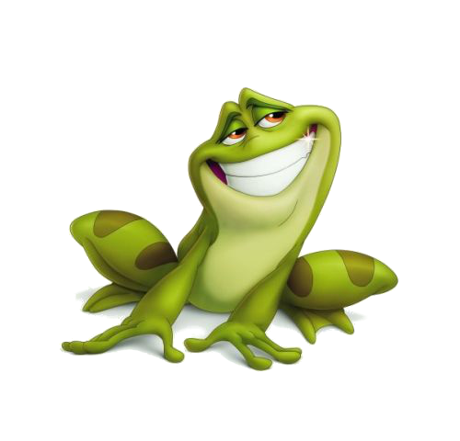
Угадай-ка

Slide 14
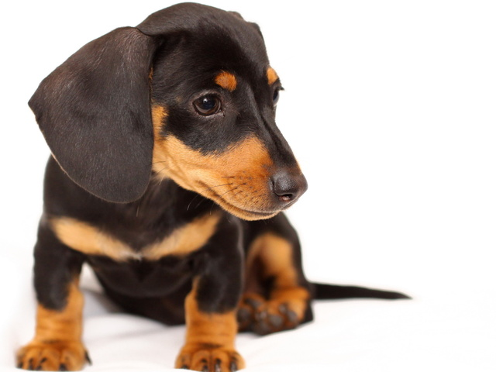
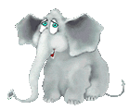
Угадай-ка

Slide 15
Let’s sing!

Slide 16
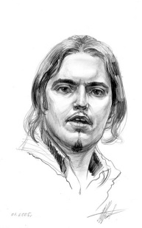

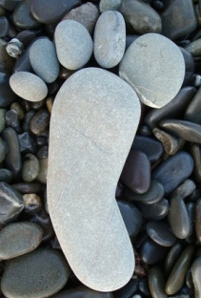

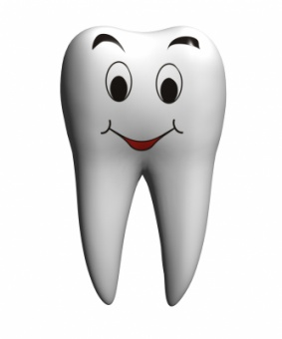
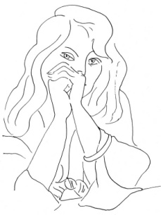
ПОМЕНАЙ-КА
A E | OO EE
MAN MEN | FOOT FEET
WOMAN WOMEN | TOOTH TEETH

Slide 17
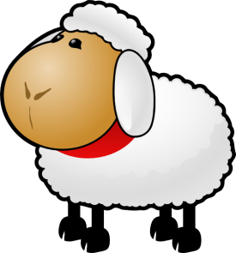
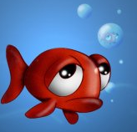
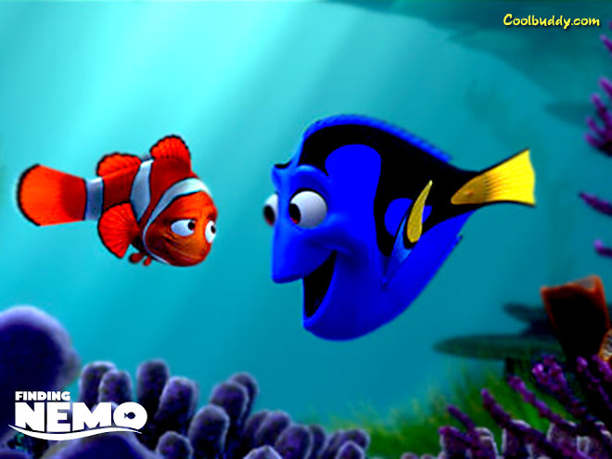
НЕ МЕНАЙ-КА
SHEEP SHEEP | FISH FISH

Slide 18
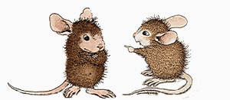
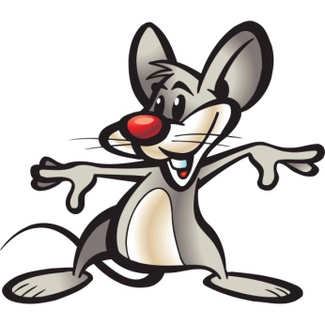
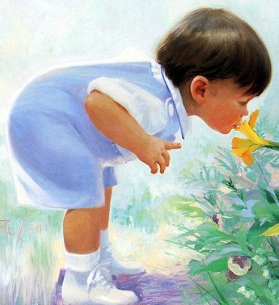
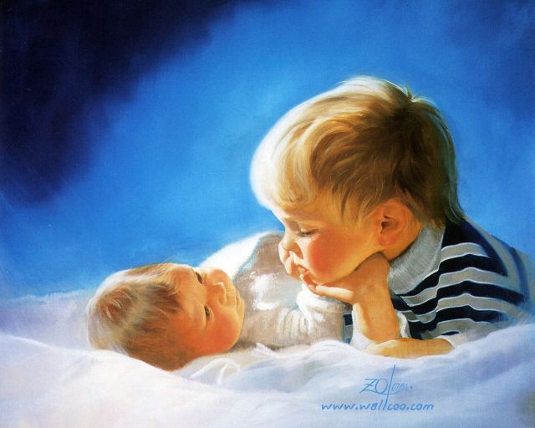
ЗАПОМИНАЙ-КА
MOUSE MICE
CHILD CHILDREN

Slide 19
Посчитай-ка
10
woman
ten women

Slide 20
Посчитай-ка
2
mouse
two mice

Slide 21
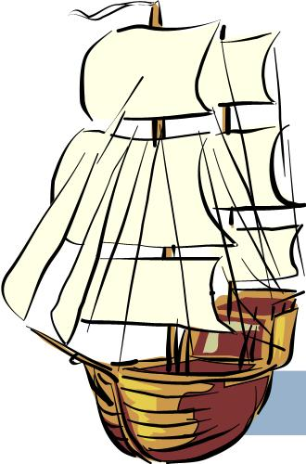
Посчитай-ка
6
ship
six ships

Slide 22
Посчитай-ка
1
child
one child

Slide 23
Homework!
SB ex 2 p 76 (ч) ex 6 p 75(уч)
WB ex 3 p 39

