Slide 1
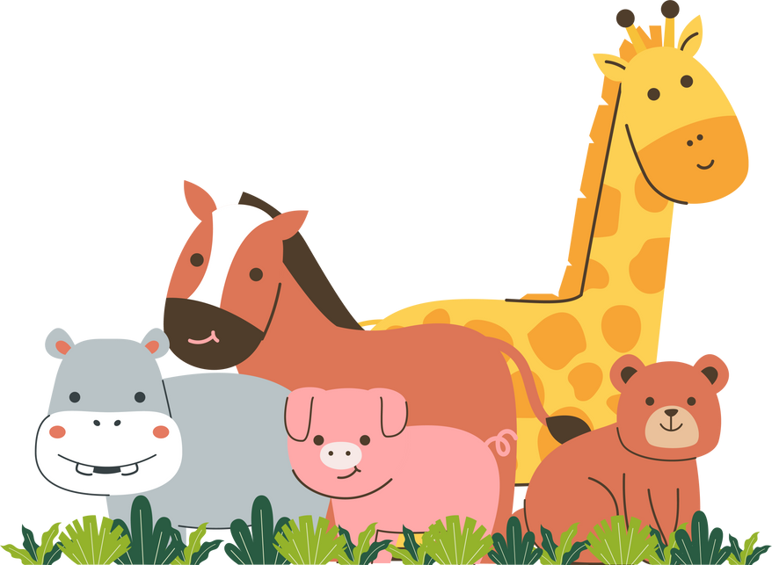


Name:
Date:
Grammar Time
1. Прочитай предложения и обведи правильный вариант.
  I were / was at the cinema yesterday.
  They was / were at the zoo last Sunday.
  She was / were not at home in the morning.
  We were / was happy to see you.
  He was / were noisy in class.
  You were / was sad yesterday.
  It were / was a great day!
2. В каждом предложении есть одна ошибка. Найди её, исправь и перепиши предложение правильно.
  We was at the park. → _________________________________
  You was at the circus. → _________________________________
  They was good children. → _________________________________
  I were at home yesterday. → _________________________________
  She were quiet. → _________________________________
3. Составь вопросы к следующим ответам.
1. Q: Was he at the zoo?
A: Yes, he was at the zoo.
2. Q: _________________________
A: No, they weren't at the cinema. They were at the circus.
3. Q: _________________________
A: Yes, I was a clever child.
4. Q: _________________________
A: No, she wasn't in the park. She was at home.
5. Q: _________________________
A: Yes, my parents were very tired yesterday evening.
6. Q: _________________________
A: No, it wasn't sunny yesterday. It was rainy and cold
1

Slide 2






4. Прочитай короткие истории от детей. Вставь пропущенные слова: was, wasn't, were, weren't.
1) Hi! I _______ at the funfair on Saturday. It _______ amazing! But my brother _______ with me. He _______ ill.
2) We _______ at school yesterday. Our lessons _______ interesting. The teachers _______ very kind.
3) My cat _______ in the garden. It _______ on the sofa! It _______ sleepy.
4) Where _______ you yesterday? You _______ at the party! All my friends _______ there, but you _______ .
5) The weather _______ nice on Monday. It _______ warm and sunny. We _______ in the park all day.
6) I _______ hungry in the morning, so I _______ late for school. My sandwiches _______ in my bag, but I _______ happy to eat them later.
5. Подпиши каждую эмоцию правильным словом.
6. Напиши 4 предложения про себя и членов своей семьи, какими вы были в детстве. Используй глаголы was, were, wasn’t, weren’t.
2

Slide 3
ОТВЕТЫ
Grammar Time
1. Прочитай предложения и обведи правильный вариант.
  I were / was at the cinema yesterday.
  They was / were at the zoo last Sunday.
  She was / were not at home in the morning.
  We were / was happy to see you.
  He was / were noisy in class.
  You were / was sad yesterday.
  It were / was a great day!
2. В каждом предложении есть одна ошибка. Найди её, исправь и перепиши предложение правильно.
  We was at the park. → _________________________________
  You was at the circus. → _________________________________
  They was good children. → _________________________________
  I were at home yesterday. → _________________________________
  She were quiet. → _________________________________
We were at the park.
You were at the circus.
They were good children.
I was at home yesterday.
She was quiet.
3. Составь вопросы к следующим ответам.
1. Q: Was he at the zoo?
A: Yes, he was at the zoo.
2. Q: _________________________
A: No, they weren't at the cinema. They were at the circus.
3. Q: _________________________
A: Yes, I was a clever child.
4. Q: _________________________
A: No, she wasn't in the park. She was at home.
5. Q: _________________________
A: Yes, my parents were very tired yesterday evening.
6. Q: _________________________
A: No, it wasn't sunny yesterday. It was rainy and cold
Were they at the cinema?
Were you a clever child?
Was she in the park?
Were your parents tired?
Was it sunny yesterday?
3

Slide 4
4. Прочитай короткие истории от детей. Вставь пропущенные слова: was, wasn't, were, weren't.
1) Hi! I _______ at the funfair on Saturday. It _______ amazing! But my brother _______ with me. He _______ ill.
2) We _______ at school yesterday. Our lessons _______ interesting. The teachers _______ very kind.
3) My cat _______ in the garden. It _______ on the sofa! It _______ sleepy.
4) Where _______ you yesterday? You _______ at the party! All my friends _______ there, but you _______ .
5) The weather _______ nice on Monday. It _______ warm and sunny. We _______ in the park all day.
6) I _______ hungry in the morning, so I _______ late for school. My sandwiches _______ in my bag, but I _______ happy to eat them later.
was
was
wasn’t
was
were
were
were
wasn’t
was
was
were
weren’t
were
were
was
was
were
wasn’t
was
were
was
5. Подпиши каждую эмоцию правильным словом.
naughty
quiet
cute
good/happy
noisy
clever
6. Напиши 4 предложения про себя и членов своей семьи, какими вы были в детстве. Используй глаголы was, were, wasn’t, weren’t.
Например:
I wasn’t a quiet baby, I was naughty.
My mother was a cute baby.
4

