Slide 1
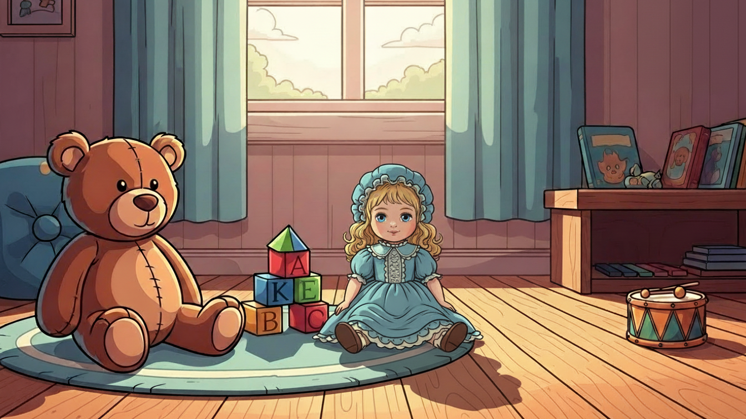
In my room!
8A

Slide 2
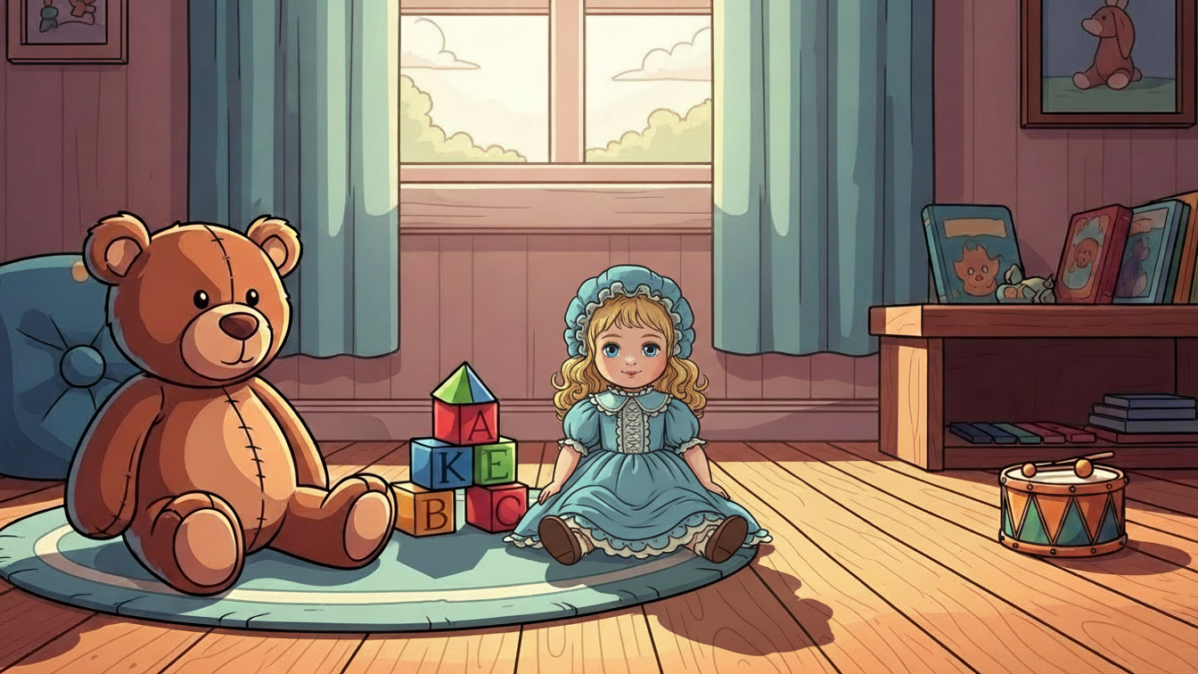




computer
TV
It is a computer.
It is a TV.
radio
armchair
It is a radio.
It is an armchair.

Slide 3
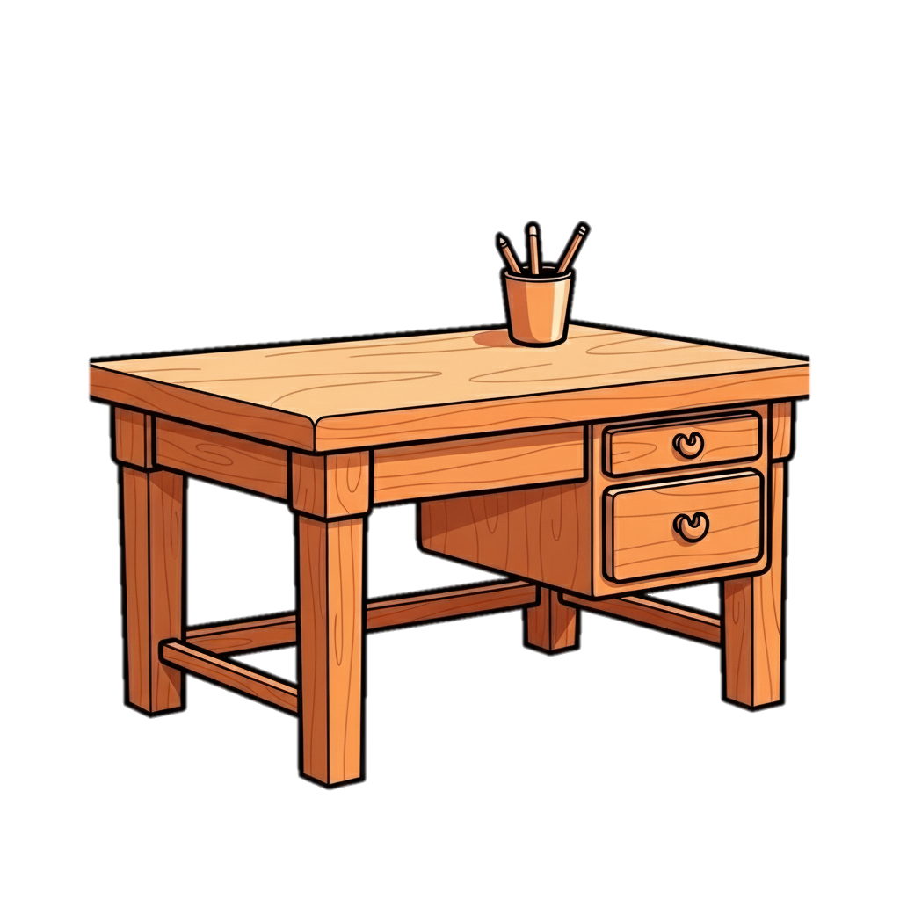
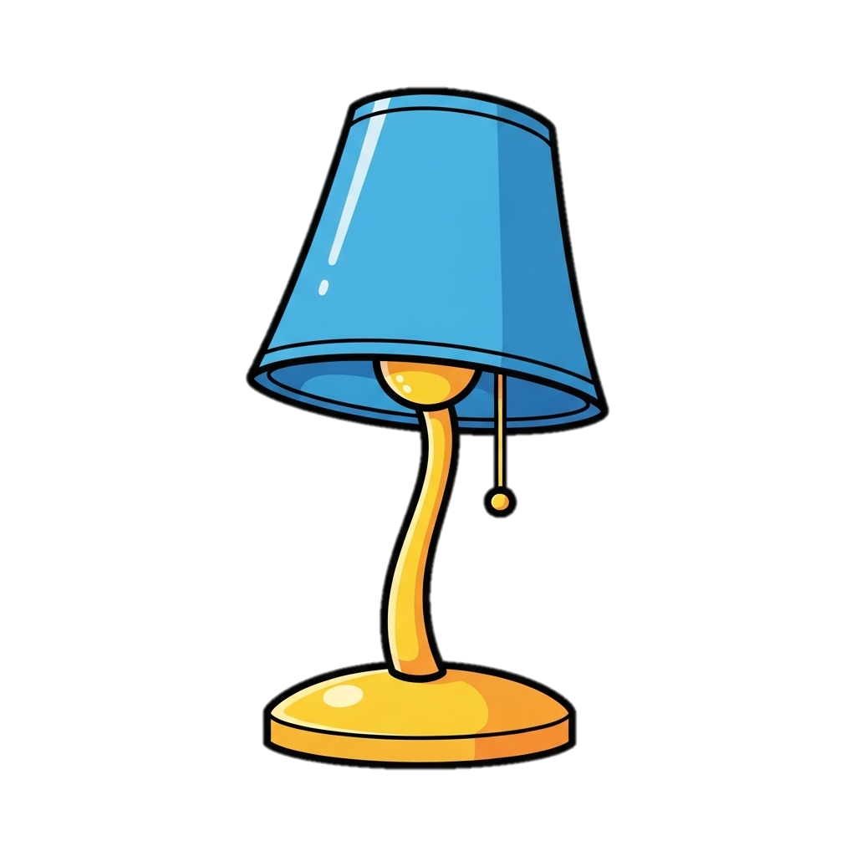
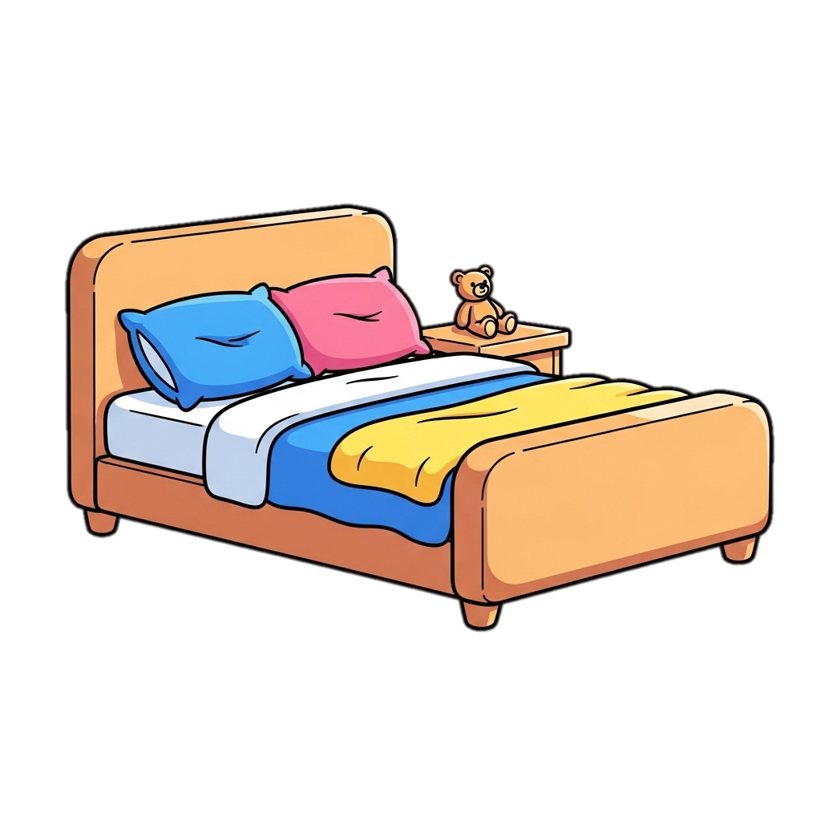
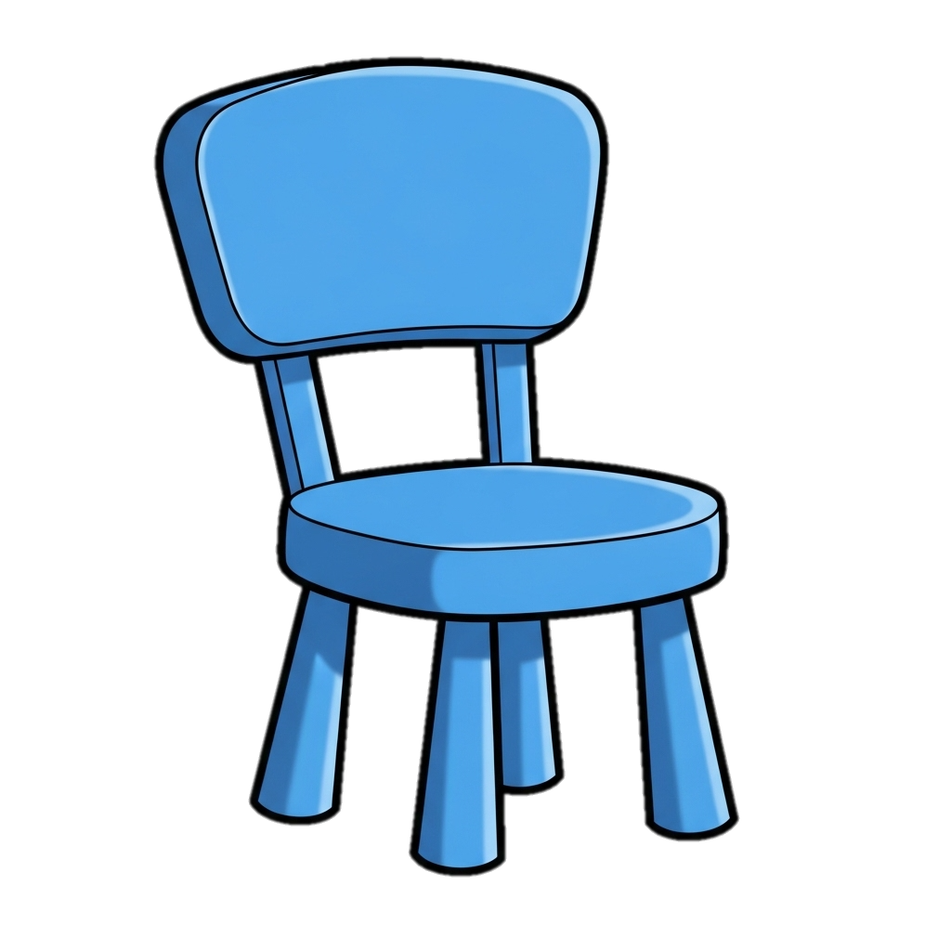
desk
lamp
It is a desk.
It is a lamp.
bed
chair
It is a bed.
It is a chair.

Slide 4


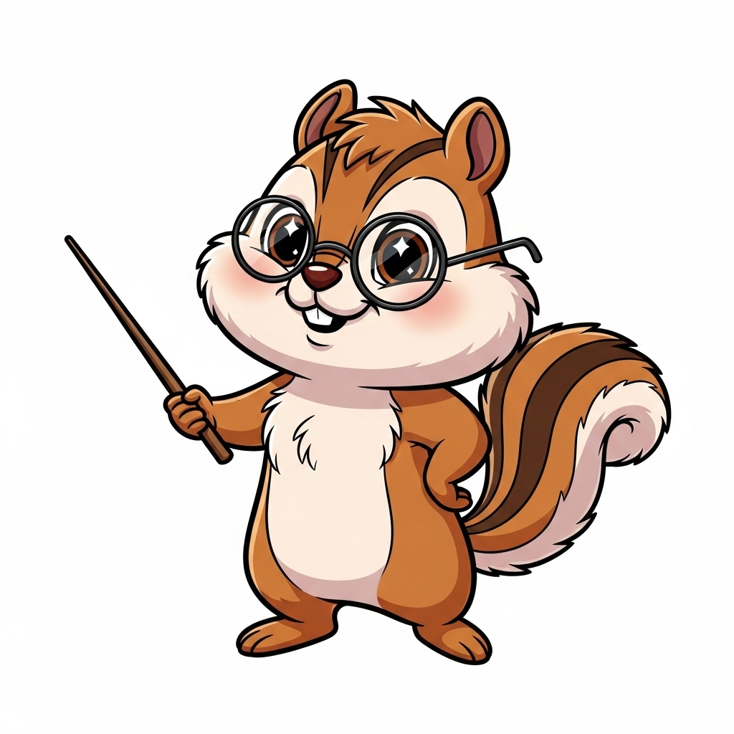
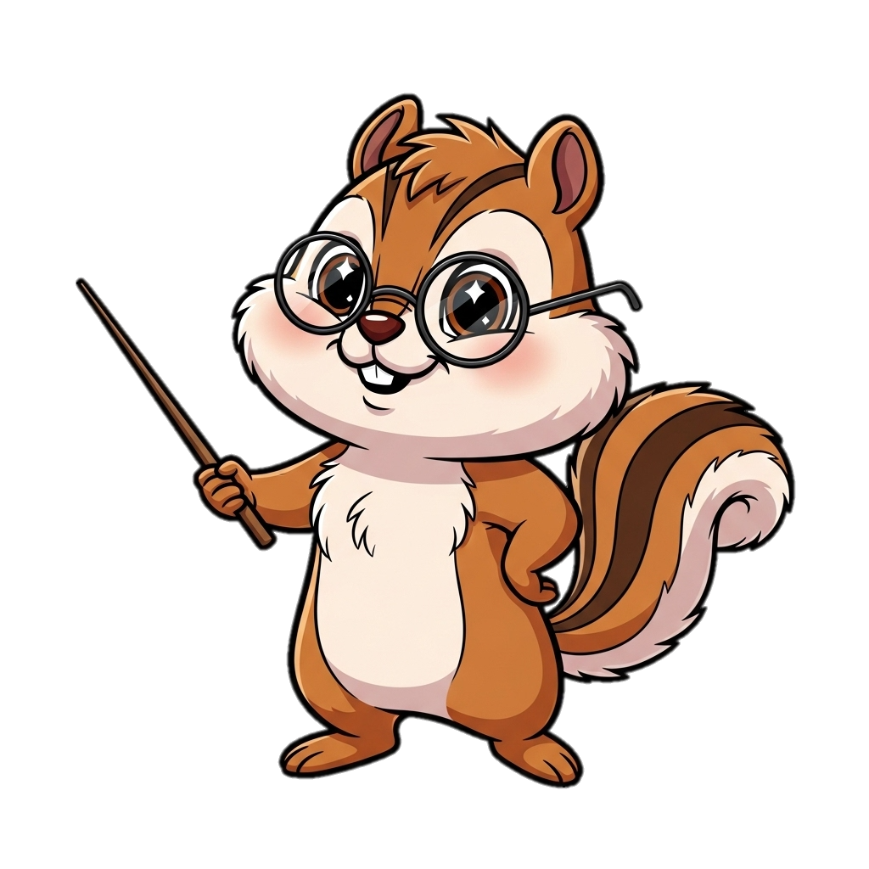
Read and learn.
This is a ball.
These are balls.
That is a ball.
Those are balls.

Slide 5
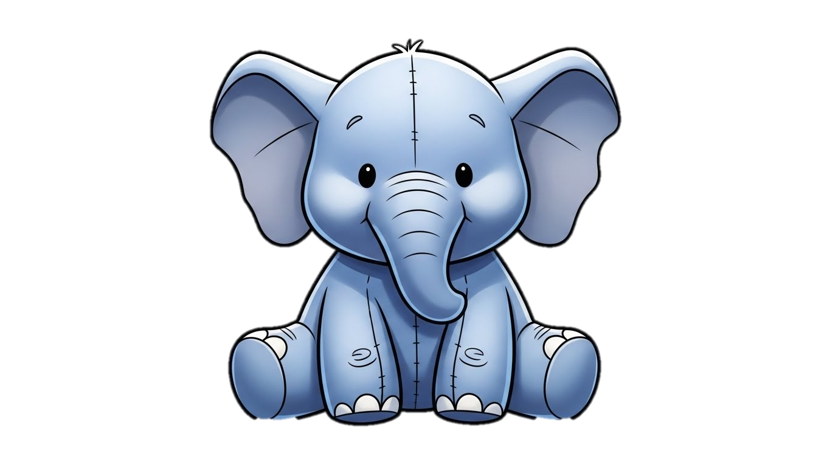

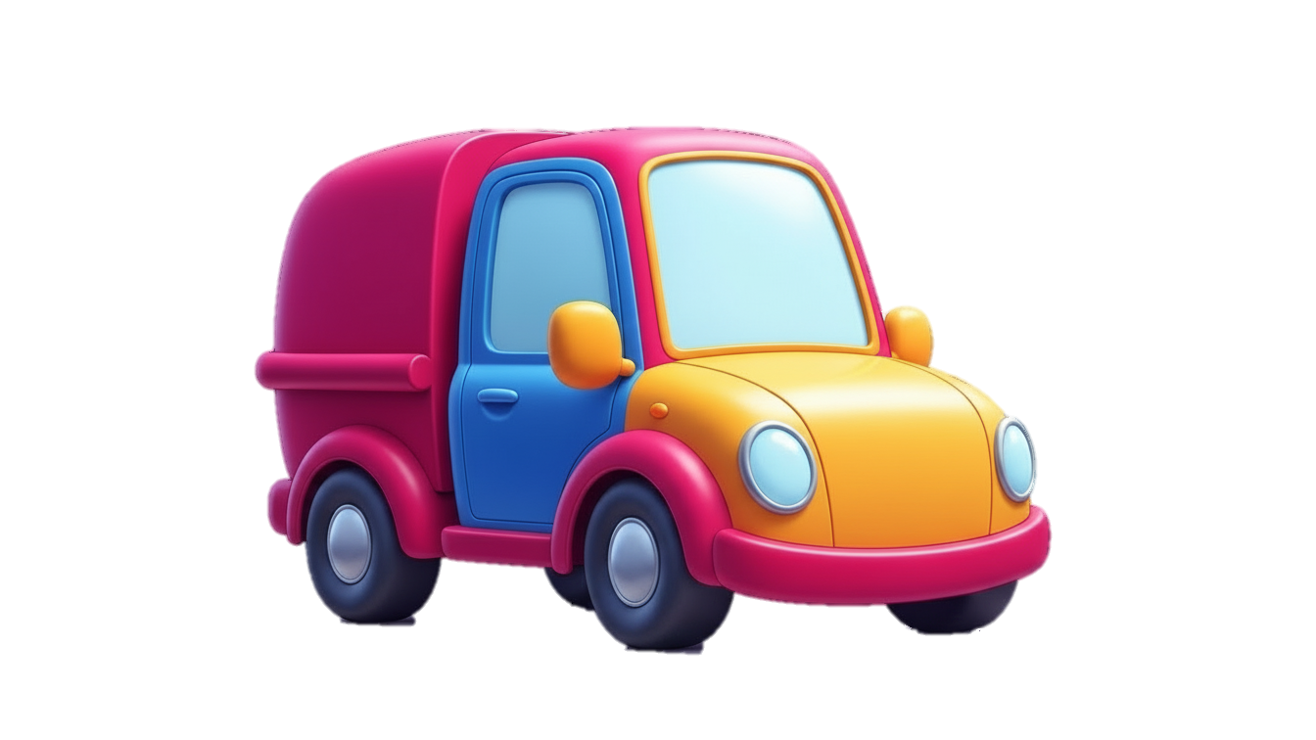
Match.
a
b
___________________________________________
___________________________________________
___________________________________________
___________________________________________
___________________________________________
___________________________________________
This is a lamp.
Those are cars.
That is a radio.
This is an elephant.
This is a car.
These are balls.
c
f
e
c
d
a
d
b
e
f

Slide 6
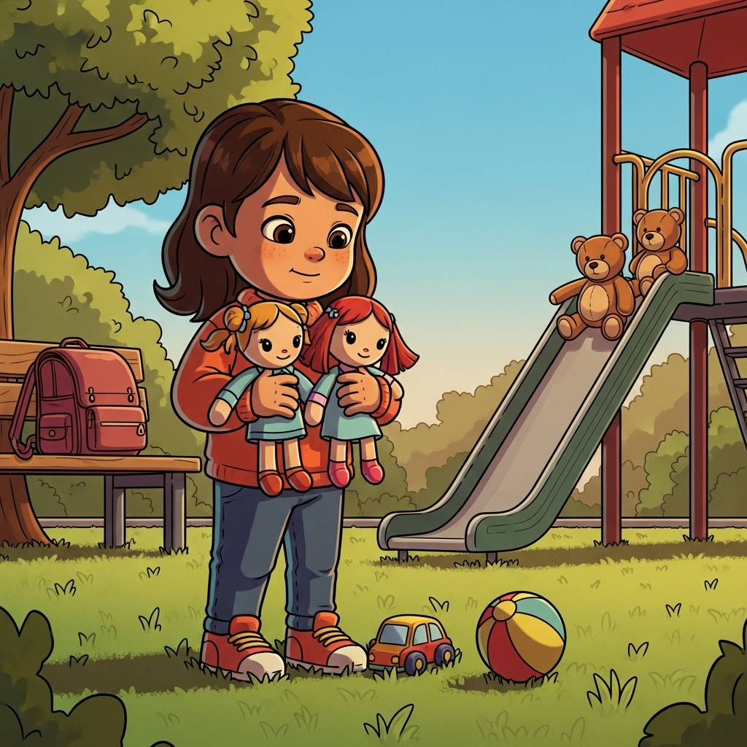
Hello. My name is Rosy. These are my toys.
(doll)
____________________________________________
____________________________________________
____________________________________________
____________________________________________
____________________________________________
These are my dolls.
(ball)
This is my ball.
(teddy bear)
Those are my teddy bears.
(car)
This is my car.
(school bag)
That is my school bag.

Slide 7
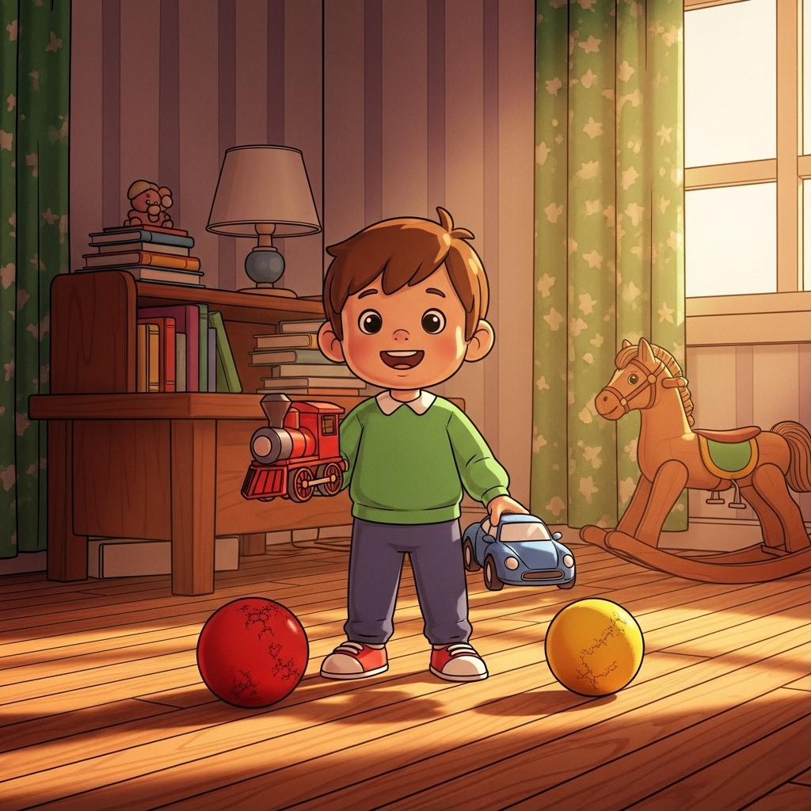
Hello. My name is Alex. These are my toys.
(train)
____________________________________________
____________________________________________
____________________________________________
____________________________________________
____________________________________________
This is my train.
(ball)
These are my balls.
(car)
This is my car.
(book)
Those are my books.
(rocking horse)
That is my rocking horse.

Slide 8
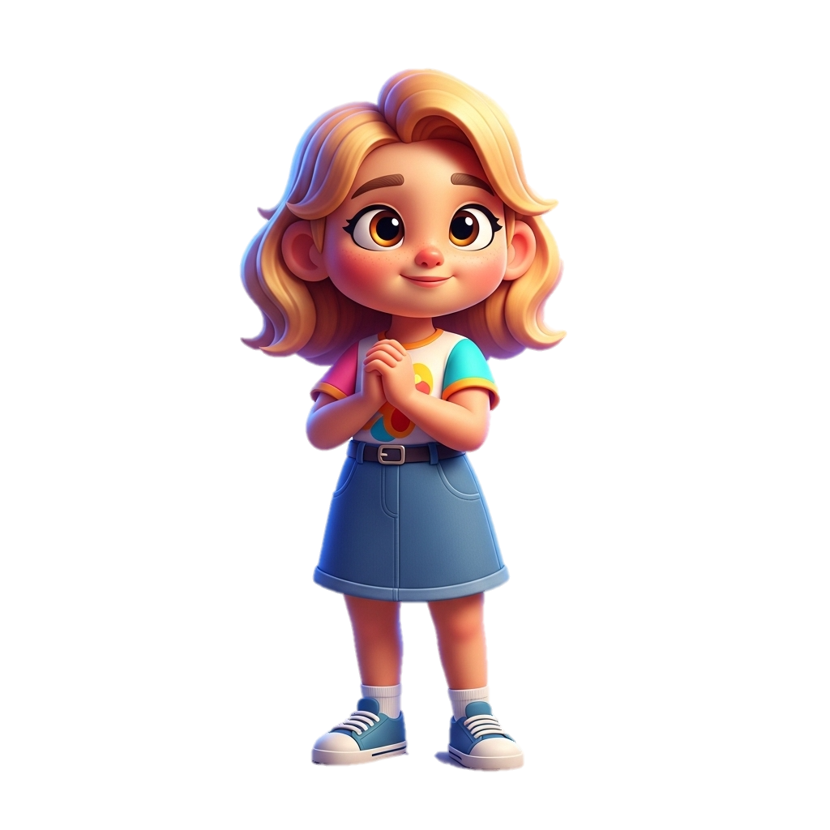
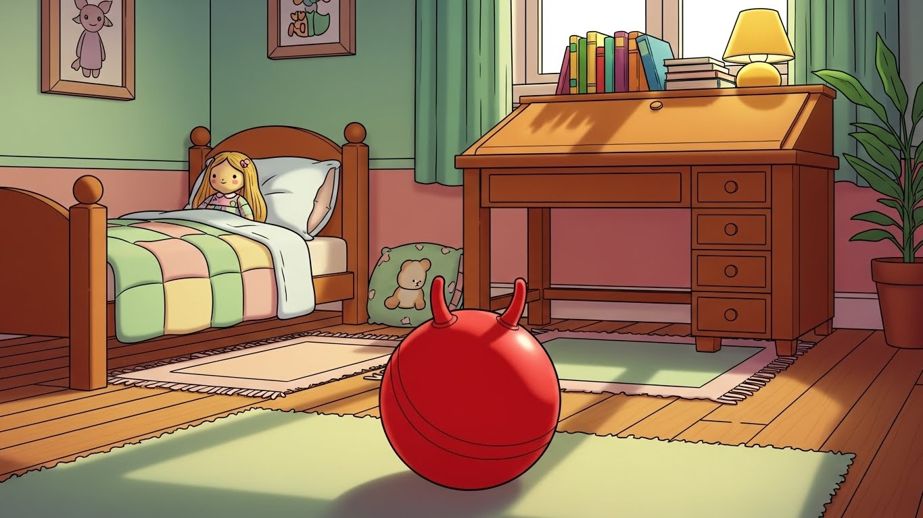
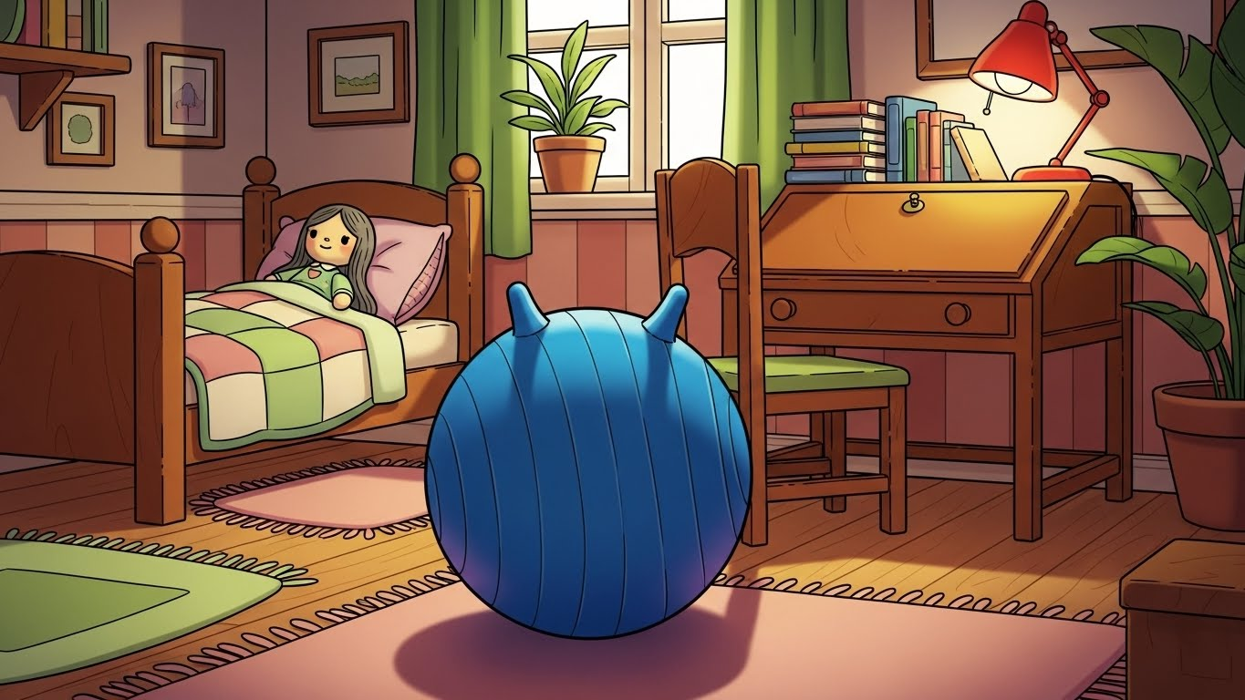
Hello. My name is Ann. This is my room. That is my doll. It has got fair hair. This is my red ball. Those are my books and a yellow lamp. I like my room!
A
A
B

Slide 9
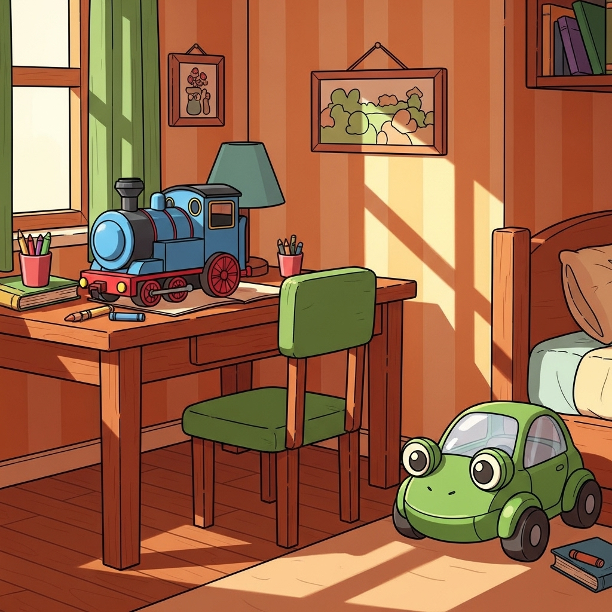
Complete.
This is Tim's room. That's his desk and this is his chair. They are __________and ________. And look at his toys! That's his __________ train and this is his _______ car. It's funny! It looks like a ________.
brown
green
blue
green
frog

Slide 10
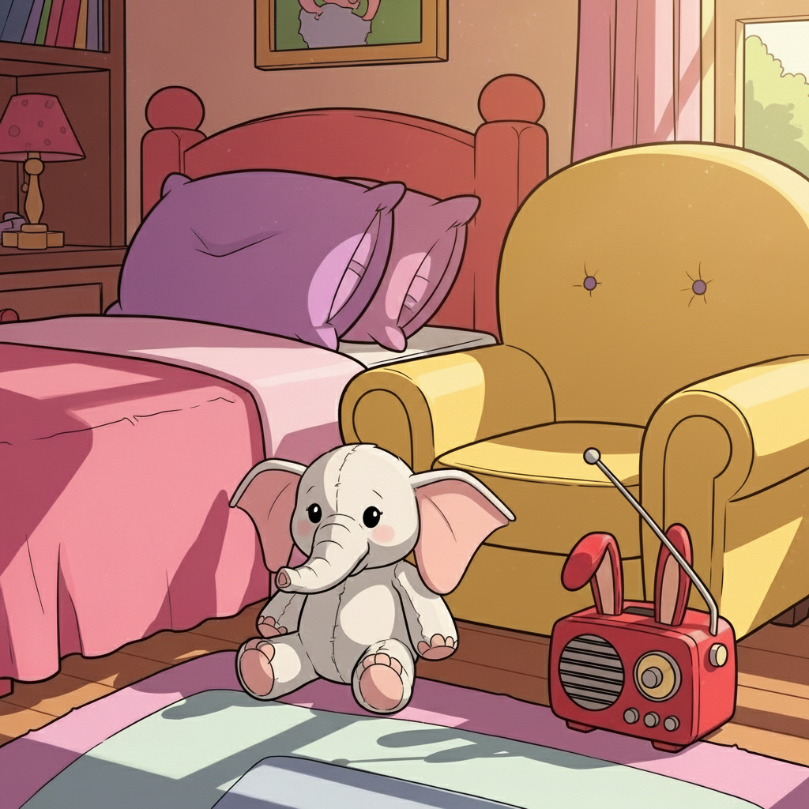
Complete.
This is Emma's room. That’s her bed and this is her armchair. They are __________and ________. And look at her toys! That’s her __________ elephant and this is her _______ radio. It's funny! It looks like a ________.
pink
yellow
white
red
rabbit

Slide 11
Write the plurals.
1. This is a book. - These are books.
2. That is a desk.-
3. That is a chair.-
4. This is an elephant.-
5. This is my sister.-
6. That is my doll.-
Those are desks.
Those are chairs.
These are elephants.
These are my sisters.
Those are my dolls.

