Slide 1
School Subjects

Slide 2



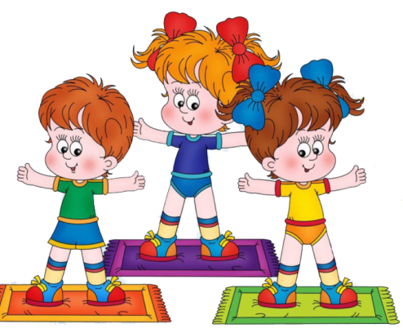




School subjects
English
Maths
Geography
PE
History
Science
Art
Music

Slide 3
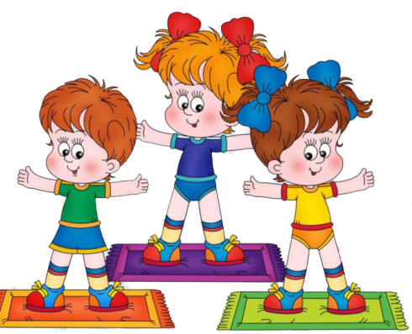
Which subjects do you have?
We have …
We don’t have …

Slide 4
What’s your favourite subject?
I like …
My favourite subject is …

Slide 5

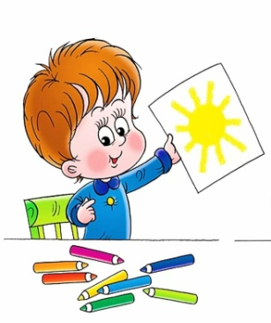

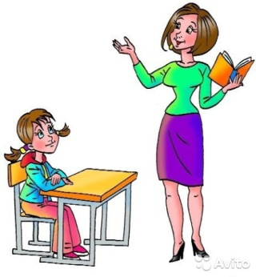
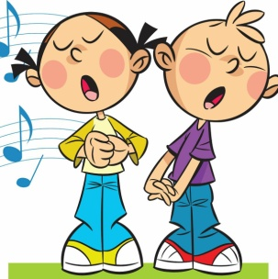
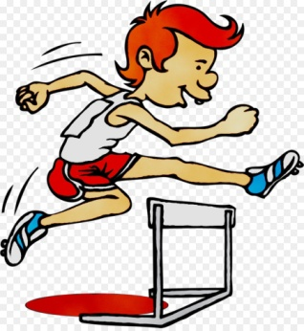
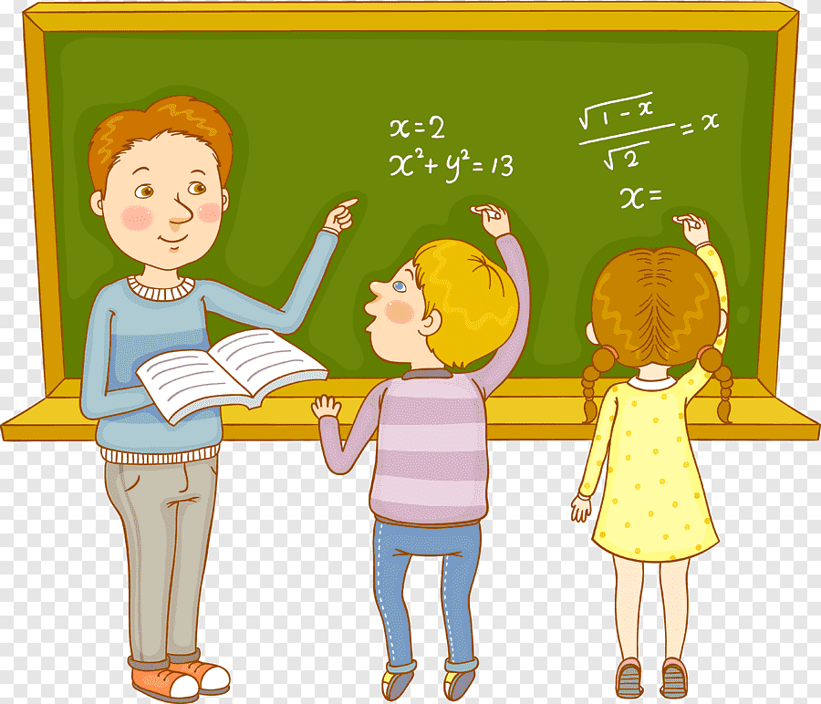
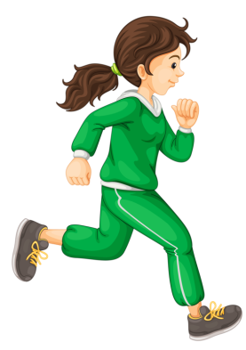

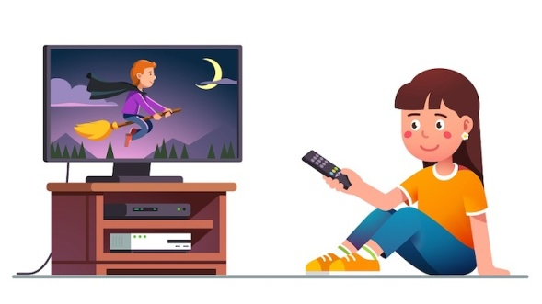

At the lesson
sing
draw
write
listen
study
play
jump
run
count
read
watch

Slide 6
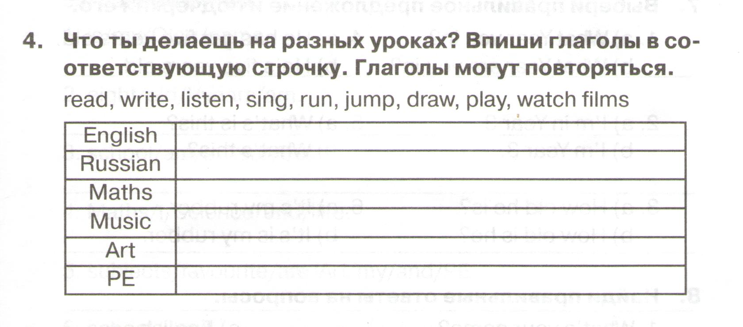
Сборник упражнений стр.17 упр. 4
read, write, listen, watch films…

Slide 7

Let’s speak!
We read books
at English lesson.

Slide 8
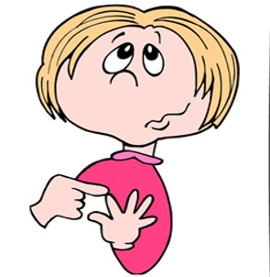
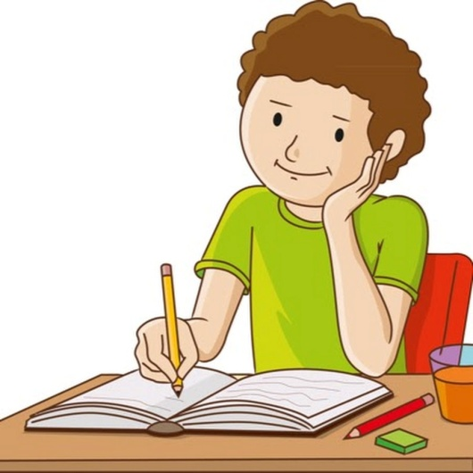
Let’s speak!
We ___ and ____at Maths lesson.

Slide 9
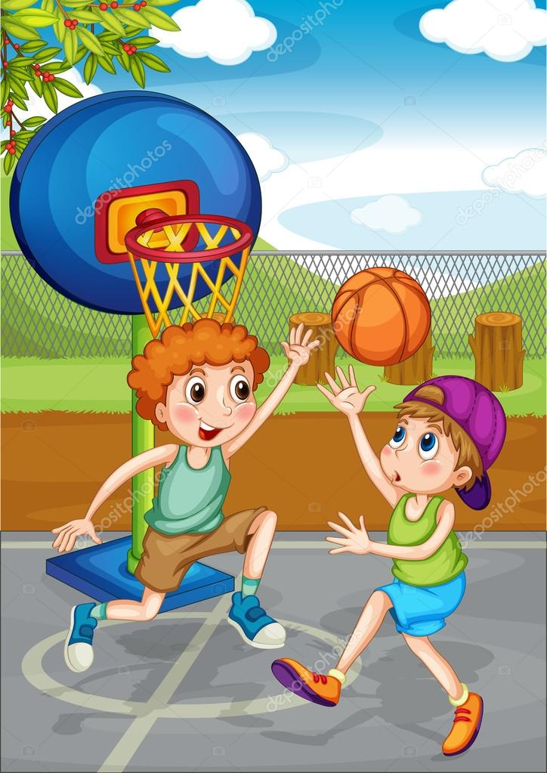


Let’s speak!
We___, ___ and ____at PI.

Slide 10
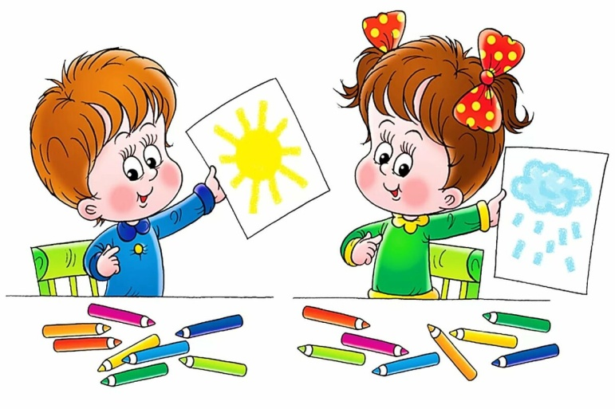

Let’s speak!
We ___ and ___at Art.

Slide 11

Let’s speak!
We ___ at Music.

Slide 12

Home Task
Учебник стр. 14 упр. 1,2,3 читать.
Рабочий лист «What do we do at the lesson?” - выполнить письменно.

