Slide 1
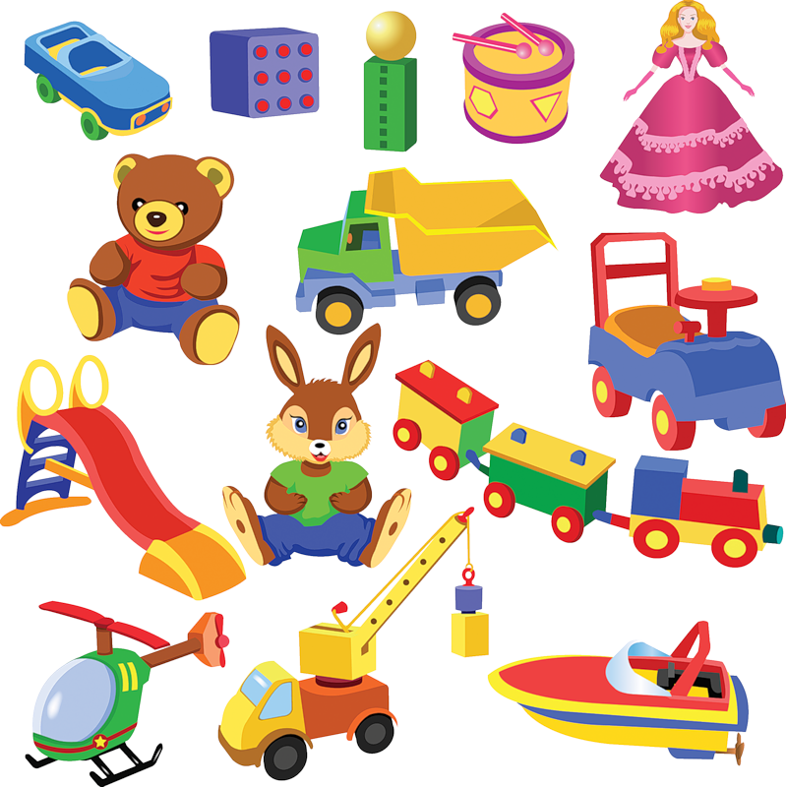
Toys for
little Betsy

Slide 2
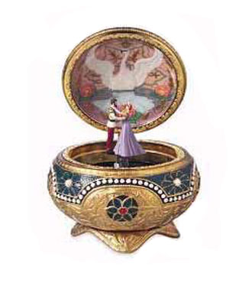
Musical box

Slide 3
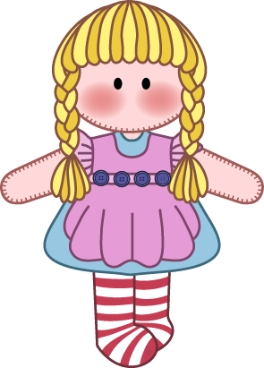
doll

Slide 4
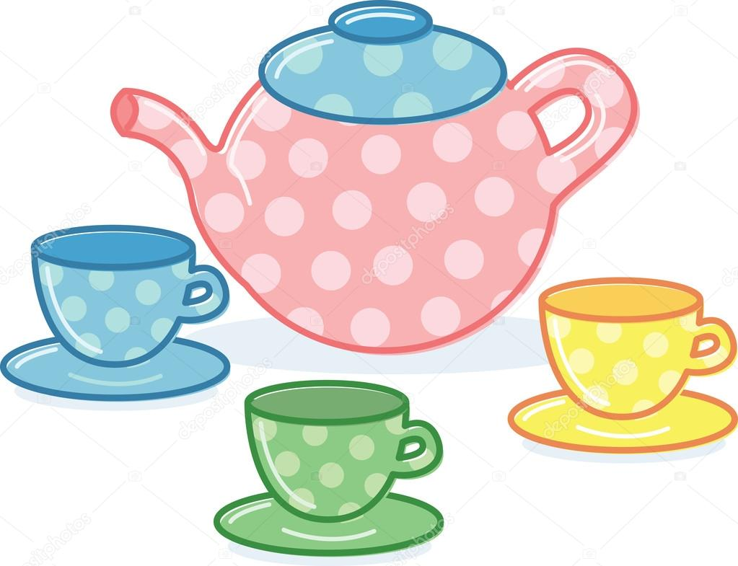
Tea set

Slide 5
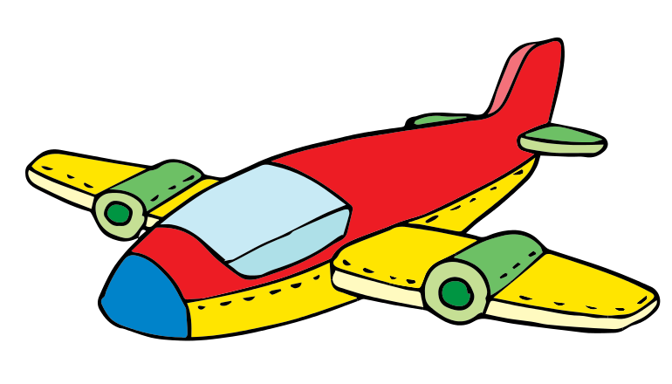
aeroplane

Slide 6

ball

Slide 7
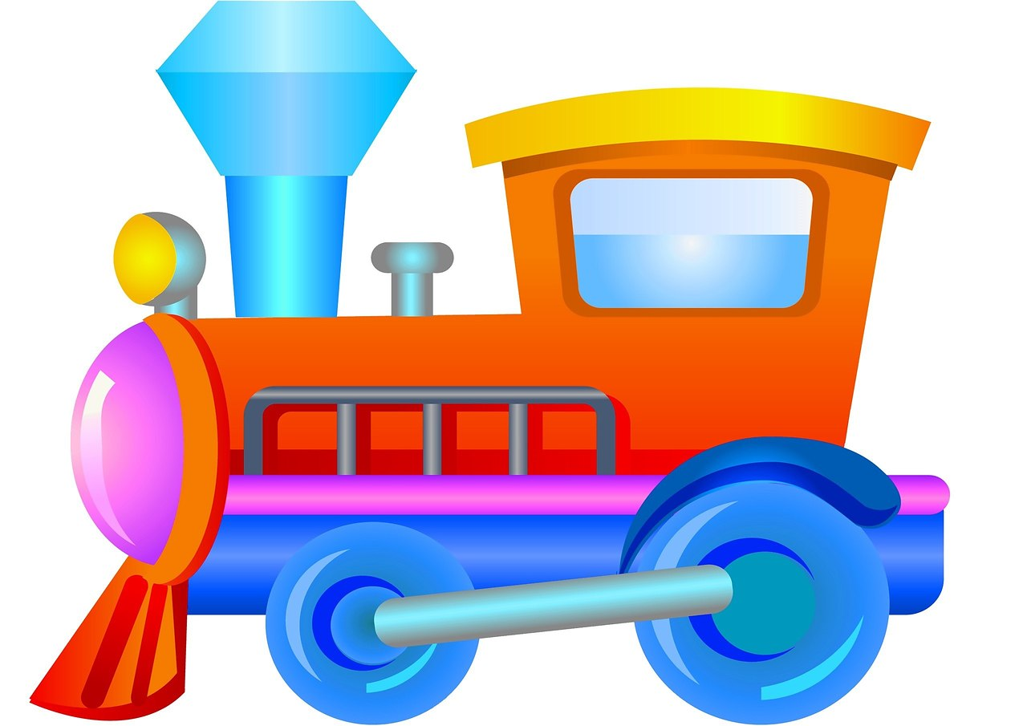
train

Slide 8
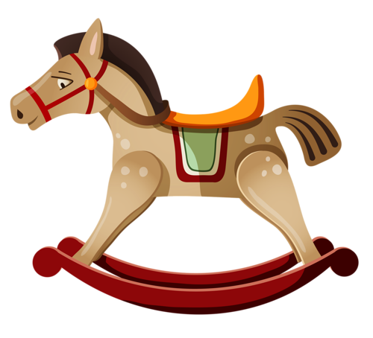
Rocking horse

Slide 9
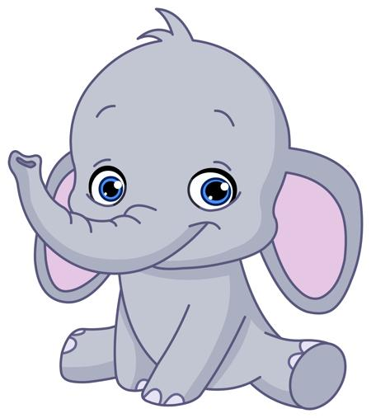
elephant

Slide 10
Let`s play
Close your eyes

Slide 11


Musical box
aeroplane
Tea set
doll
elephant
train
ball
Rocking horse

Slide 12
aeroplane
Tea set
doll
elephant
train
ball
Rocking horse

Slide 13
Musical box
aeroplane
Tea set
doll
elephant
train
ball
Rocking horse

Slide 14
Musical box
Tea set
doll
elephant
train
ball
Rocking horse

Slide 15
Musical box
aeroplane
Tea set
doll
elephant
train
ball
Rocking horse

Slide 16
Musical box
aeroplane
doll
elephant
train
ball
Rocking horse

Slide 17
Musical box
aeroplane
Tea set
doll
elephant
train
ball
Rocking horse

Slide 18
Musical box
aeroplane
Tea set
elephant
train
ball
Rocking horse

Slide 19
Musical box
aeroplane
Tea set
doll
elephant
train
ball
Rocking horse

Slide 20
Musical box
aeroplane
Tea set
doll
elephant
train
Rocking horse

Slide 21
Musical box
aeroplane
Tea set
doll
elephant
train
ball
Rocking horse

Slide 22
Musical box
aeroplane
Tea set
doll
elephant
ball
Rocking horse

Slide 23
Musical box
aeroplane
Tea set
doll
elephant
train
ball
Rocking horse

Slide 24
Musical box
aeroplane
Tea set
doll
elephant
train
ball

Slide 25
Musical box
aeroplane
Tea set
doll
elephant
train
ball
Rocking horse

Slide 26
Musical box
aeroplane
Tea set
doll
train
ball
Rocking horse

Slide 27
Musical box
aeroplane
Tea set
doll
elephant
train
ball
Rocking horse

Slide 28
Musical box
aeroplane
Tea set
elephant
train
Rocking horse

Slide 29
Musical box
aeroplane
Tea set
doll
elephant
train
ball
Rocking horse

Slide 30
Tea set
doll
elephant
train
ball
Rocking horse

Slide 31
Musical box
aeroplane
Tea set
doll
elephant
train
ball
Rocking horse

Slide 32
Musical box
aeroplane
doll
elephant
train
ball

Slide 33
Musical box
aeroplane
Tea set
doll
elephant
train
ball
Rocking horse

Slide 34
Musical box
doll
elephant
ball
Rocking horse

Slide 35
Musical box
aeroplane
Tea set
doll
elephant
train
ball
Rocking horse

Slide 36
Tea set
doll
elephant
train
Rocking horse

Slide 37
Musical box
aeroplane
Tea set
doll
elephant
train
ball
Rocking horse

Slide 39
Musical box
aeroplane
Tea set
doll
elephant
train
ball
Rocking horse

Slide 40
True or false

Slide 41
elephant

Slide 42
Musical box

Slide 43
aeroplane

Slide 44
Tea set

Slide 45
ball

Slide 46
doll

Slide 47
train

Slide 48
aeroplane

Slide 49
doll

Slide 50
ball

Slide 51
train

Slide 52
Tea set

Slide 53
Rocking horse

Slide 54
elephant

Slide 55


Артикль a/an
Артикль а/an используется с исчисляемыми существительными в единственном числе и означает «один», «один из», «любой».
Артикль a ставится, если слово начинается на согласный звук, аn используется, если слово начинается на гласный звук.
Например:
A book — книга;
An apple — яблоко

Slide 56
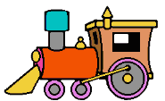
Распредели вагончики к правильным поездам
A
An
dolphin
ice cream
fish
orange
elephant
horse
chicken
apple

Slide 57
Распредели вагончики к правильным поездам
A
fish
dolphin
horse
chicken
An
orange
ice cream
elephant
apple

Slide 58
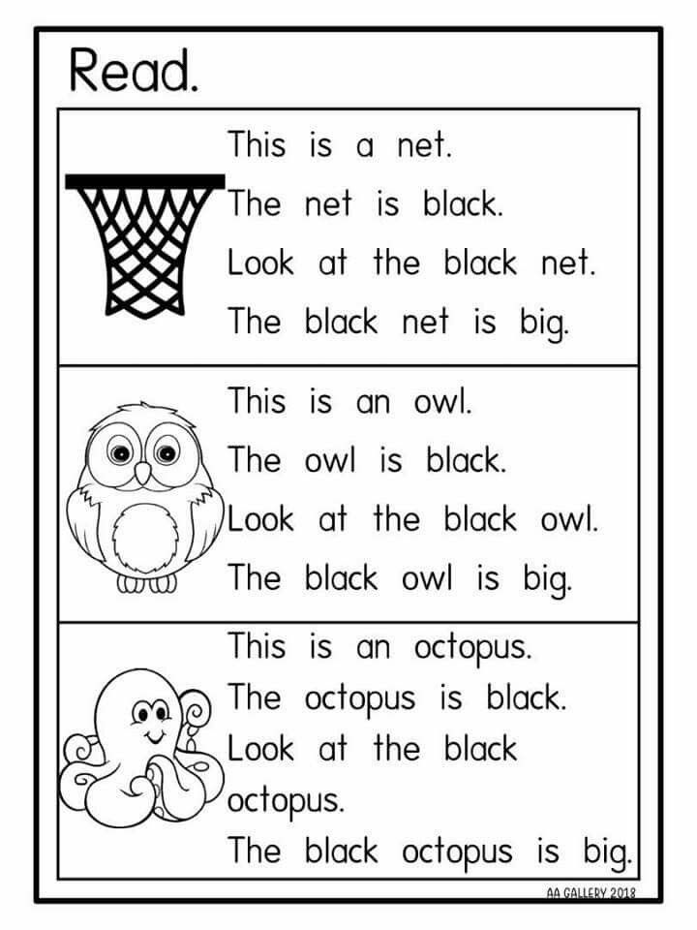

Slide 59
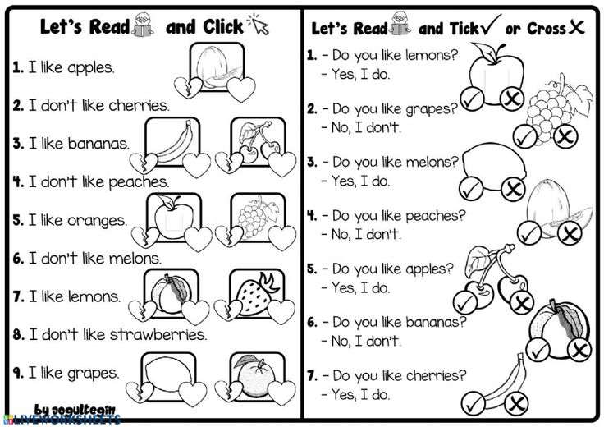

Slide 60
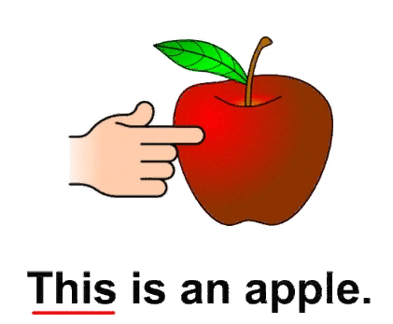
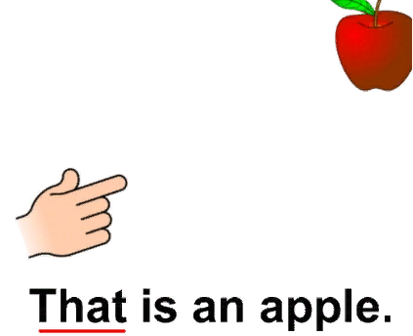
This is… or That is...
Близко-близко присмотрись:
Если рядом, значит, This
Далеко лежит предмет,
Выбирай скорее That

Slide 61
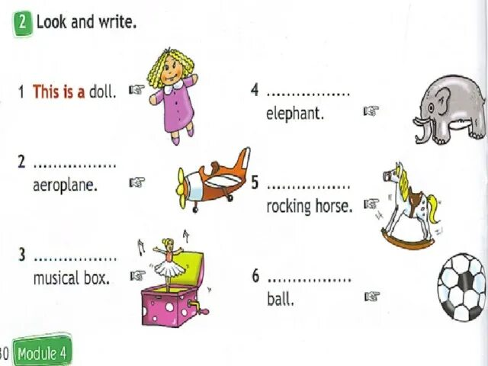
That is an
That is an
This is a
This is a
That is a

