Slide 1



Warming up:
What date is it today?
What day of the week is it today?
What`s the weather like today?
How are you?
How old are you?
What`s your favourute subject?

Slide 2
day of week school subject teacher colour sport game
3. What’s your favourite …? Use the words from the box.
1 My favourite day of week is ….
2 My favourite …
3 My …
4 …
5 …
6 …

Slide 3

4. What’s this in English?
1 любимый день недели
2 расписание уроков
3 учитель естествознания
4 перемена на обед
5 вторник и четверг
6 любимый предмет

Slide 4
https://www.youtube.com/watch?v=LIQsyHoLudQ

Slide 5
Dictation
S_nd_ _
M_ _ _ _ _
T_ _sd_ _
W_ _ _ _ _d_ _
T_ _ _ _ _ _ _
Fr_ _ _ _
S_ _ _ _ _ _ _

Slide 6













Read the numbers:

Slide 7


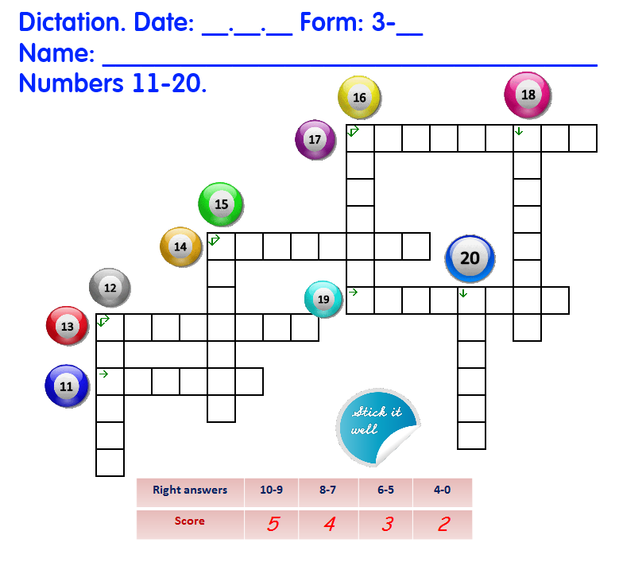


Slide 8
P.28 Ex.2
P.28 Ex.3
P.28 Ex.4

Slide 9
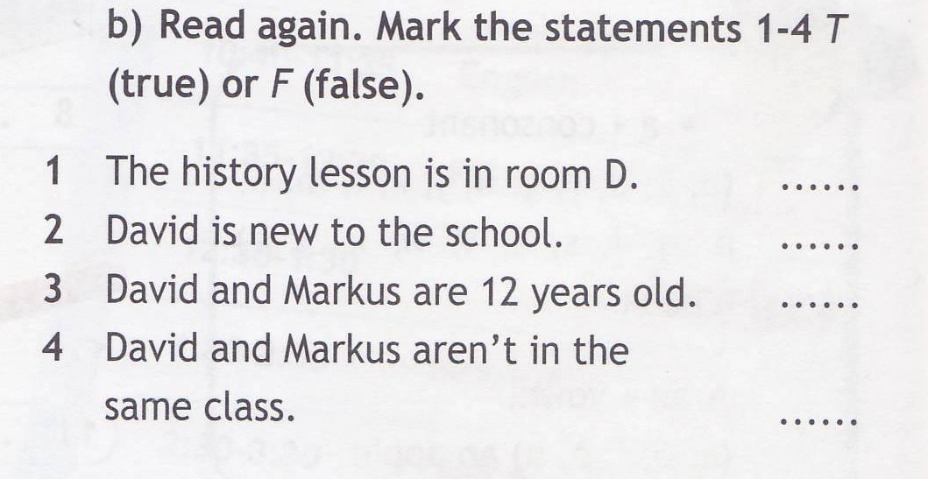

Slide 10
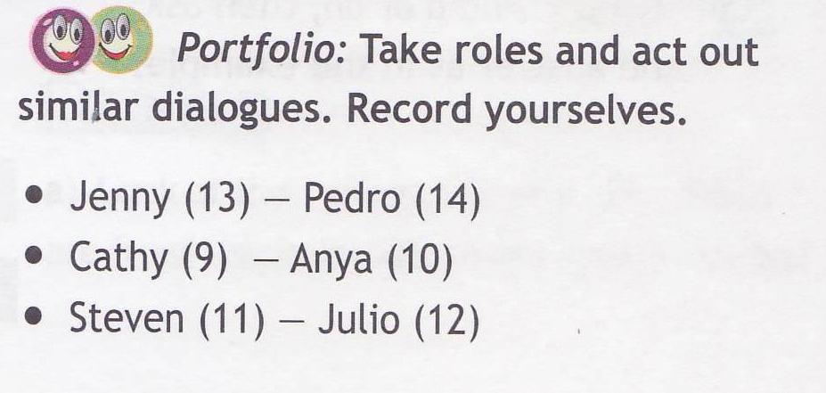

Slide 11
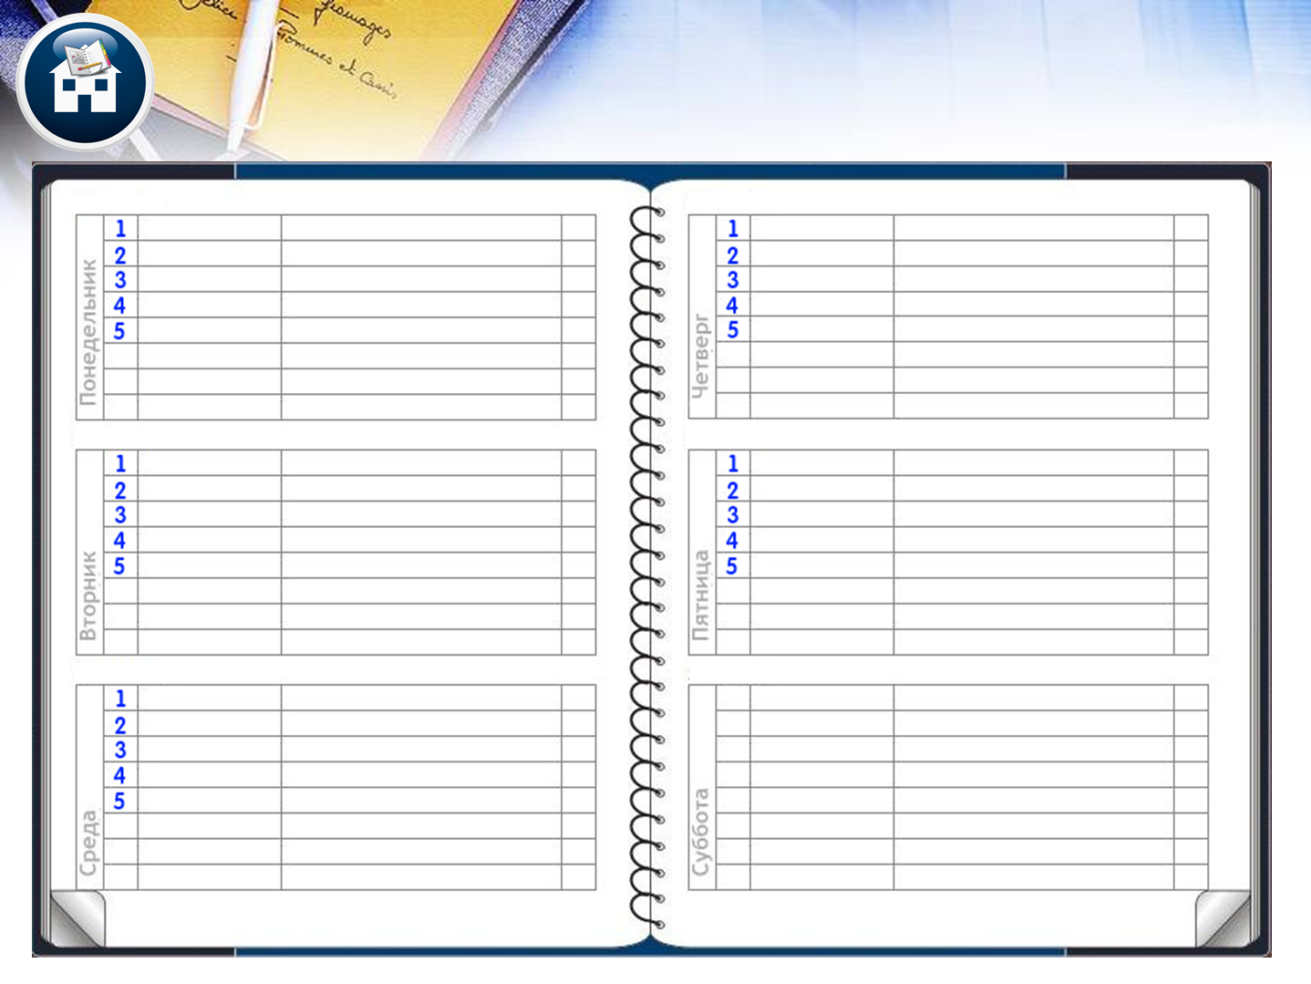



At home
11-20 диктант, с.28 №5 наизусть

