Slide 1
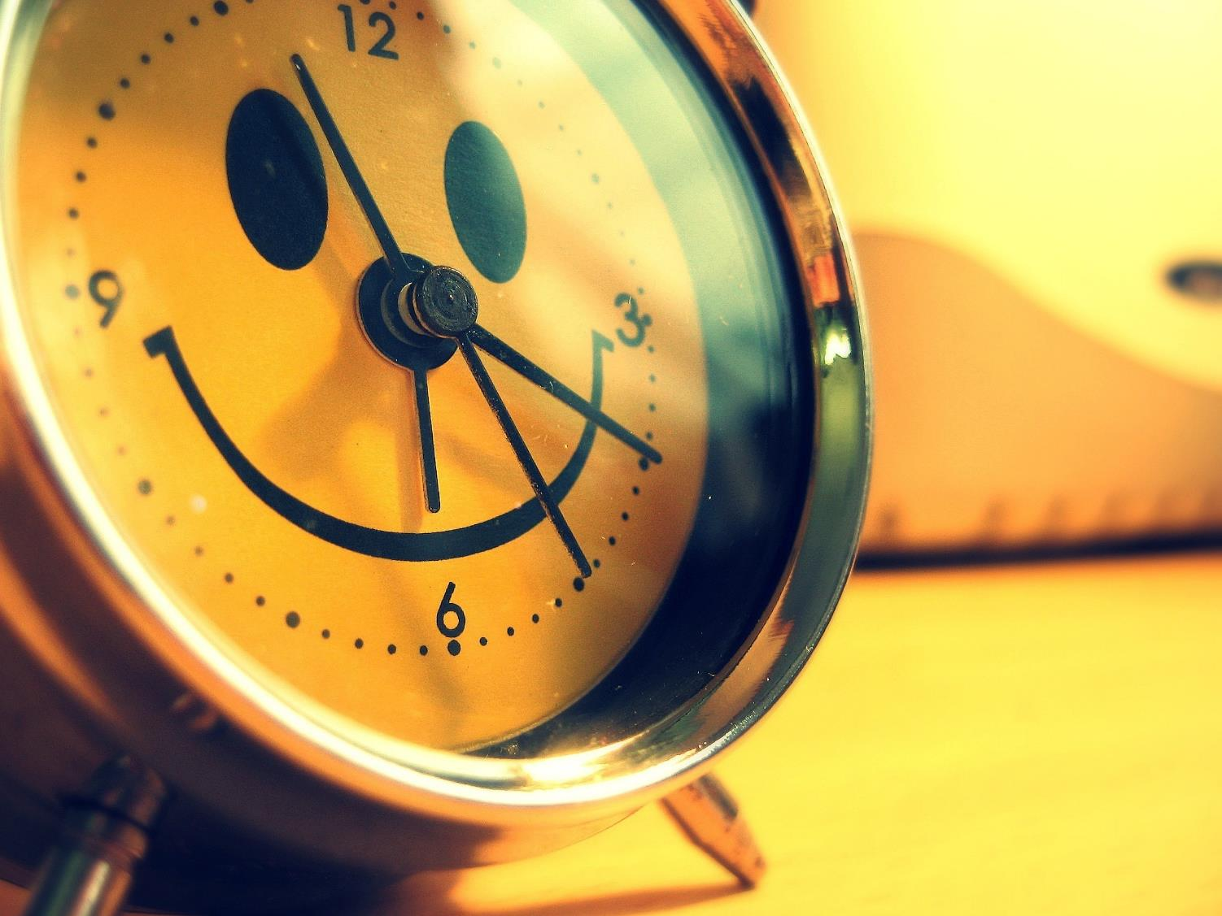
Wake up!

Slide 2
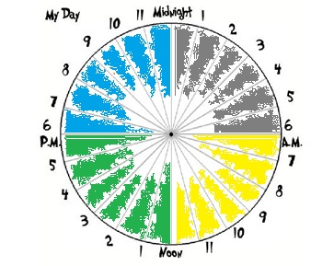
in the
evening
at night
in the
afternoon in the
morning

Slide 3
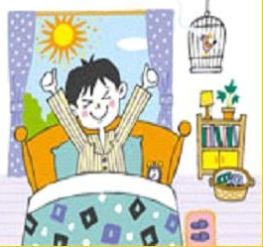
Get up

Slide 4
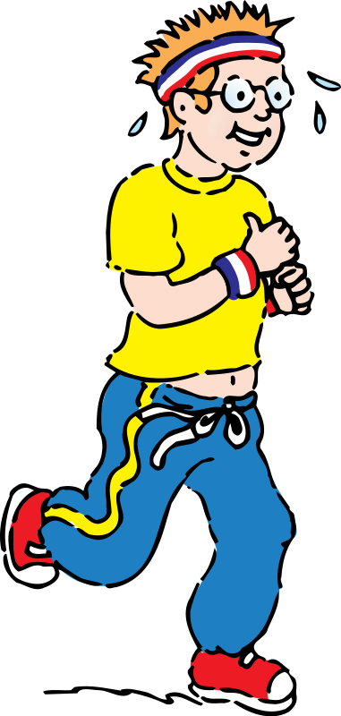
Go jogging

Slide 5
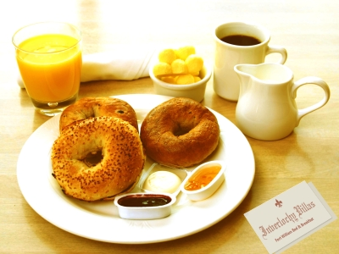
Have breakfast

Slide 6
Get dressed

Slide 7

Go to school

Slide 8
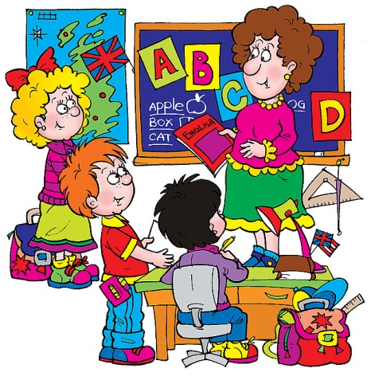
Have lessons

Slide 9

have lunch

Slide 10

do homework

Slide 11
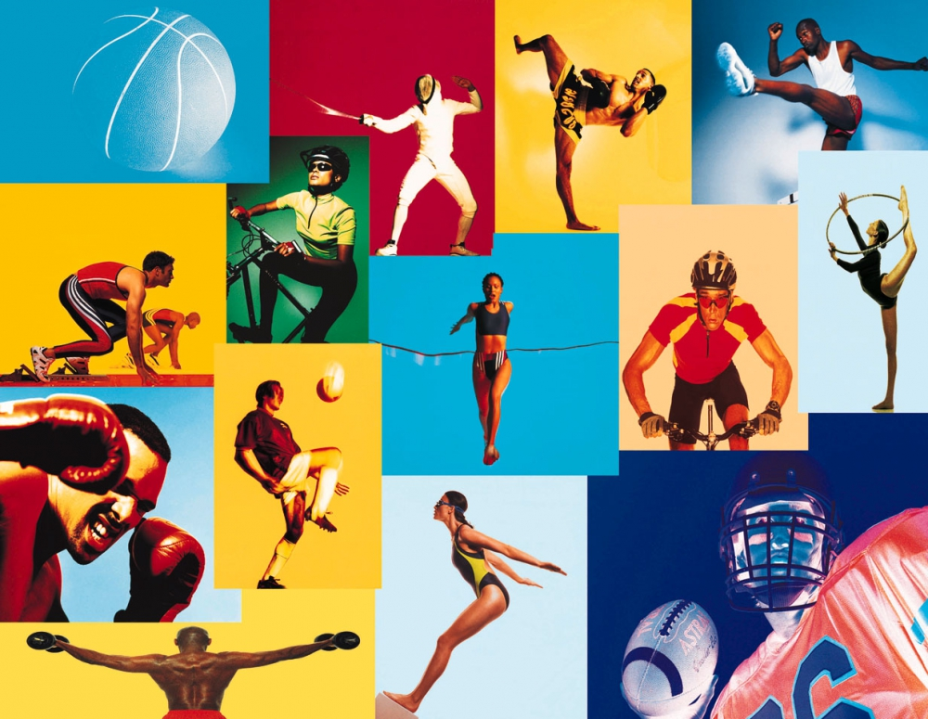
do sports / work out

Slide 12

have a cup of tea

Slide 13
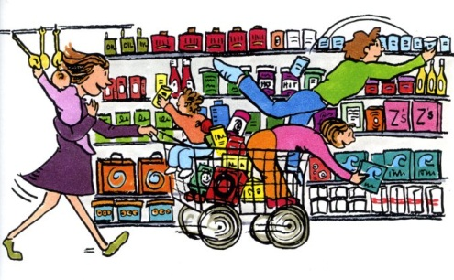
go shopping

Slide 14
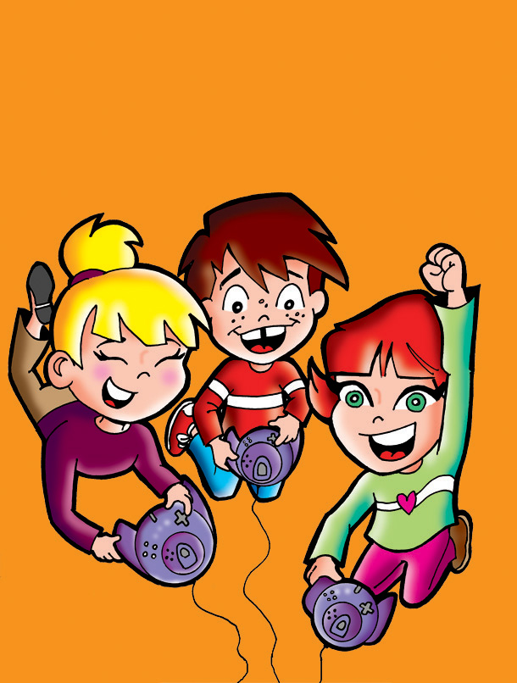
play computer games

Slide 15
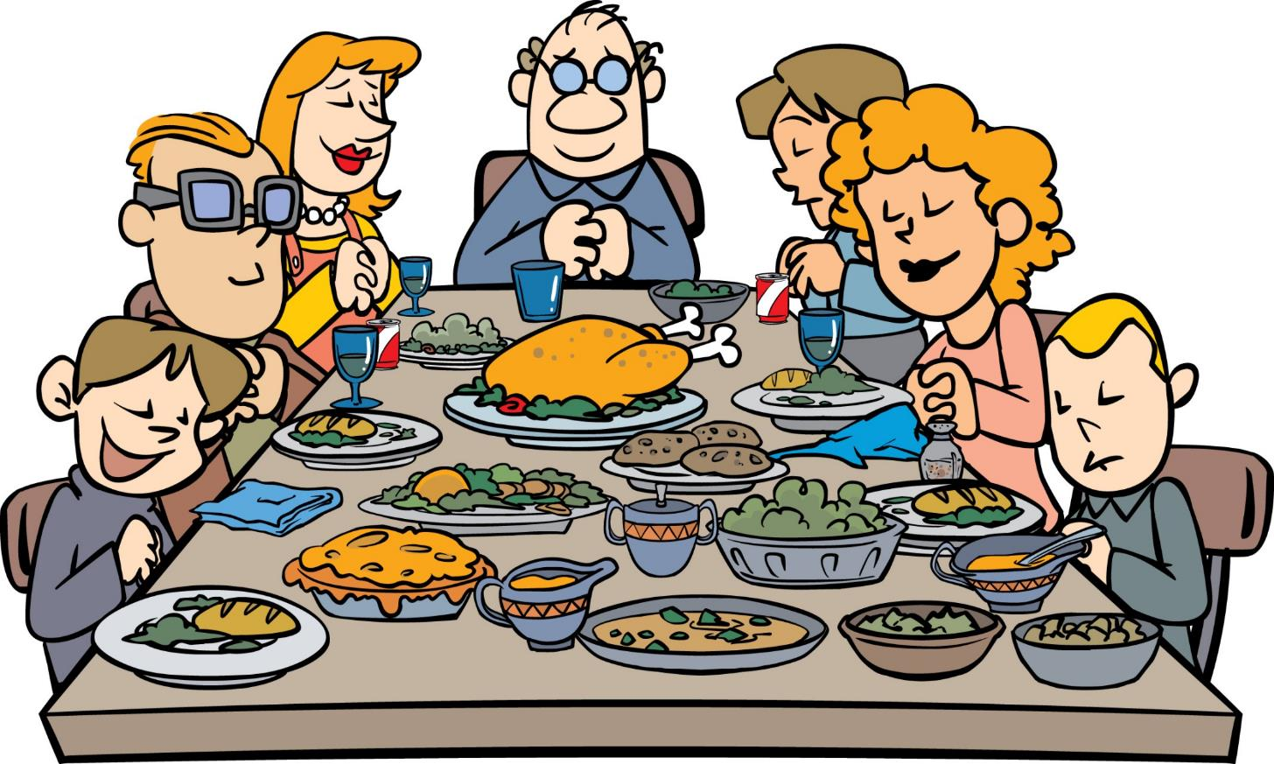
have dinner

Slide 16

read a book

Slide 17

work on a computer

Slide 18
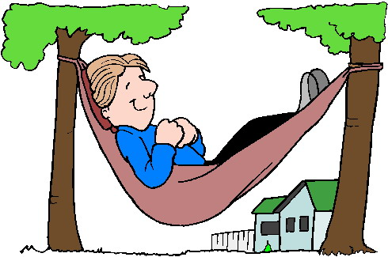
relax

Slide 19
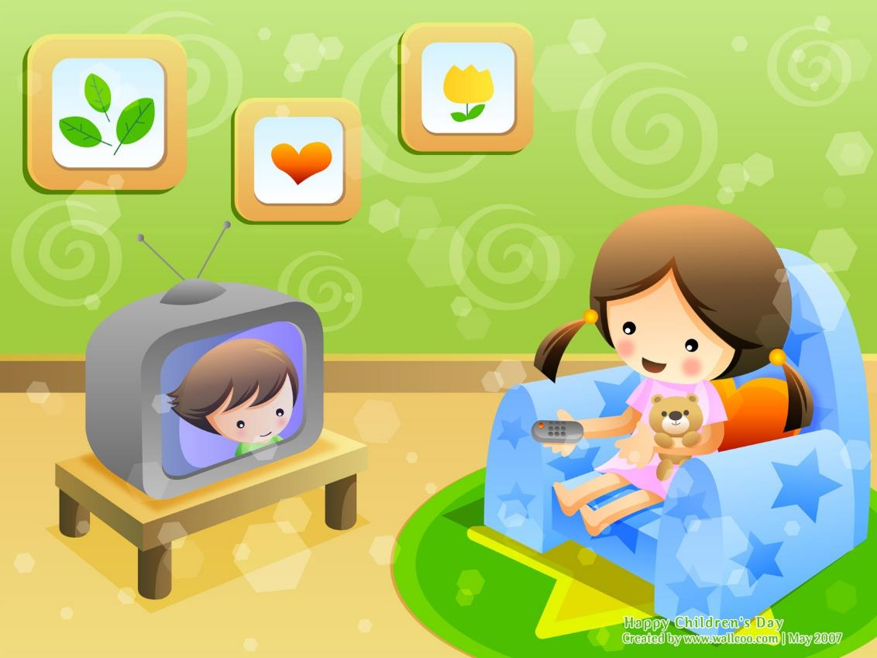
watch TV

Slide 20
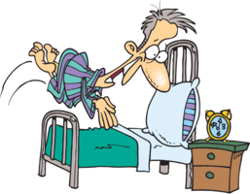
go to bed

Slide 21
do the shopping, get up, watch DVD, have lunch,
go to school, go jogging, have lessons,
go to bed, do my homework, do sports,
have a cup of tea, watch TV, have dinner,
listen to music, read books, have breakfast,
play computer games

Slide 22
In the morning: Get up, get dressed, have breakfast, go to school, go jogging
In the afternoon: Have lessons, have lunch, do my homework, do sports, have a cup of tea
In the evening: Watch TV, watch DVD, have dinner, do the shopping, listen to music, read books, play computer games, go to bed

Slide 23
Adverbs of frequency
Lara usually eats lunch at about quarter past one.
She sometimes goes shopping.
Her father often visits her.
Lara usually practices kickboxing.
She never goes to bed late.
She is usually very busy.

Slide 24
Put the word in brackets into the correct place
1. She plays computer games. (often)
2. I watch TV in the morning. (never)
3. My dad doesn’t go jogging in the morning.
(usually)
4. My mother goes shopping in the evening. (always)
5. Do you have lunch at school or at home?
(usually)
6. Does she go to bed at 9 o’clock? (sometimes)

Slide 25
Keys
1. She often plays computer games.
2. I never watch TV in the morning.
3. My dad doesn’t usually go jogging in the morning.
4. My mother always goes shopping in the evening.
5. Do you usually have lunch at school or at home?
6. Does she sometimes go to bed at 9 ’clock?

Slide 26
Prepositions of time
IN
AT
the morning
the afternoon
the evening
3 o’clock
7:45 pm
noon
midnight
night

Slide 27
Keys
____ 3 o’clock
____ the morning
____ midnight
____ noon
____ the afternoon
_____half past six
____ the evening
at 3 o’clock
in the morning
at midnight
at noon
in the afternoon
at half past six
in the evening

Slide 28
Tell about yourself
always 3 o’clock
usually the morning
often at midnight
I sometimes … noon
rarely in the evening
never half past six
in the afternoon
8 o’clock

Slide 29
Choose the correct verb form
1. My dad ____at 6 o’clock. (get up / gets up)
2. My brother ___ jogging in the morning.
(go/ goes)
3. I ___ breakfast at 7:30. (have/has)
4. She ____ coffee at lunch. (drinks/ drink)
5. We always ___ dinner at home. (have/has)
6. They ___ shopping on Sundays. (go/ goes)
7. She often ___ her friends in the evening. (meet/ meets)

Slide 30
Keys
1. My dad gets up at 6 o’clock.
2. My brother goes jogging in the morning.
3. I have breakfast at 7:30.
4. She drinks coffee at lunch.
5. We always have dinner at home.
6. They go shopping on Sundays.
7. She often watches TV in the evening.

Slide 31
In the morning In the evening
- wake up – when? - have dinner – when?
- after that – what? - after dinner – what?
- have breakfast – when? - go to bed – when?
- then – what?
In the afternoon
- lunch – when?
- after that – what?

Slide 32
In the morning In the evening
- When do you get up? - When do you have dinner?
- What do you do after that?
- When do you have breakfast ? - What do you do after dinner?
In the afternoon
- When do you have lunch? - When do you go to bed?
- What do you do after lunch?

Slide 33


