Slide 1
Buying a souvenir

Slide 2
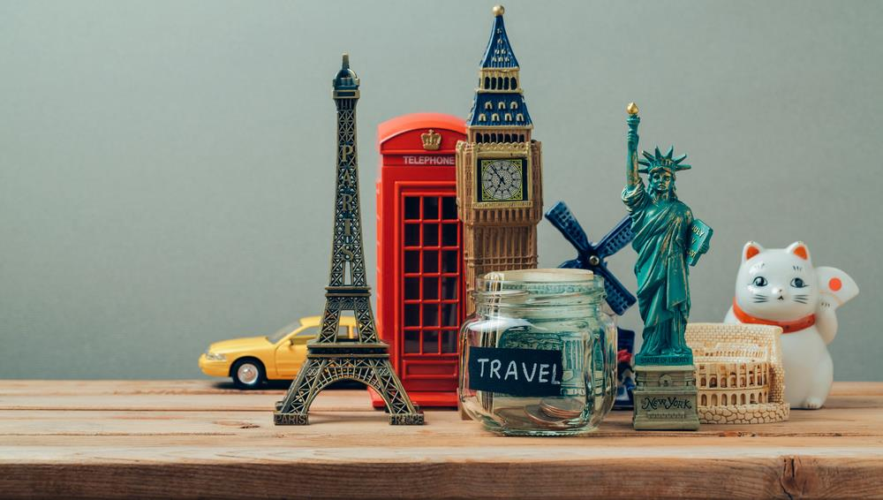
What we are going to do…
Introduce and practice language for buying a souvenir
Revise vocabulary for names of souvenirs of the UK
Revise Plural forms
Revise rules for have/ has got/, haven’t/hasn’t got

Slide 3
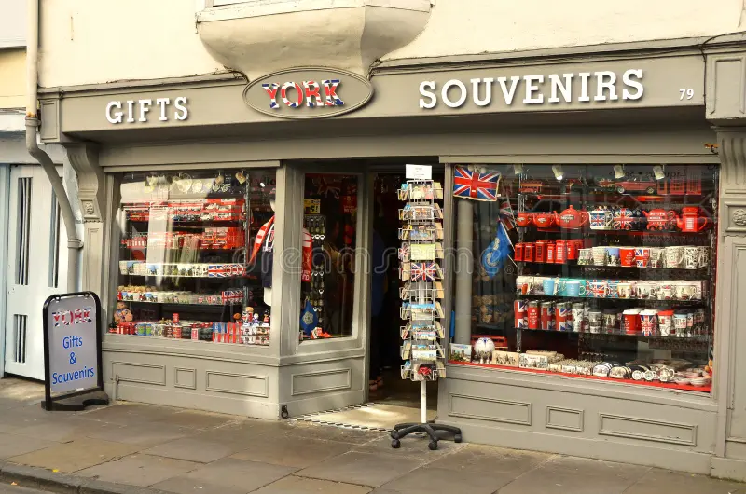
The situation:
You are at a souvenir shop in the UK

Slide 4
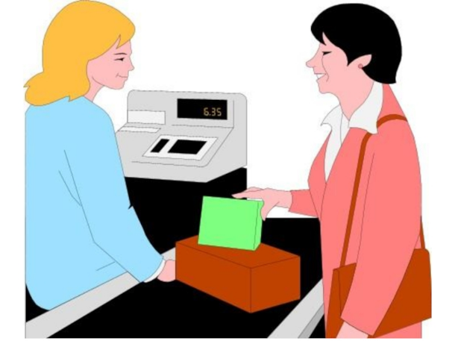
The situation:
You are customers who would like to buy a souvenir at a souvenir shop
customer
shop assistant

Slide 5

What should we know to buy a souvenir there?

Slide 6
What is the main aim of this lesson?
We should know the names of souvenirs.
We should know polite phrases for buying souvenirs.

Slide 7
The main aim of this lesson is to find out what phrases people use to buy a souvenir at a souvenir shop.

Slide 8
Let’s check your home task
England
Scotland
Wales
Northern Ireland
The UK
Walsh
English
Northern Irish
British
Scottish
Russia
Russian

Slide 9
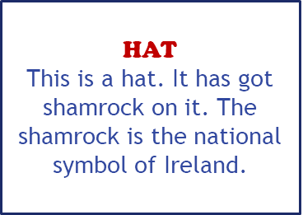
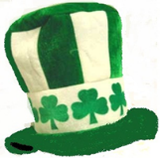
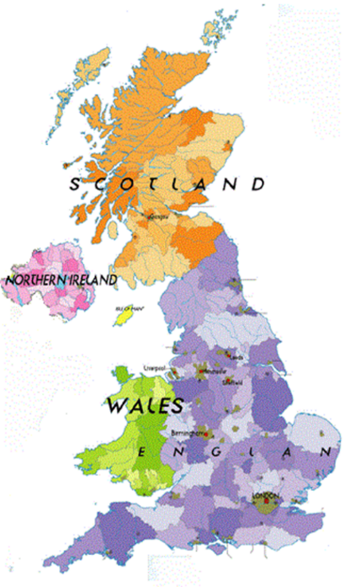
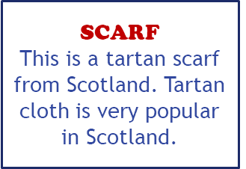
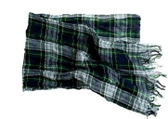
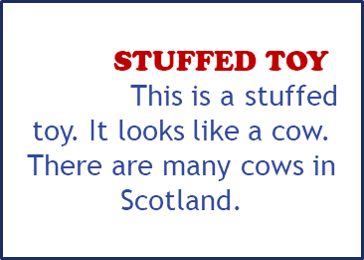
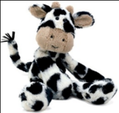
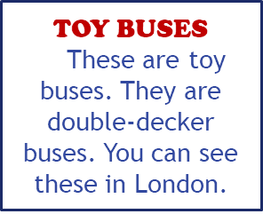

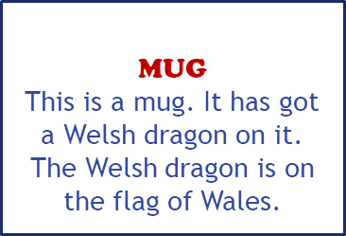
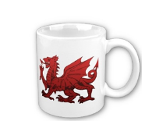
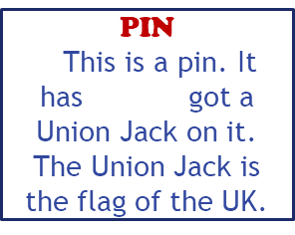
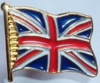
The scarf is Scottish.

Slide 10
Write the plurals.
-s:
-es:
-ves:

Slide 11
Let’s check up.
mugs, buses, stuffed toys, hats, magnets, umbrellas, bells, flags, dragons, key rings, T-shirts, CDs, pins, scarves

Slide 12

Fill in has, hasn’t, have, haven’t.
………..they got a magnet?
Yes, they ………….. .
2. …………he got a scarf?
No, he …………. .
3. …………Bill got a key ring?
Yes, he ………….. .
4. …………….you got a pin?
No, I ……………….. .
Have
haven`t
Has
hasn`t
Has
has
Have
haven`t

Slide 13
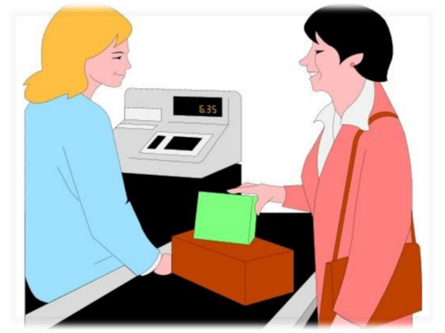
Which sentences does the shop assistant (s) say?
Which sentences does the customer (c) say?
How can I help you?
How about this key ring?
I want to buy a souvenir.
Here you are.
How much is it?
It’s 4 pounds.
C
S
C
C
C
S

Slide 14

What is the English for:
Я хочу купить сувенир?
I want to buy a souvenir?
Чем я могу вам помочь?
How can I help you?
Сколько это стоит?
How much is it?
5 фунтов.
It’s 5 pounds.
Возьмите.
Here you are.

Slide 15
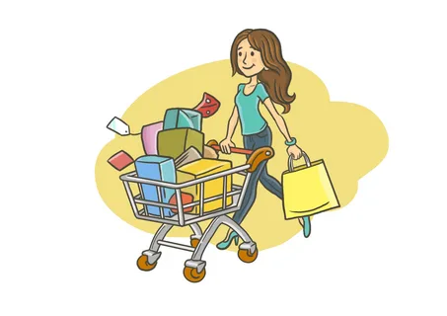
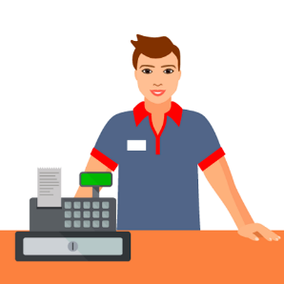
Let’s try to act out several dialogues between a customer and the shop assistant.

Slide 16




After this lesson I am……
great!
sad!
in love with English!
interested!

Slide 17
Thank you for the lesson!
Good-bye!

