Slide 1
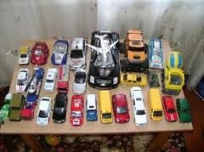
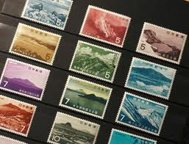
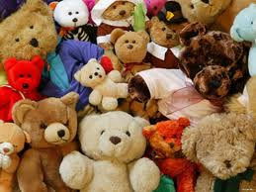
Thursday, the 20th of october. classwork.
My collection
Notes:
Шапилева Н.С., учитель английского языка
МОУ гимназия № 20

Slide 2
stamps

Slide 3
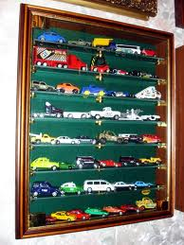
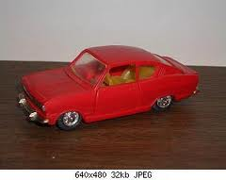

Cars

Slide 4
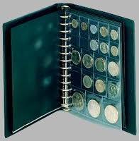
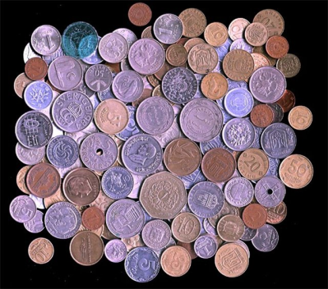
coins

Slide 5


books

Slide 6
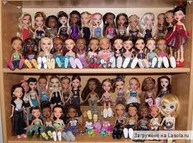
dolls

Slide 7
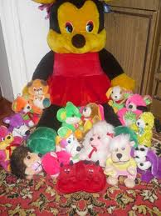
Soft toys

Slide 8
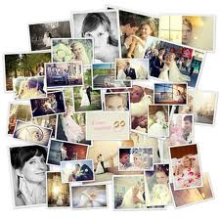

photos

Slide 9
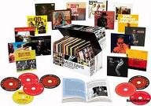
CDs

Slide 10

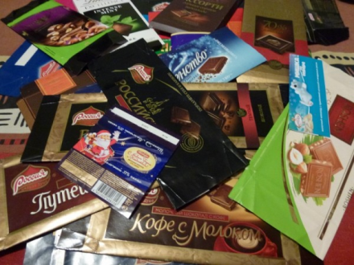
stickers

Slide 11
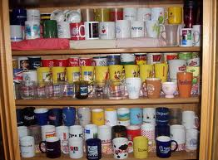
mugs

Slide 12




magazines

Slide 13
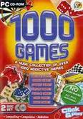
games

Slide 14
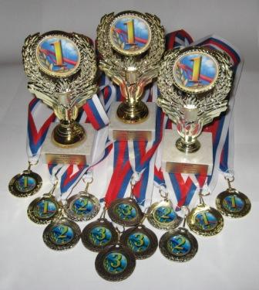
Cups and medals

Slide 15
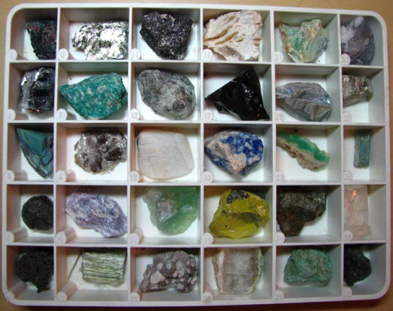
stones

Slide 16
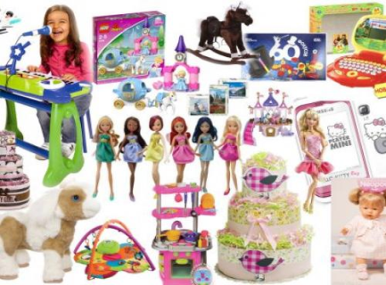
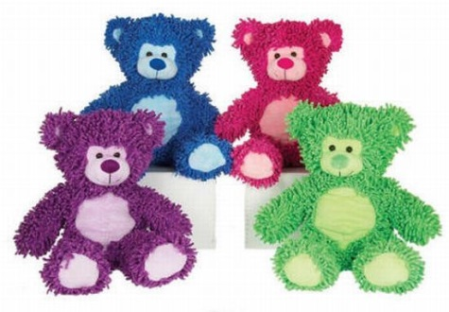
I have got a collection of…

Slide 17
Guessing game
Have you got a collection of….?
No, I haven`t.
Yes, I have. I have got a collection of….

Slide 18
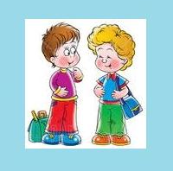
Dialogues
P1: Hello, Kostya! Nice to see you.
P2: Glad to see you too, Max!
P1: Do you have any hobbies?
P2: I am fond of collecting stickers. Do you like collecting things?
P1:Yes. I have got a collection of coins.
P3: Hello, Nastya! I know you have got an unusual hobby.
P4: Well. I collect historical articles from the newspapers and magazines.
P3: That is interesting. Will you show me your collection?
P4: OK. And what is your hobby?
P3: Oh, I am fond of collecting stamps.

Slide 19
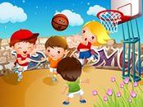
Let`s have a rest
Stand up, please!
Do like me!
Hands up! Clap! Clap! Clap!
Hands down! Shake! Shake! Shake!
Hands on hips! Jump! Jump! Jump!
Stand still ! (2)
Sit down!

Slide 20

Reading
Hi Betty!
How are you? I’ve got a great doll collection. I have got seventeen dolls. They are from the UK, the USA, Australia, France, Japan and Canada. My Japanese doll is a present from my mum and dad. I’m proud of my collection. Doll collecting is fun and easy. It makes me happy.
Love,
Amy.

Slide 21

1 The letter is from Betty.
2 Amy likes her doll collection.
3 She has got 16 dolls in her collection.
4 The doll from Japan is from her friend.
5 Amy is proud of the collection.
6 Doll collecting isn’t easy.
1.False
2. True
3. False
4. False
5. True
6. False

Slide 22
Listening
1. Tom
2. 11
3. London
4. stamps
5. 68
6. Japan, France, Australia, Canada and New Zealand
7.Yes, he does

Slide 23
Writing
Write:
Your name
Your age
Where you are from
What your collection is
How big your collection is
How you feel about it

Slide 24
Writing a cinquain (in groups)
1.Collecting
2. (2 adjectives)
3. (3 verbs)
4. (a sentence)
5. Hobby

Slide 25

«My collection» learn by heart

Slide 26



GOOD JOB!
Choose a smile for your own according to your work at the lesson.
Be objective!
I did my best! Excellent!
I tried as much as I could. Good!
I should learn English better! Not very well…

