Slide 1
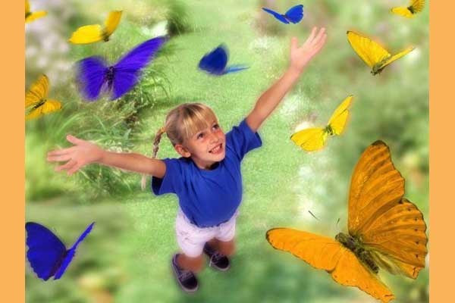
London Zoo
ГБОУ № 378 Кировского района
г. Санкт-Петербурга
учитель английского языка
Тагина Л. Н.

Slide 2
My family
My mum is like a bee,
Because she’s as busy as she can be.
My dad is like an ox,
Because he’s strong and he can box.
My sis is like a mouse,
Because she’s quiet in the house.
But I’m like a mule,
Because I’m stubborn but really cool!!!

Slide 3
My family
My mum is like…..
Because she’s as busy as she can be.
My dad is like…..
Because he’s strong and he can box.
My sis is like…..
Because she’s quiet in the house.
But I’m like……
Because I’m stubborn but really cool!!!

Slide 5
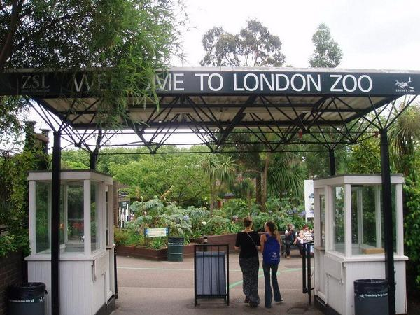
London Zoo is one of the most famous of all London attractions. It is situated in Regent’s Park and was opened in 1828 by the Zoological Society of London.

Slide 6
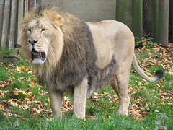
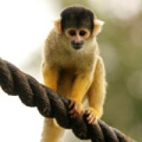
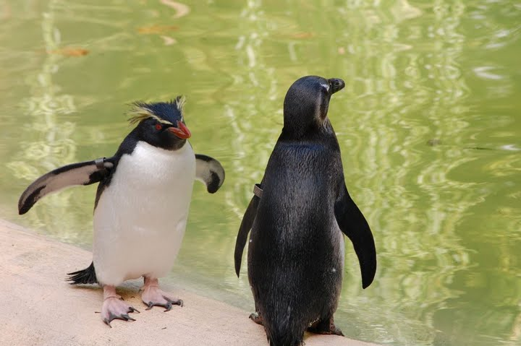
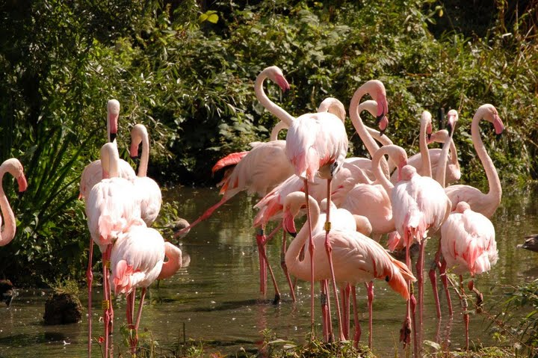
London Zoo is the world's oldest scientific zoo.
The Zoo is open every day from 9 o’clock in the morning till 7 o’clock in the evening.

Slide 7
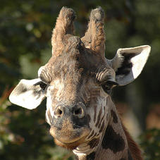
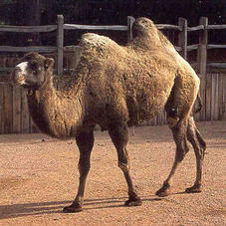
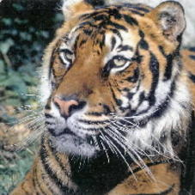
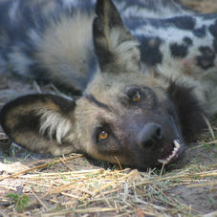
London Zoo has almost 750 species of animals, from the smallest monkey to the tall giraffe. Over 12,000 animals live in the Zoo today, many of them are rare and endangered.

Slide 8
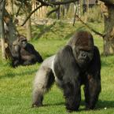
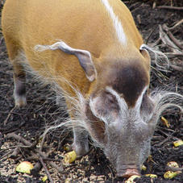
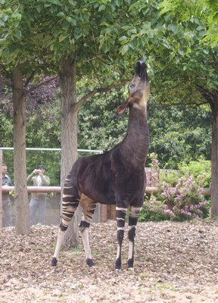
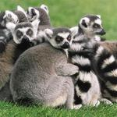
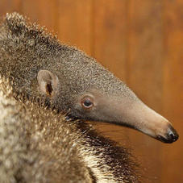
Visitors can find out facts about the animals, including where they live, what they eat .

Slide 9
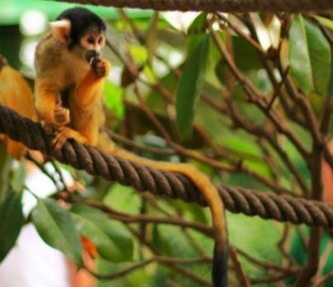
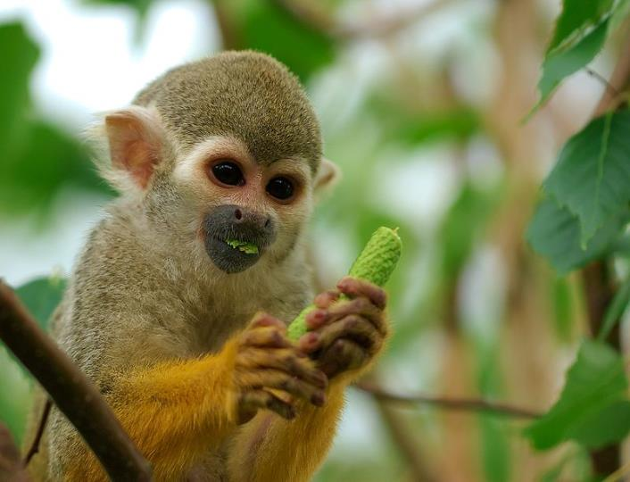
The funniest animals in London Zoo are monkeys.
They jump, run and play with each other.

Slide 10
Complete the sentences:
1828
London Zoo was opened in …
The Zoo is open from … till … every day.
Over … animals live in the Zoo today.
The funniest animals in London Zoo are …
London Zoo is the perfect day out for …
9 o , clock in the morning
7 o , clock in the evening
12.000
the monkeys
the people

Slide 11
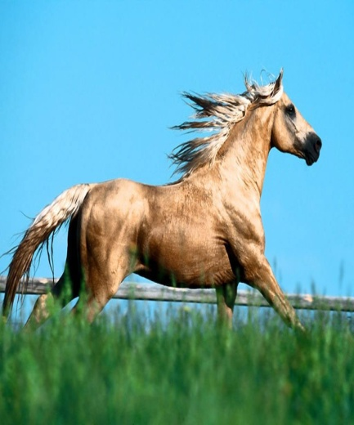
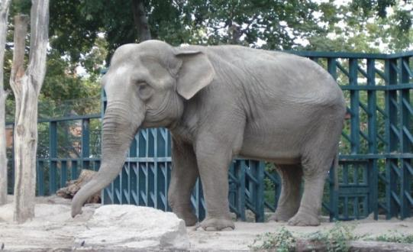
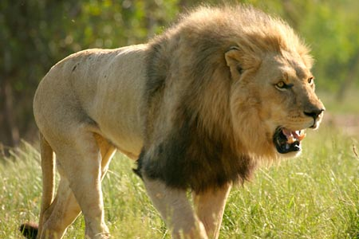
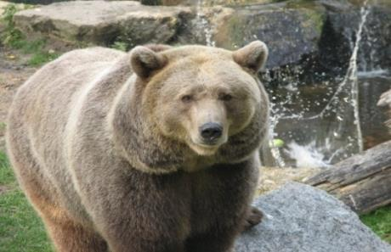
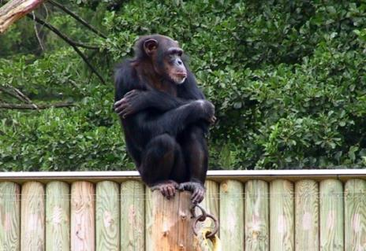
Which animals did Jim see?
a lion
a horse
an elephant
a bear
a monkey

Slide 12
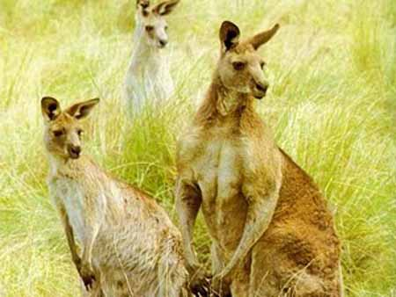
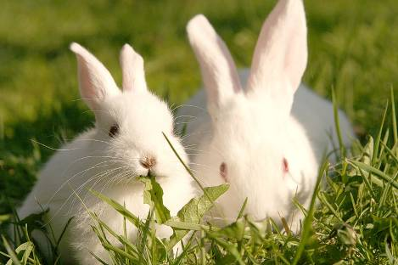
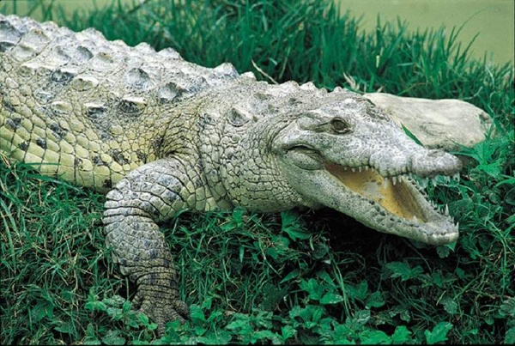
Describe the animals:
a kangaroo
a rabbit
a crocodile
Green and long;
Live in the rivers;
Can swim very well;
Have a long and strong tail;
Eat only meat.
Have 4 legs:
2 big and strong and 2 short;
Brown;
Have a long tail;
Don’t eat meat.
White and grey;
Live in the forest;
Run very quickly;
Don’t eat meat.

Slide 13
Choose the right answers to these questions:
1. Where do kangaroos live? a. No, it doesn’t.
2. Does the giraffe eat meat? b. Yes, it can.
3. What colour is the panda bear? c. No, usually not.
4. Can rabbits swim? d. No, they can’t.
5. Do dogs have just one puppy? e. They live in Australia.
6. Can the giraffe run fast? f. It’s white and black.

Slide 14



I am fine
I am so – so
I am bad

