Slide 1

My pet

Slide 2
Goals
read and understand information about pets
listen and understand information about pets
talk about pets

Slide 3
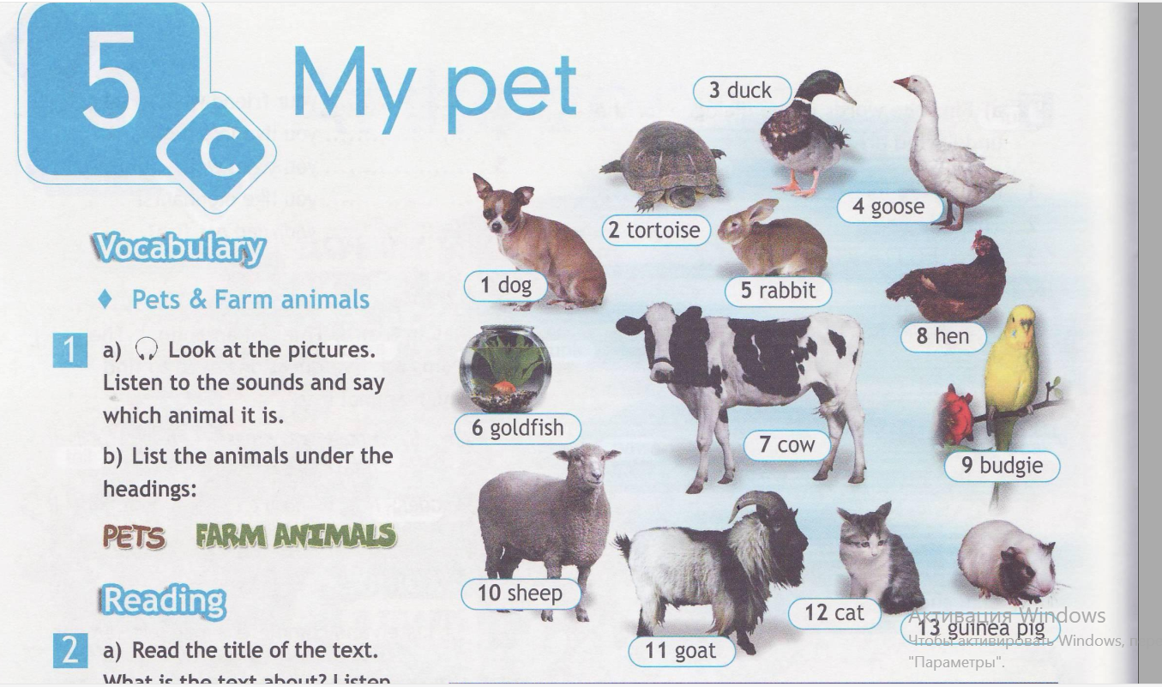

Slide 4
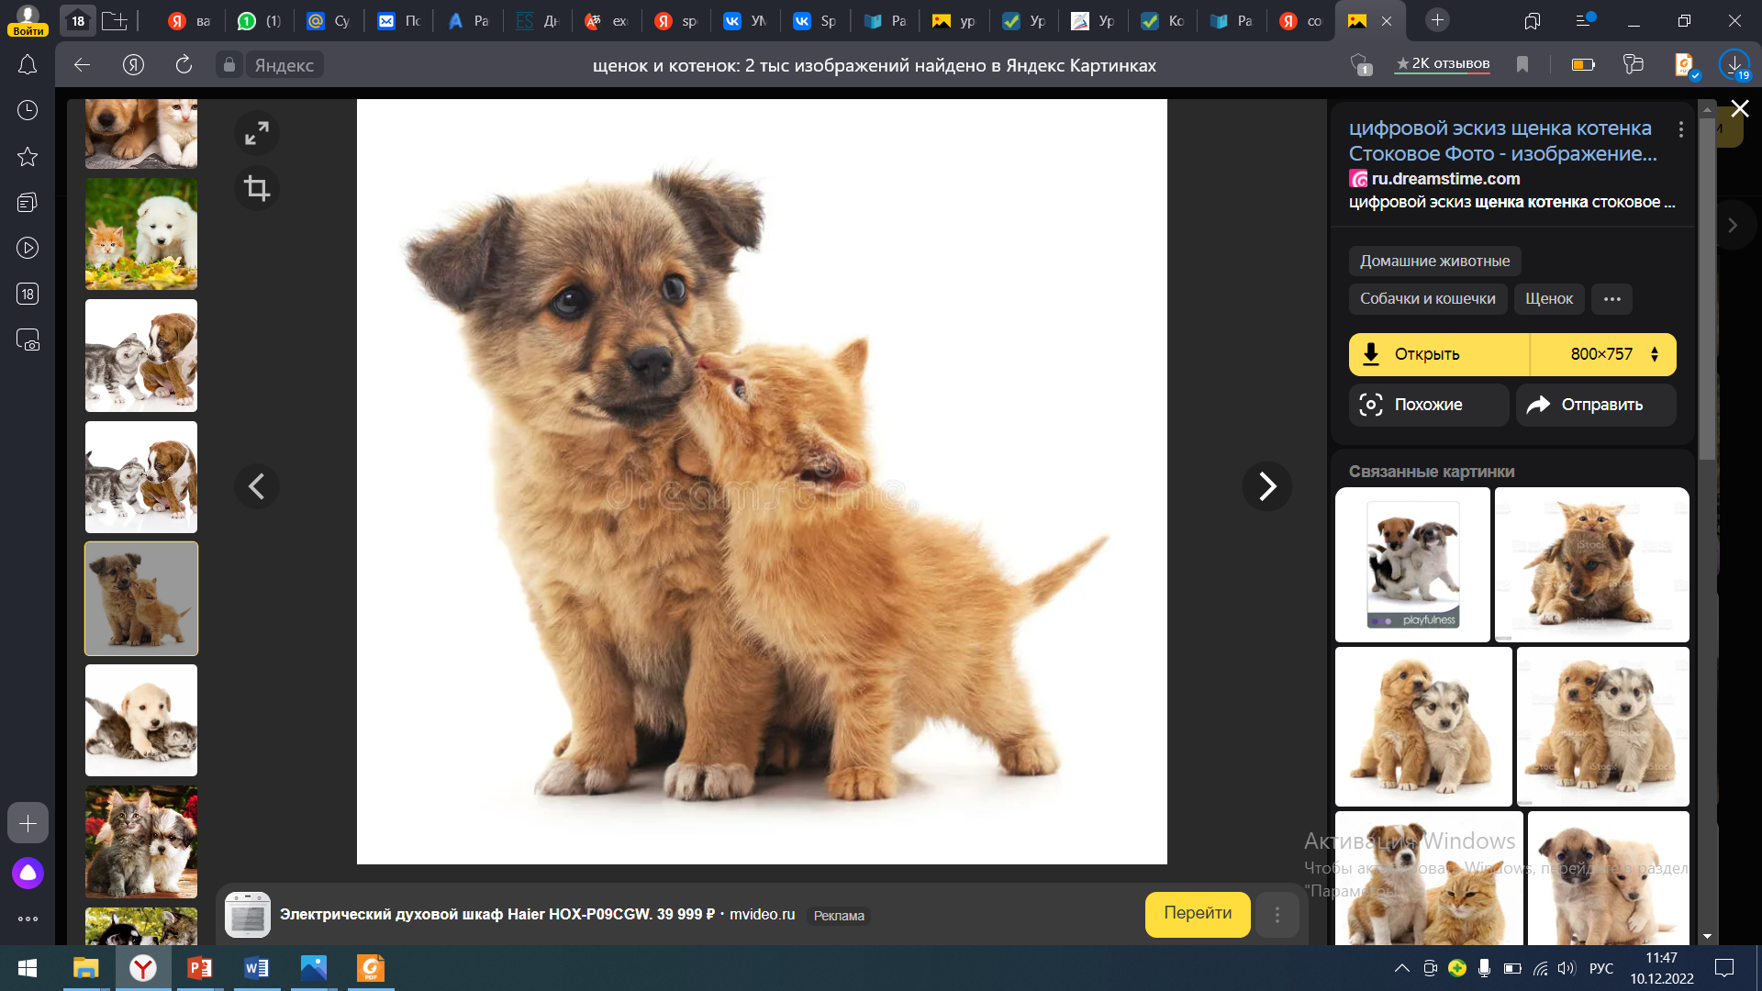
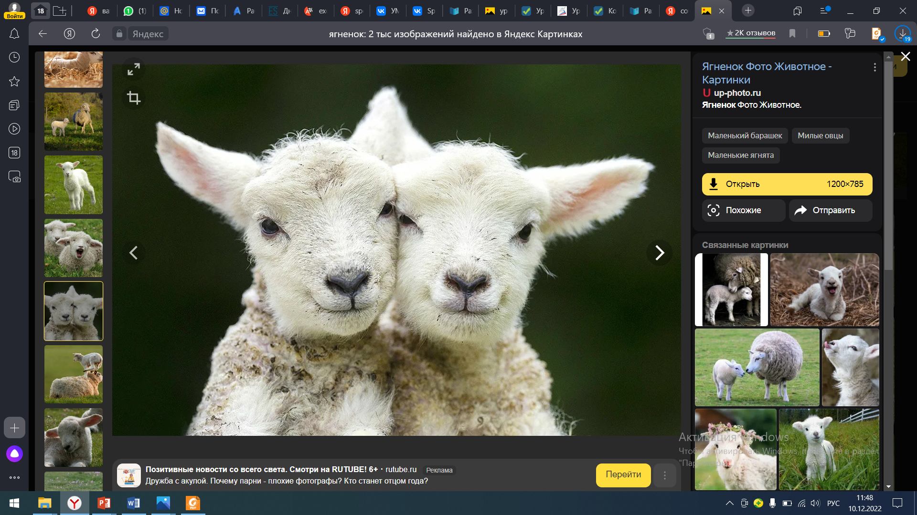
Vocabulary
Your task is to say (write) whether it is a pet/ a farm animal.
Pets | Farm animals

Slide 5
Pets | Farm animals
Dog | Duck
Budgie ['bʌdʒɪ] | Goose
Cat | Hen
Tortoise ['tɔ:təs] | Cow
goldfish | Sheep
Guinea pig ['gɪnɪpɪg] | Goat [gəut]
Rabbit | Rabbit

Slide 6
Let`s guess the riddles. You should guess what animal it is.
Read the description of an animal .
This animal`s got a big body and lives on a farm. It can run but it can`t jump.
It`s got horns (рога) on it`s head.
It`s got green feathers (перья). It lives in the house.
It`s a small animal with a round body. It`s got a small head. It can`t run.
It`s got short fur (мех) and long ears. It can`t run. It can only jump.
It`s got feathers (перья) and wings (крылья). It lives on a farm.

Slide 7
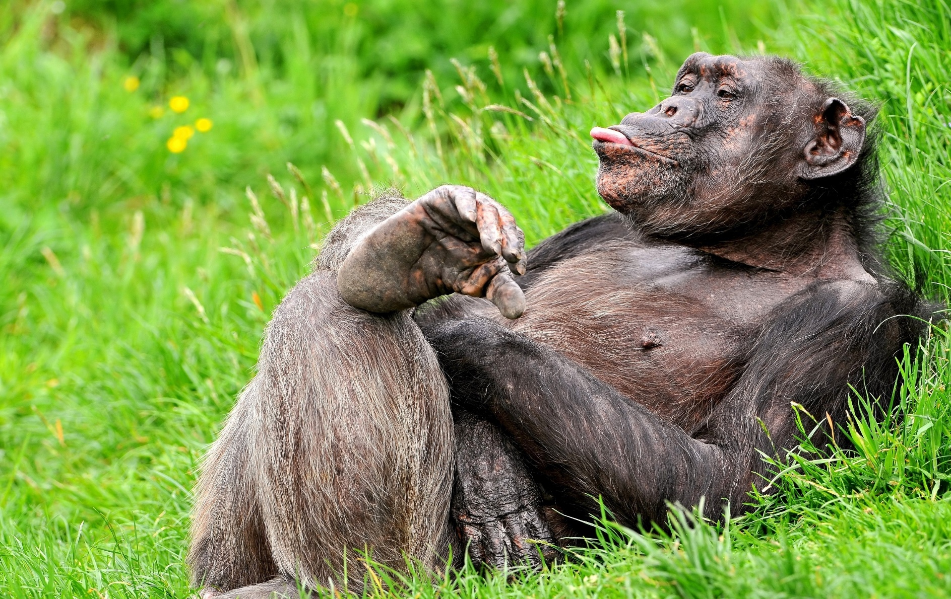
Relaxation
Let's watch an
interesting video about
animals
https://yandex.ru/video/preview/14445457852006707272

Slide 8
Speaking
What pet have you got? I’ve got a …
What is his/her name? His/Her name is ….
How old is ….? He/She is … years old.
What can your…..? He/She can…
Why do you like…? I like my… because he/she is funny/playful/….

Slide 9
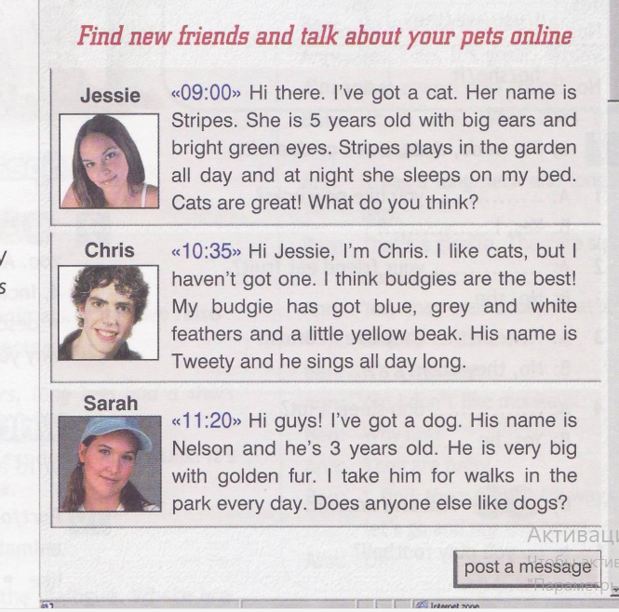
Listening
What do you know about Jessie’s pet?
What can you say about Chris’s pet?
What can you say about Sarah’s pet?

Slide 10
Grammar
Find out all the present simple verb forms from the text and enumerate them.

Slide 11
Summarizing
Let's remember the animals we’ve passed today.
Which groups of animals have we revised today?

Slide 12
Well, it was pleasant to work with you today.
And your home task for the next lesson will be to write a message about your pet.
Thank you!

