Slide 1
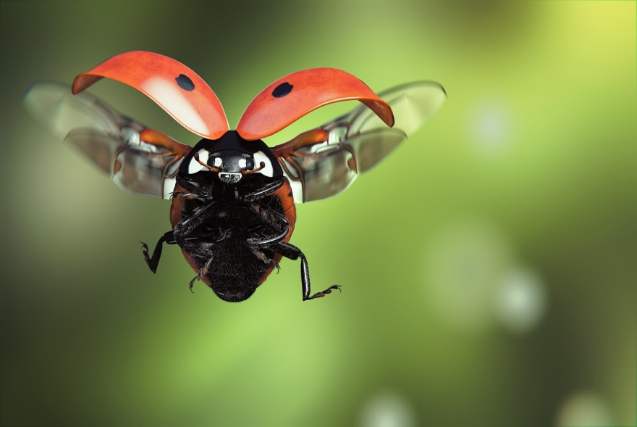
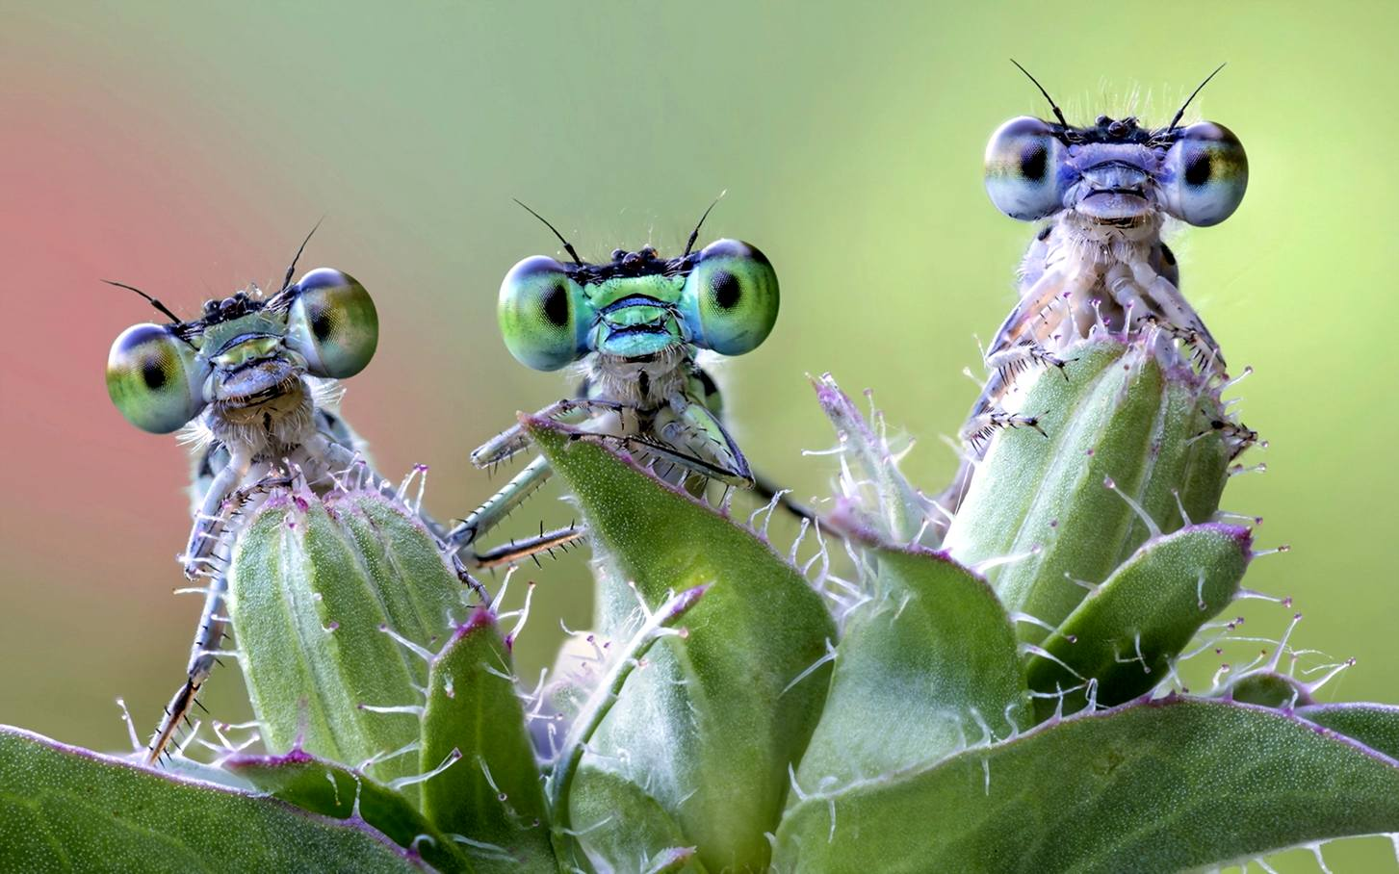
SCIENCE: INSECTS
Выполнила:
Антюшина А.В.

Slide 2
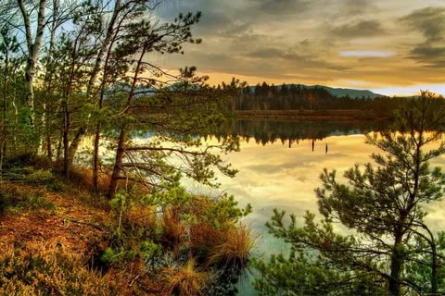
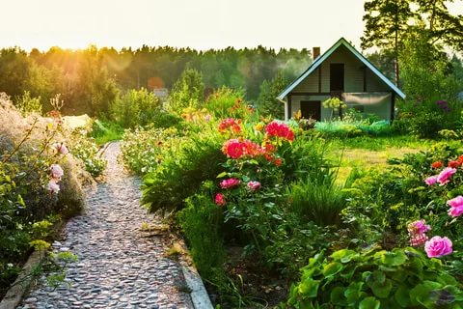
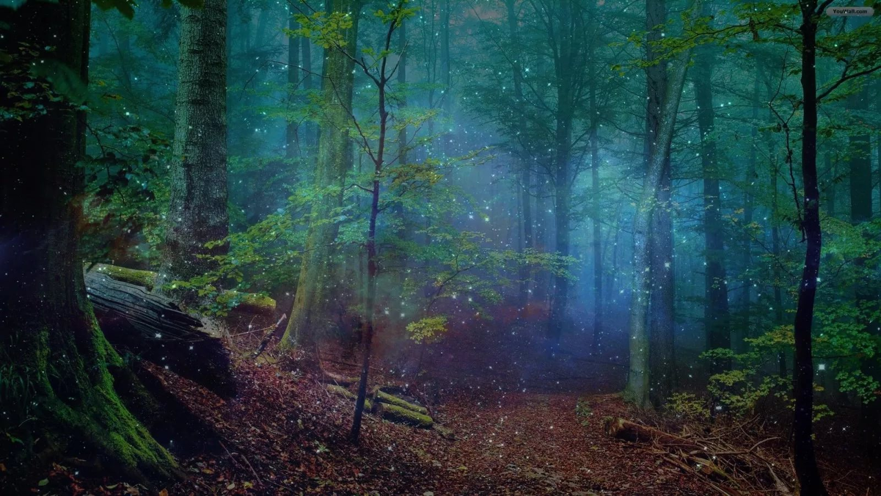

Slide 3
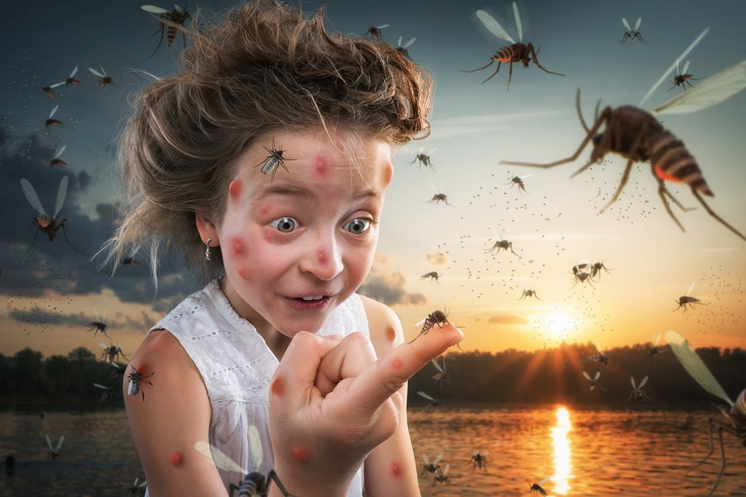
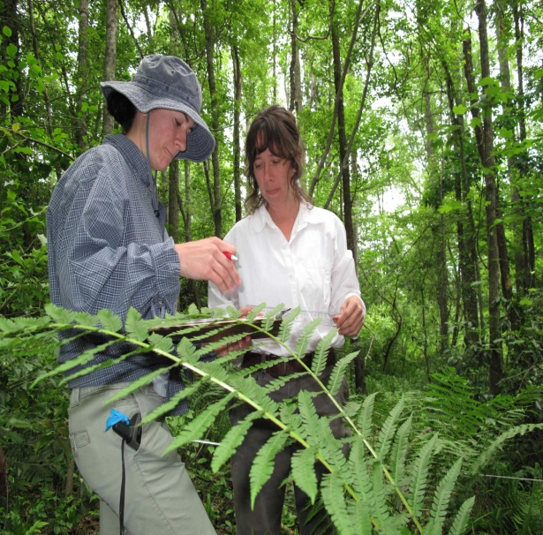
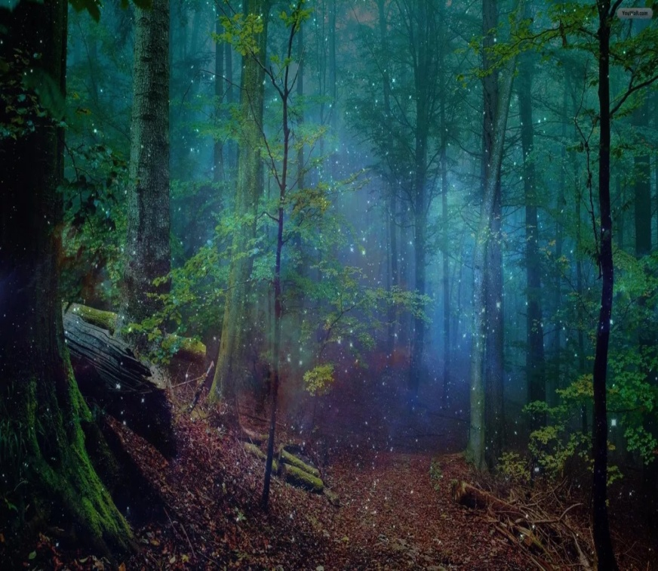
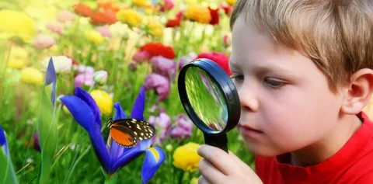

Slide 4
Guess
I am colourful and bright
I can fly but can not climb
I am beautiful and fine..
Who am I ?

Slide 5
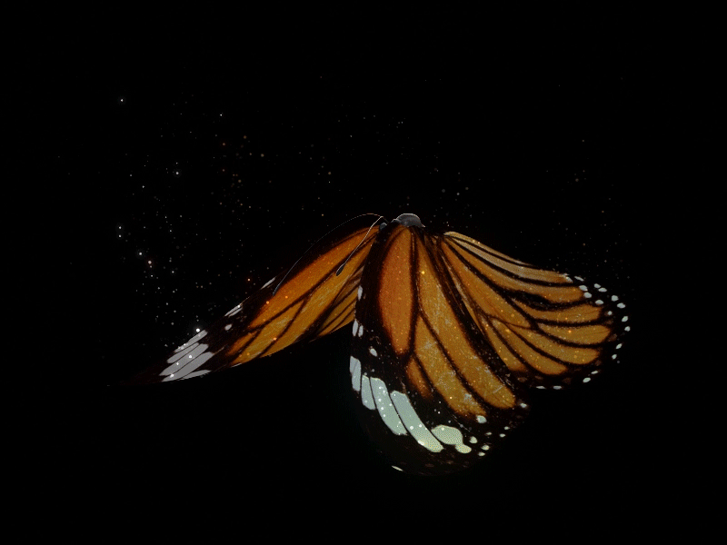

Slide 6

Dragonfly, butterfly
Where do you fly?
Little beetle, ladybirds
Where do you climb?

Slide 7
Listen and repeat
Dragonfly, ……………..
Where do you fly?
Little beetle, ladybirds
Where do you ………..?

Slide 8
Listen and repeat
Dragonfly, ……………..
Where do you ……….?
Little ……………, ladybirds
Where do you ………..?

Slide 9
Listen and repeat
Dragonfly, butterfly
Where do you fly?
So quick and so high
In the fine, blue sky.

Slide 10
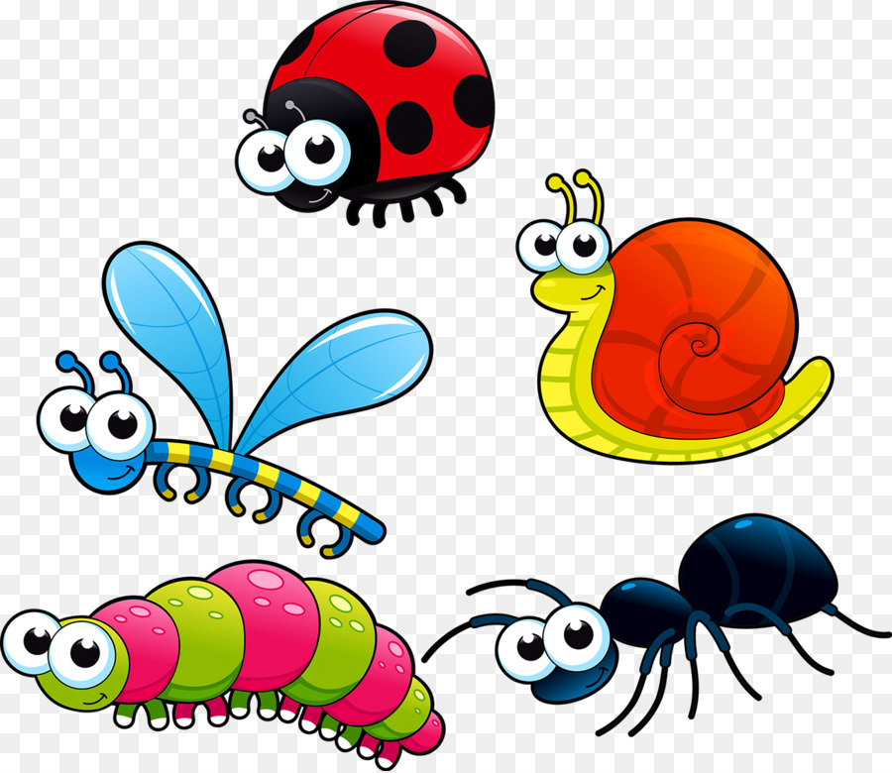
What are we going to speak about?
I think, we are going to speak about…….

Slide 11


Slide 12
Goals of the lesson
Remember and practice the words on theme “Insects”
Revise and practice grammar constructions
Find out more about life of different creatures
Answer three vital questions
What Where Why

Slide 13
mosquito -
wasp -
butterfly -
dragonfly -
grasshopper -
beetle -
məsˈkiːtəʊ
wɒsp
ˈbʌtəflaɪ
ˈdrægənflaɪ
ˈgrɑːsˌhɒpə
ˈbiːtl

Slide 14
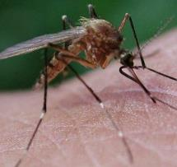
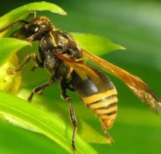
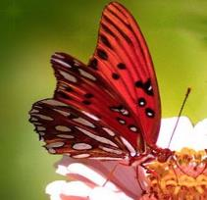
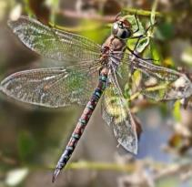
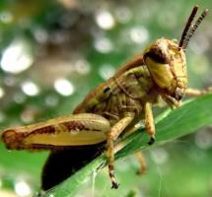
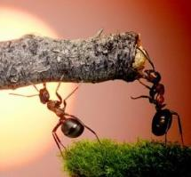
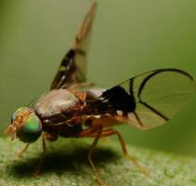
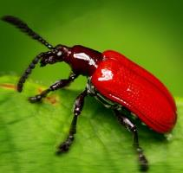
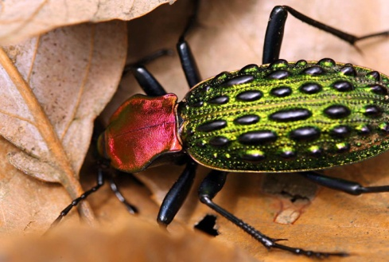
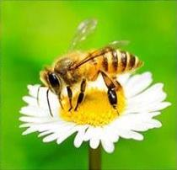
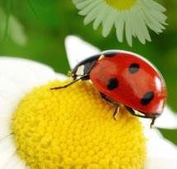
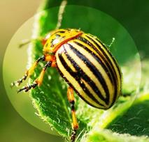
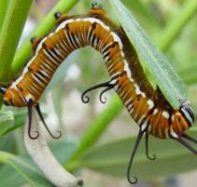
Types of insects
wasp
butterfly
mosquito
dragonfly
grasshopper
ants
fly
beetle
bee
ladybird
bug
caterpillar

Slide 15
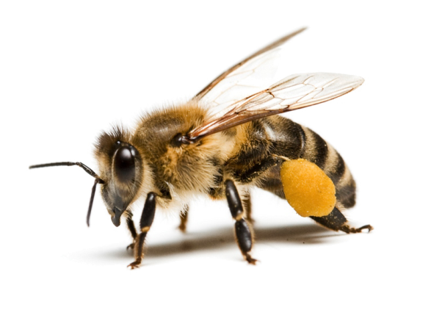
What has the insect got?
head
wings
eyes
body
antennae
legs

Slide 16


Slide 17
1.How many insects are there in the world?
There are……..
2.Where do they live?
They live

Slide 18

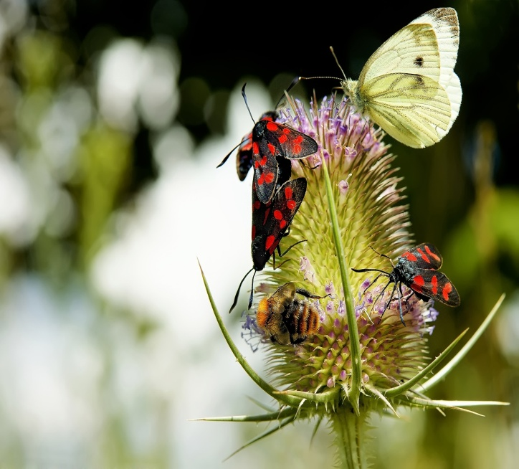
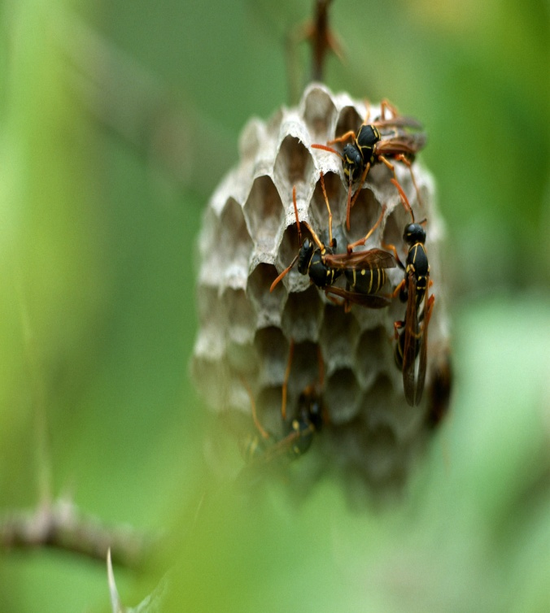
3.Are insects important?
4. What useful things do they do?

Slide 19
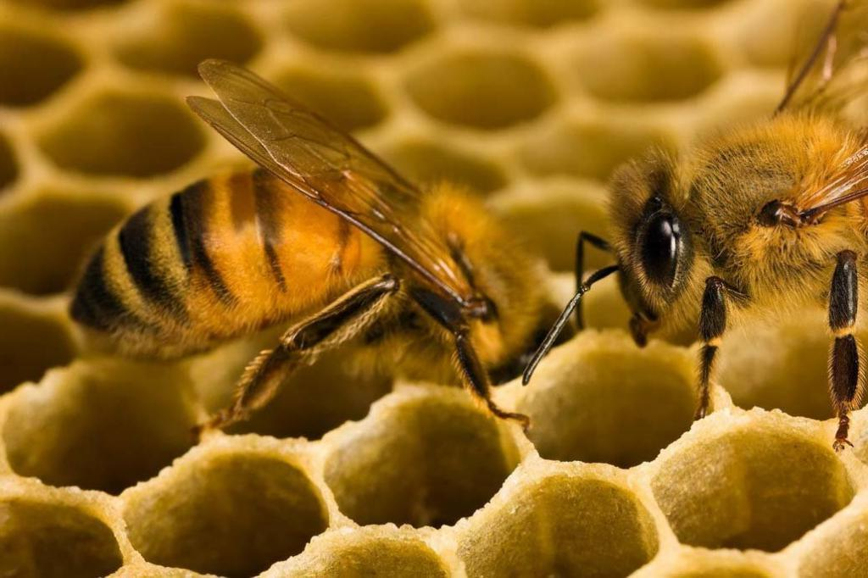
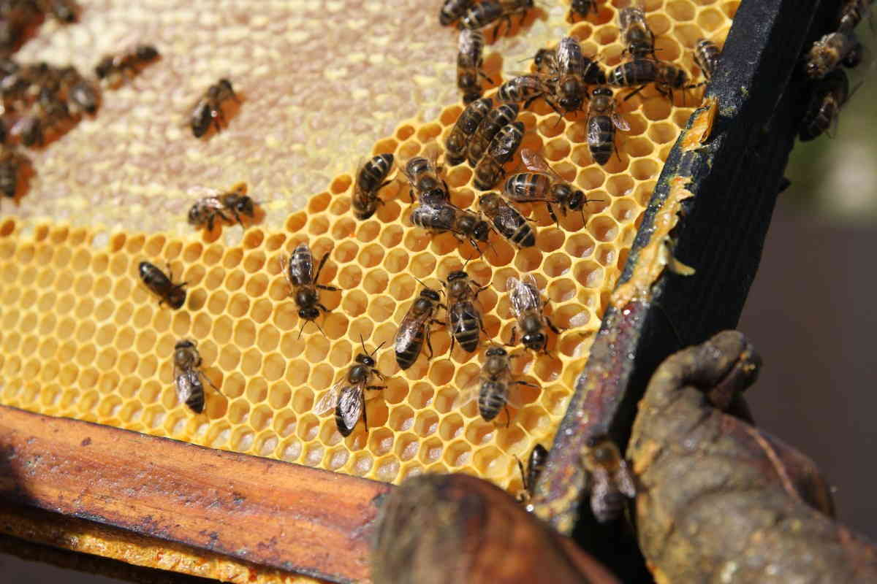
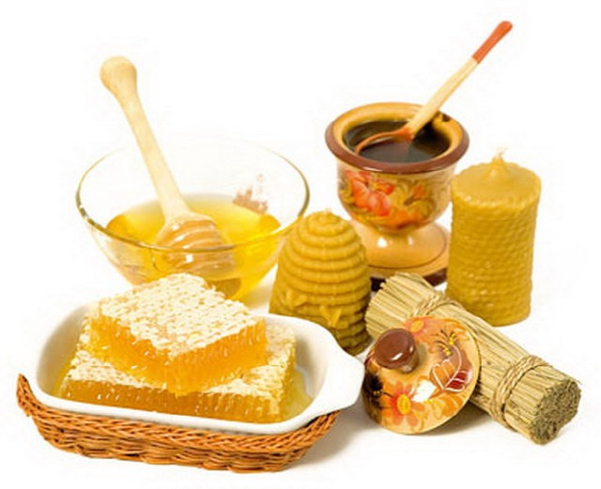
5.What can bees do?

Slide 20
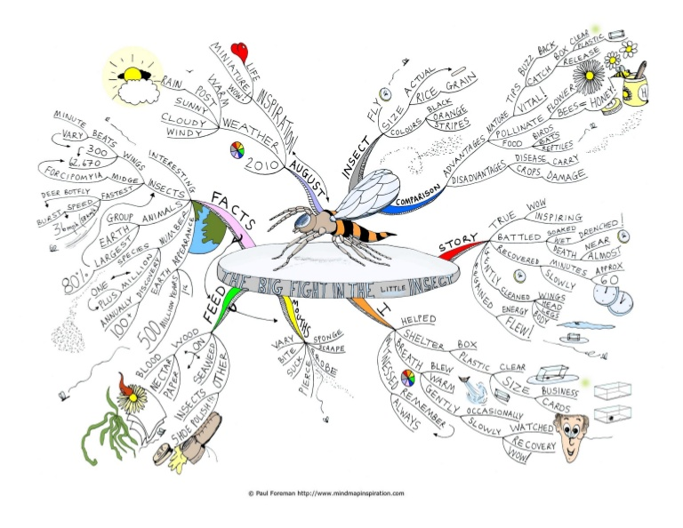
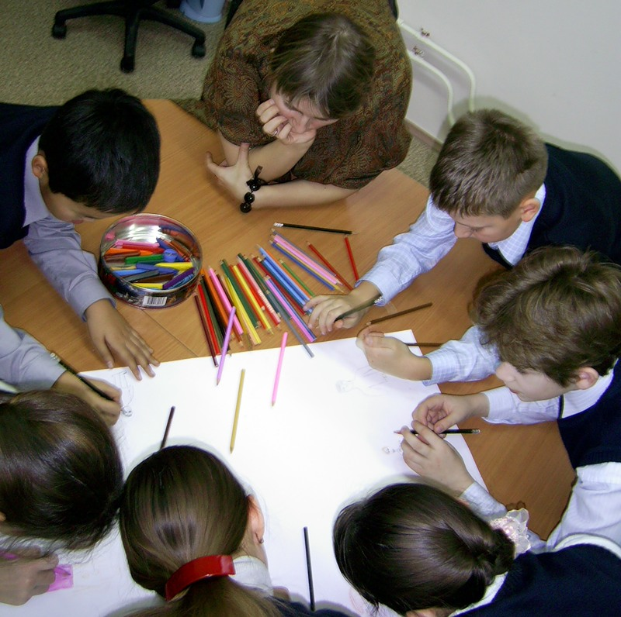
Mind - map

Slide 21
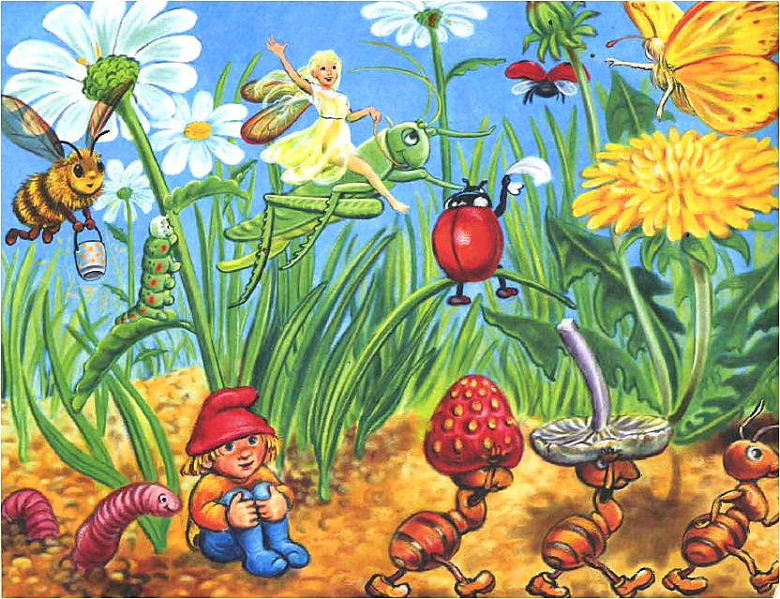
Ladybird
butterfly
bee
grasshopper
beetle
caterpillar
grass
ground
ant

Slide 22
Fill in the gaps:
There are about … million types of insects in the world. These little creatures live in our … and gardens. Some live near water, others live in fields, … and forests. Some … come out during the day while others come out at night.
… are really important. They keep our gardens clean because they … dead leaves and other waste. They are also an important food for … and other animals. Some insects, like bees even make food-….

Slide 23
Let’s play cinquain
1. What are we talking today about?
2. Give 2 adjectives describing insects.
3. Now give 3 verbs characterizing them.
4. Give 4 words or one sentence, describing them.
5.Give a synonym to the word «insect»

Slide 24

SHOW

Slide 25
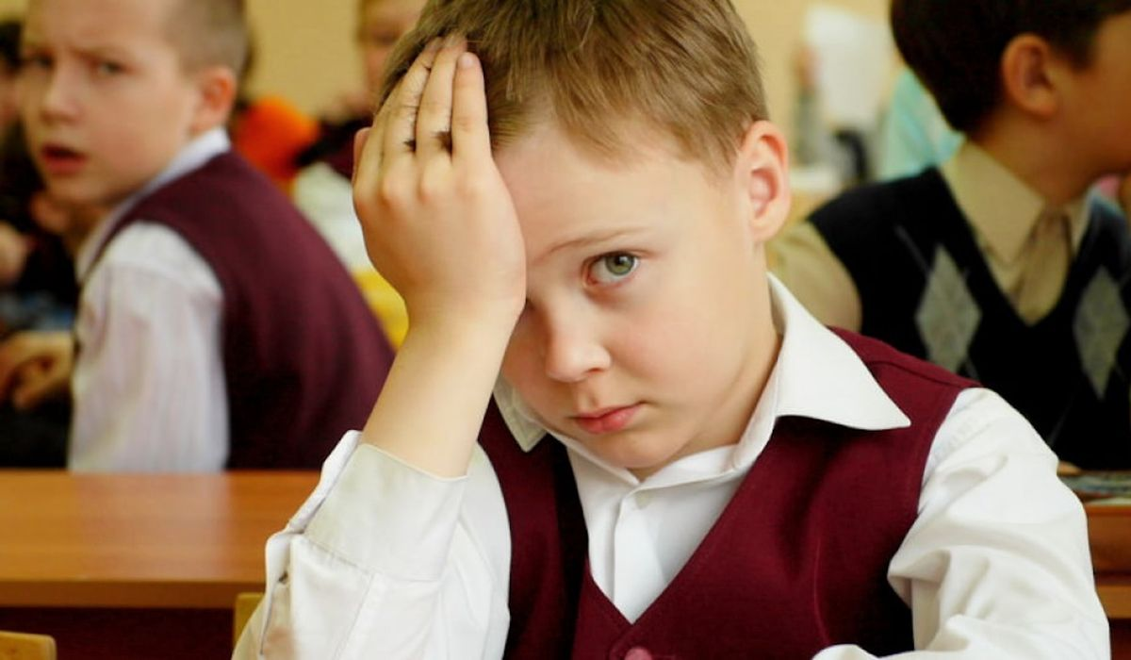
SHOW

Slide 26
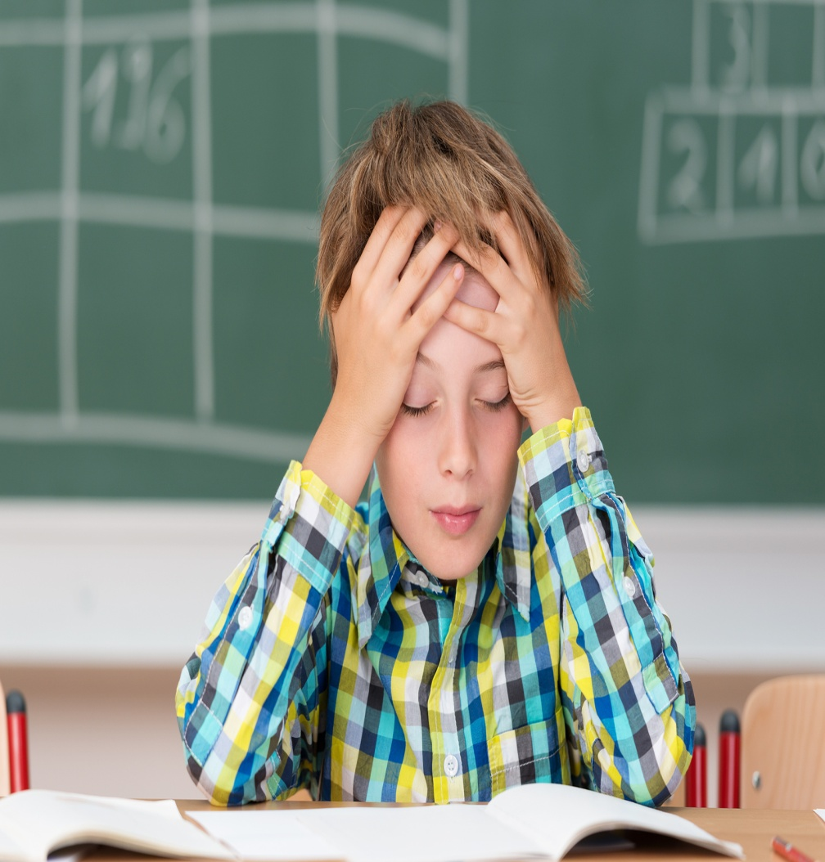
SHOW

Slide 27



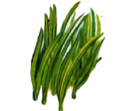
homework
Become a garden detective:
Make up a project about insects
SB.p.73 ex.4

Slide 28
Thank you for your work!

